Slide 1
Share Your Story

Slide 2
Colorado Local
Section of the ACS – 2018
ChemLuminary Awardee Fall 2017:
Young Chemists Committee ChemLuminary Award & Local Section Career ChemLuminary Award
Event Objective: To provide young members a platform and share their accomplishments
Presenter Debbie Cans (Chair COACS 2016 and 2017) Jan 2018
Notes:
8

Slide 3
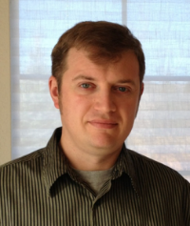
Organizers, Collaborators and Event Components
Organizers & Collaborators
Blakemore Hassell Olivo-Delgado Crans Rakowsky Shores Neilson
Concept – Chemistry is Fun: Let’s talk about it
“Let us help young members shine”
1) Oral presentations – Scientific Opportunities for Assistant Professors and Students
2) Poster Presentations – Younger members and REU Students; Poster Awards are given
3) Celebration of Senior Members

Slide 4
Overview: “Young Talent in Colorado and Beyond” Symposium
What was Event? One and a half day Symposium — four sessions Oral and Poster presentations (August 4 and 5th, Summer 2016)
What was the Purpose: Support Career Development of Younger Members including Assistant Professors, Postdoctoral fellows, Graduate and Undergraduate Students
Other Supportive Activities
  Celebrate COACS Senior Members – 50-year anniversary
  REU Poster Section
Networking Locally, Inter-generational Event, Awards
Link to Local Organizations at Colorado State University and in the Region
Follow-up event – One Day Symposium at Rocky Mountain Regional Meeting Oct. 25-28, 2017

Slide 6
“Young Talent in Colorado and Beyond” Symposium: Getting Participants there
Advertisement is Key to Broad Representation in State
  Plan and Vision of Program
  Flyers on Website
  Local and Personal Invitations
  Emailed to to Universities and Governmental Agencies
  Abstract book
Local Participation and Inclusion of Other Groups
  Senior Chemists in COACS (participants)
  REU student Summer Program (participants)
  The Department of Chemistry, Colorado State University (funding)
  The College of Natural Science at Colorado State University (funding)
Attendees – about 100-120 people
SYMPOSIUM
Young Talent in Colorado & Beyond 2016
August 4 and 5, 2016
Organizers/Contact:
Debbie C. Crans (debbie.crans@colostate.edu)
James Blakemore (Blakemore@ku.edu)
Senior ACS Member Luncheon
August 4, 2016
Organizer/Contact:
Margaret Rakowsky (margerakowsky@gmail.com)
Yates 406
Department of Chemistry, Colorado State University

Slide 7
Organization: How do we make it memorable for participants?
Needed: Components for Successful Event (Before, During, After)
  Excellent program to bring participants there
  Food to keep participants at event
  Effective networking (bring other people to event)
  Public relations to get participants and to keep memory of event
Accomplished: Before, During or After Event
  Advertisement: Program and Abstract booklet
  Location appropriate (Lecture room and Main Lobby for posters)
  Excellent Oral and Poster Presentations
  Other social activities at event: Senior Chemist and REU Program
  Participants are kept at event because food and drinks are provided
  Follow-up completed Abstract Book, recognition and Award continuation

Slide 8
Impact and Lessons for Future
What we did well
  Excellent Program brought busy people together
  Flyers and Abstract Booklet excellent
  Involvement of other groups enhanced program
  Food in session kept people at event
  Information on Website and Reminders of Program after the Event
  Continuation of program in 2017
  CSU’s Dean – “If I had know what it was I would have supported it more”
Desirable Improvements and Lessons Learned
  When students are involved in program double # of RSVPs - because food planning will be too little
  Advertisements - More reminders and earlier Reminders
  Involvement of other groups – difficult to coordinate
  Continuation is difficult at sites other CSU (no volunteers to host event)

Slide 9
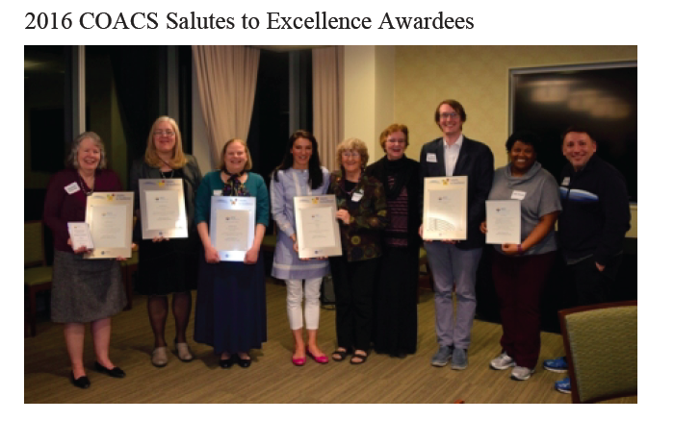
Public relations

Slide 10
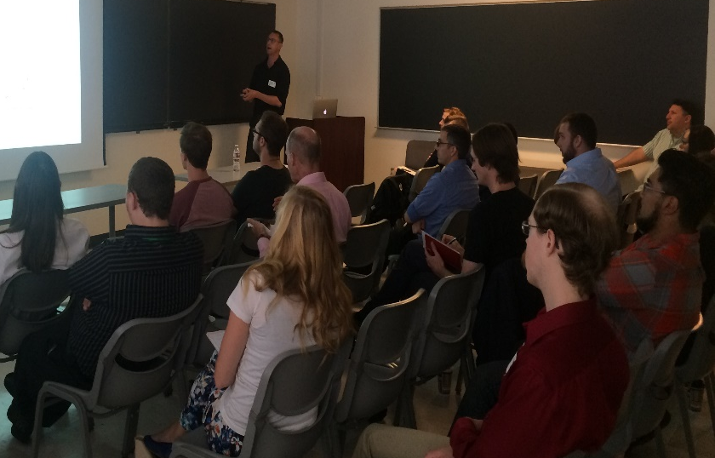
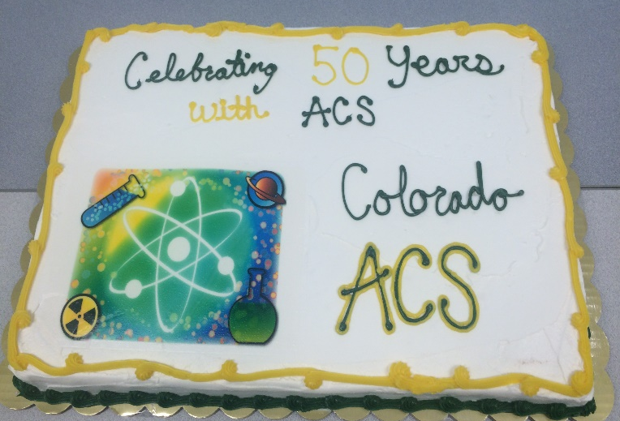
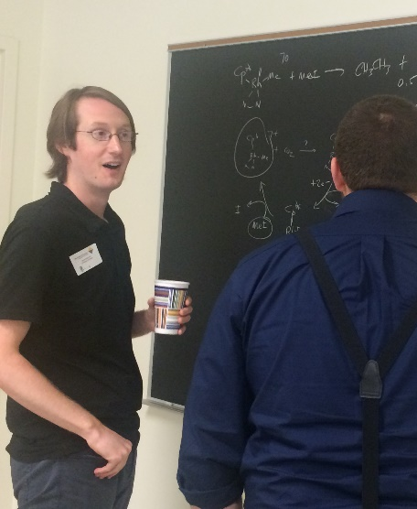
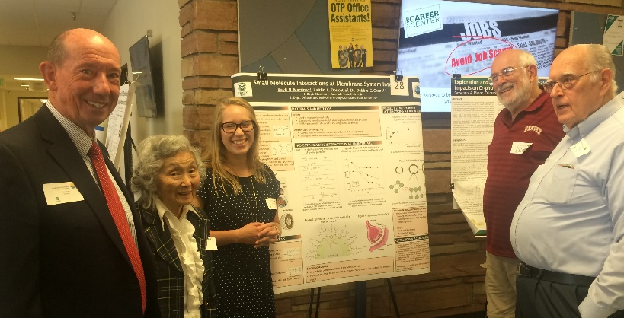
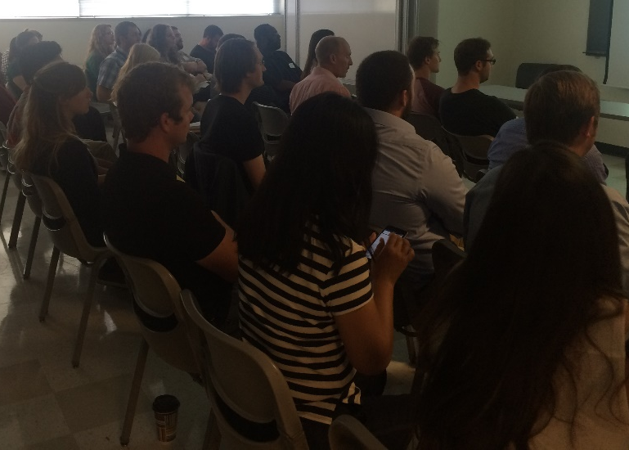
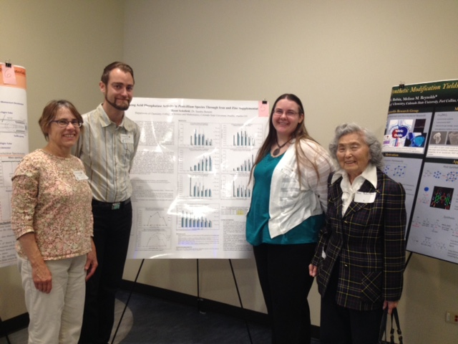
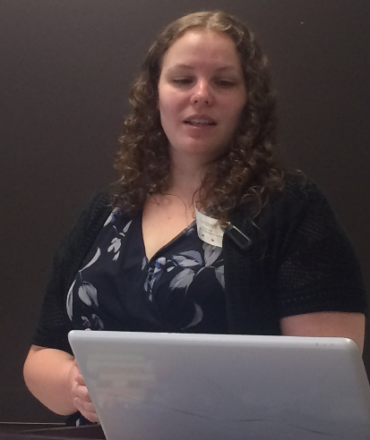
Better Life Through Chemistry

Slide 11
Comet Chemistry Camp
Stephanie Taylor
Dallas Ft. Worth Local Section

Slide 12
Comet Chemistry Camp Overview
24 girls ages 11-14
Entering grades 7-9
8 school districts
5 days, from 9AM to 3PM
Daily theme:
  All about atoms
  Molecule Day
  Reactions
  Food Chemistry
  Art/Fun Friday
~20 volunteers throughout the week
3 guest speakers
4 rooms on campus in 3 buildings
LOTS of paperwork and training to work with minors

Slide 13
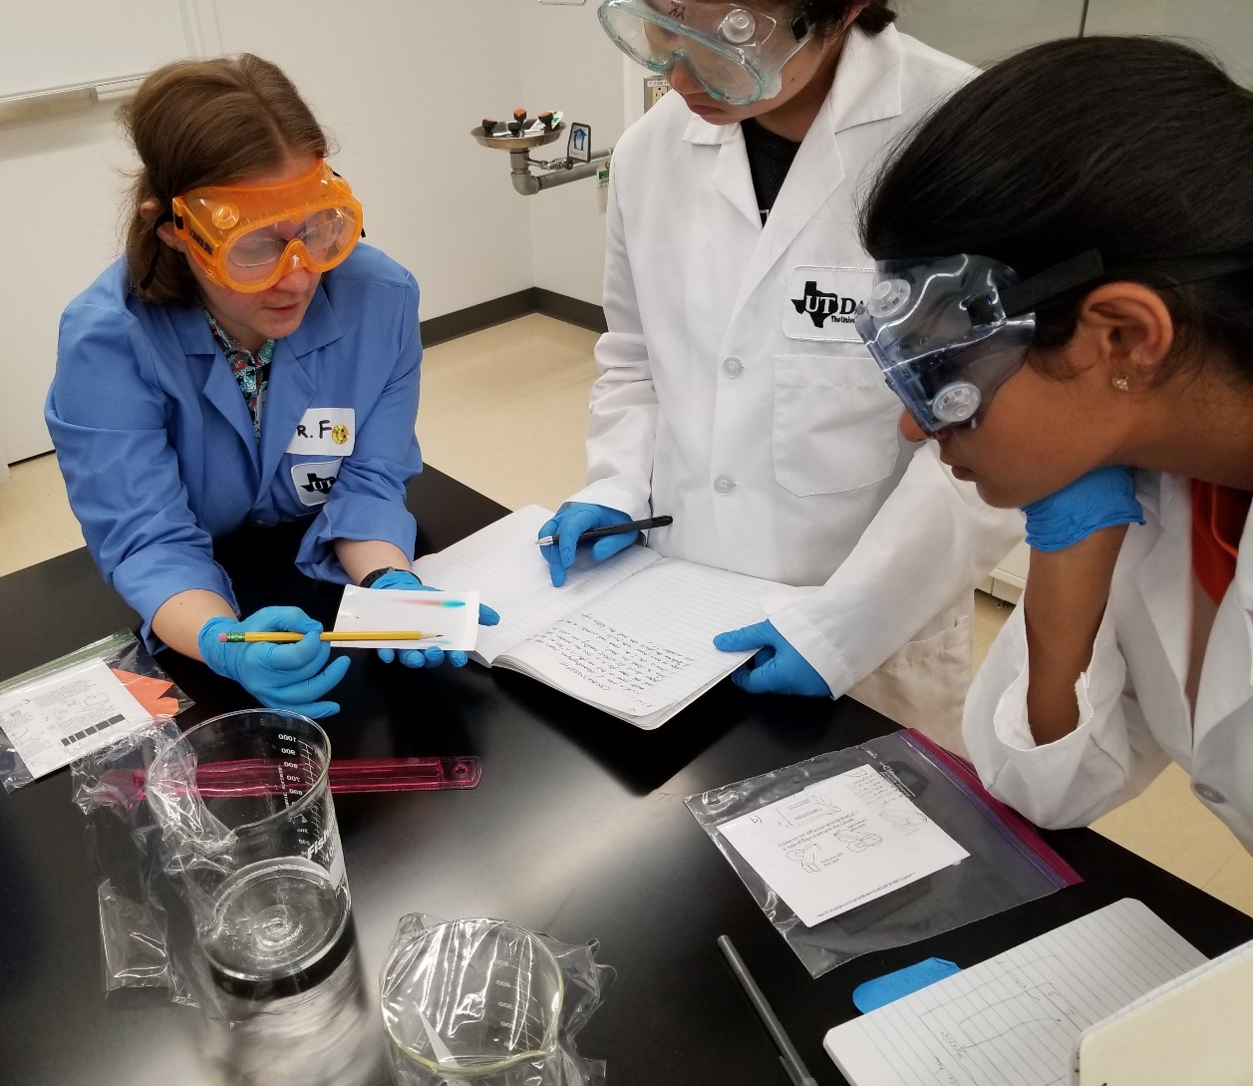
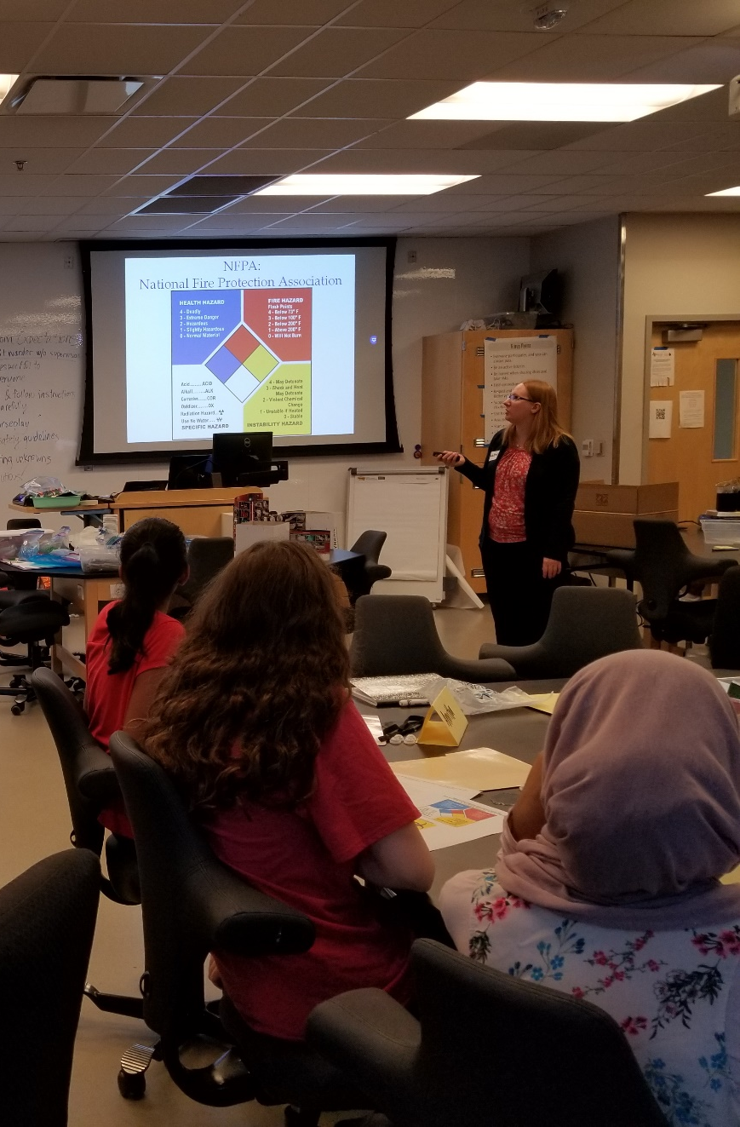

Slide 14
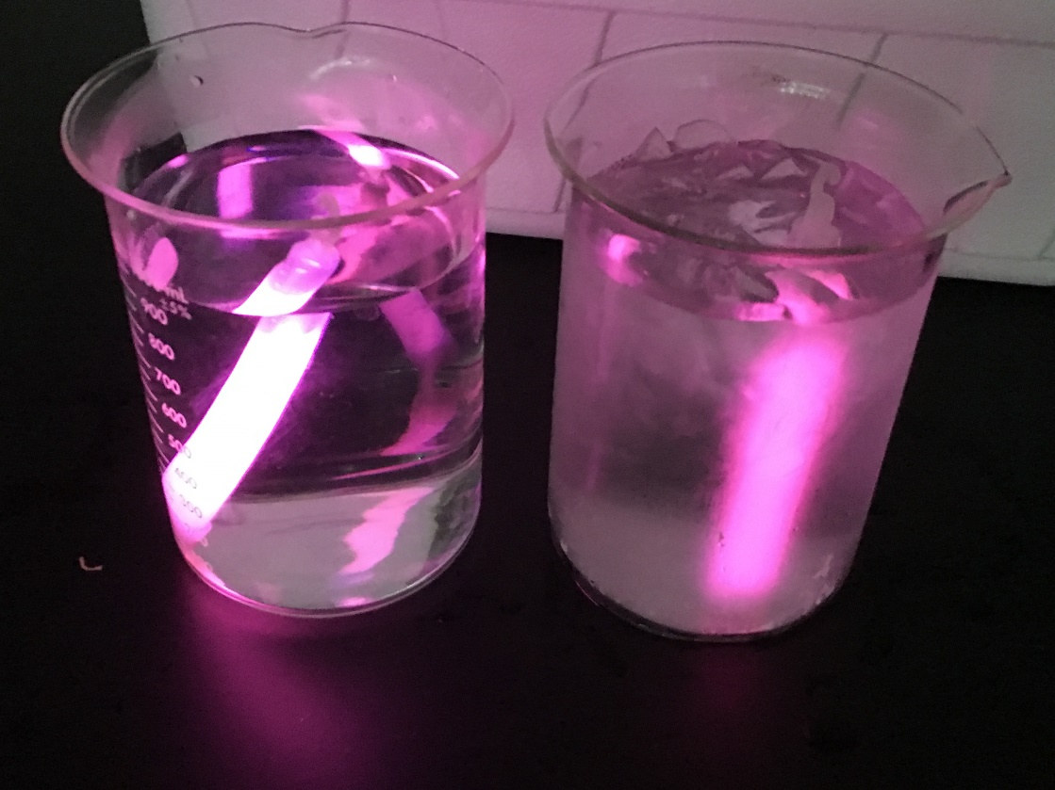

Slide 16
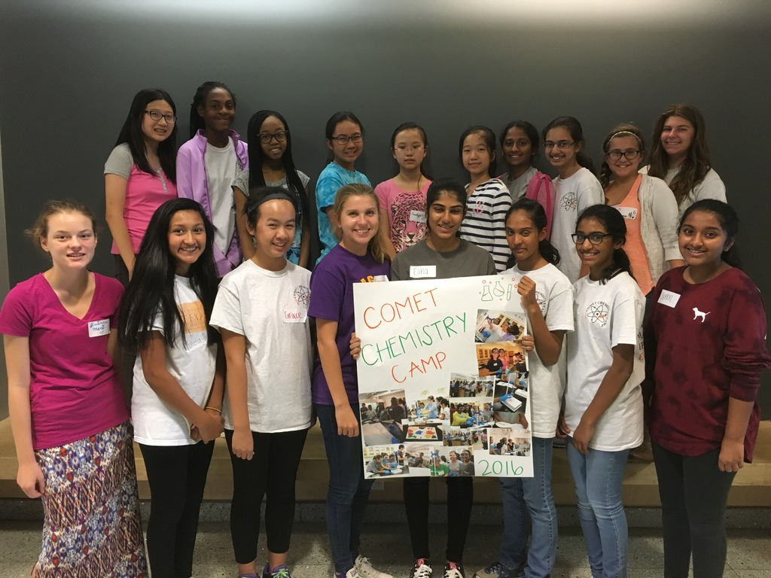
Find the curriculum at: http://tinyurl.com/ChemCampDFW

Slide 17
Science Rocks! In the Illinois Heartland Local Section
Michael Appell &
Manori Perera
Illinois Heartland Local Section

Slide 18

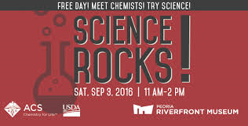
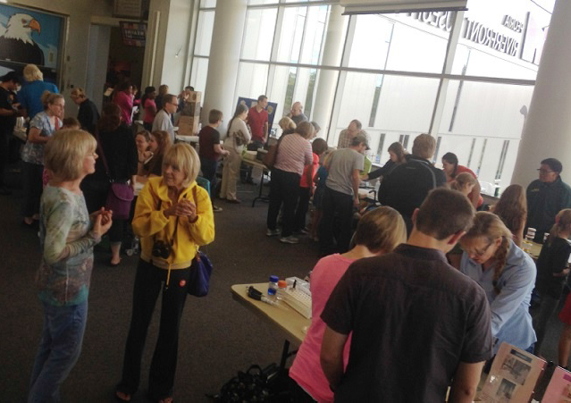
Local Section Partnership Award
Supported by LSAC IPG

Slide 19
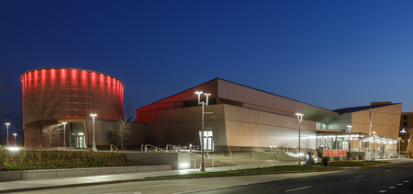
Science Rocks in the Illinois Heartland!
The Peoria Riverfront Museum held a Science Rocks! event on September 3rd, 2016 and invited the ACS Illinois Heartland Local Section to conduct all the science demonstrations for the event
1500 attendees were exposed to demos that highlighted ACS, Chemistry, and AACT to increase awareness of these organizations
The American Association of Chemistry Teachers (AACT) is a professional community by and for K–12 teachers of chemistry

Slide 20
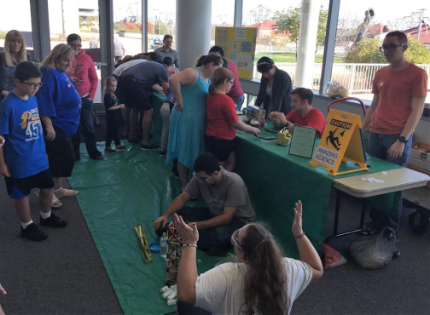
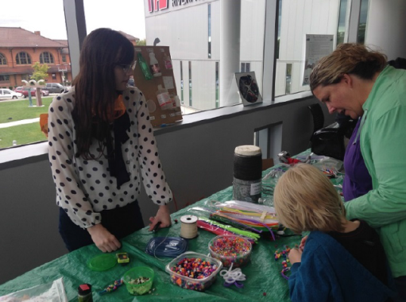
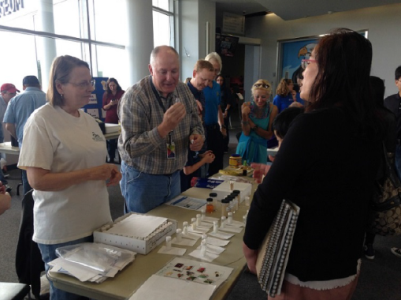
Science Rocks in the Illinois Heartland!
Developed in a few months
Major features included:
  3D Printing Station
  Personal Protection Equipment (Pictures!)
  Climate Science
  Rock Chemistry
  Demo Crew (Chem Club Demos)
  Supported by a LSAC Innovative Project Grant
  The 3D printing and PPE demos were huge hits, and highlighted ACS, AACT, and chemistry

Slide 21
Passport to Nashville
Amanda Carroll
Nashville Local Section

Slide 22

“Your Passport to Nashville”
Nashville
Local Section of the American Chemical Society
Presenter: Dr. Amanda J. Carroll
Author: Dr. Susan Sutton

Slide 23
Programming Design
Many small events targeted at different groups to:
Stimulate involvement of current members
Increase number of undergraduate members
Serve the public through outreach
We used the ‘Passport’ model shared at
2016 Leadership Conference from other
Local Sections
After polling our LS, our focus was on:
Professional Development (career panels)
Social Events
Volunteerism
14 ‘attendance’ points: chem club meetings, chemistry seminars, presentations, attending ACS conferences, etc.
4 ‘volunteer’ points: organizing/participating in ACS event, volunteering through chem club, etc.
End-of-year trip for student members with completed passport! (ORNL)

Slide 24
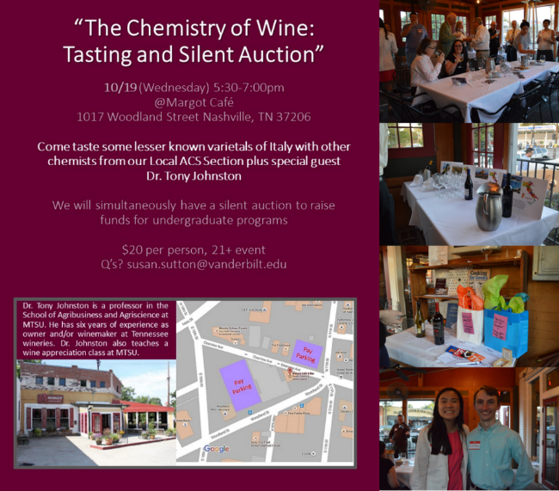
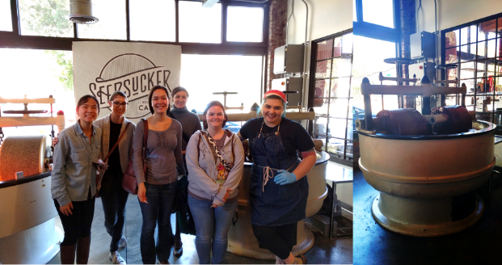
Stimulating Involvement of Current Members
There are few events designed strictly for social gatherings in a non-formal environment
University faculty, students & industry professionals mingled (and had a good time!)
Undergraduates volunteered to host the silent auction—used to raise funds for student travel to ACS conferences
Chemistry of Chocolate

Slide 25
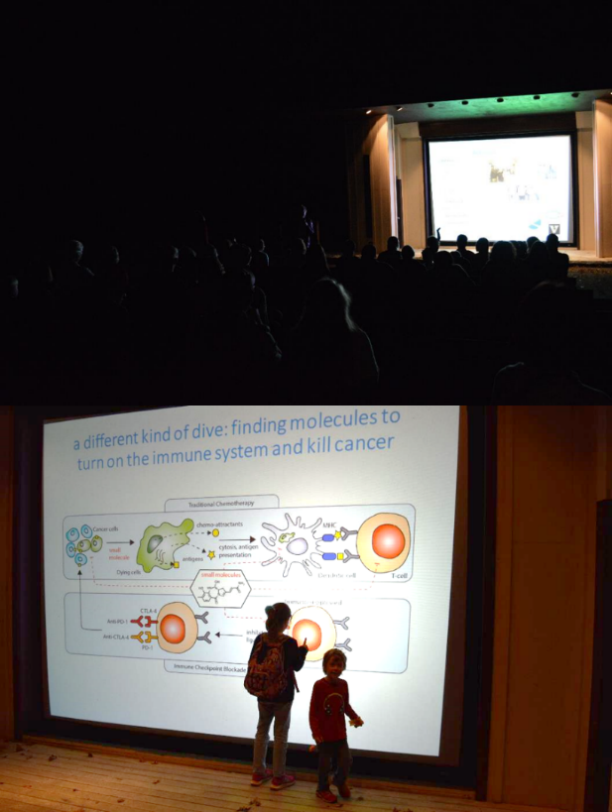
Public Outreach
This event was the recipient of ACS ChemLuminary Award for “Best New Public Relations Program for a Local Section”
‘Bacterial Fight Club’ with
Dr. Brian Bachmann at
Mammoth Cave National Park
The event energized the public who attended the presentation. Small children (~5 y.o.) up to senior citizens were engaged and asked 20+ min of questions after the 40 min presentation was complete. Dr. Bachmann did a great job engaging the audience; this was a good fit for Mammoth Cave since his research centers around bacteria found in caves.

Slide 26
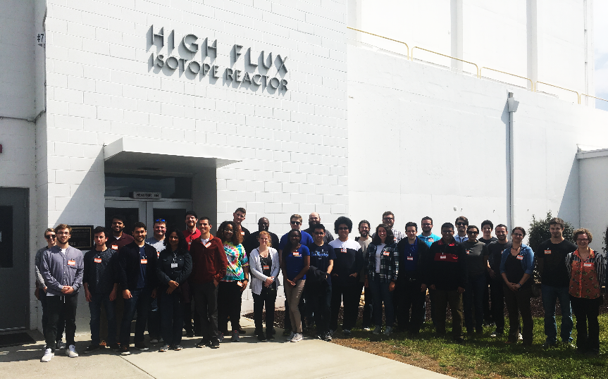
Encouraging New Undergraduate Members
Trip to Oak Ridge National Laboratory: Completed Passports!
2016: 115 student members
2017: 130 student members
13% increase!

