Slide 1
Welcome to the Local Section Leaders Track
Please sit at the table number that matches the table assignment on the rear of your badge.

Slide 2
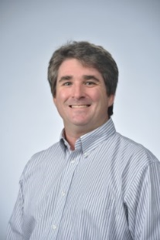
American Chemical Society
Welcome and Introduction
2018 ACS
Leadership Institute:
Local Section Track
Jason Ritchie,
2017 Chair,
Committee on
Local Section Activities (LSAC)
January 19-21, 2018
Notes:
2
Good afternoon: on behalf of the Leadership Institute, the Local Section Activities Committee,, I would like to welcome you to the 2018 ACS Leadership Institute. Before we get started, I encourage you to use the post-it notes on the table to jot down questions that you may have that you’d like us to answer during the Town Hall meeting on Sunday. We will cover a wealth of information today and you may think of questions along the way or even overnight. You should post the questions to one of the poster boards and we’ll answer them Sunday morning.
A lot of work goes into the Leadership Institute and in supporting local sections so I thought it would be useful to show you the LSAC team for this weekend and some of the national ACS staff you may encounter over your term in office. This will allow you to put names and faces together.
Next Slide

Slide 3
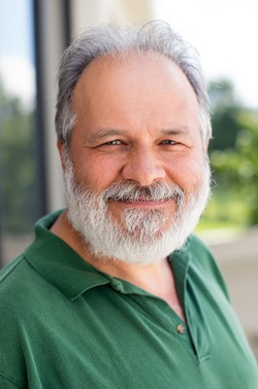
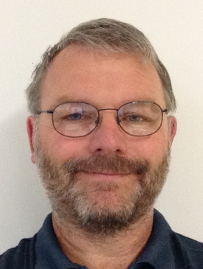
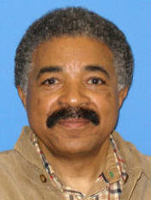
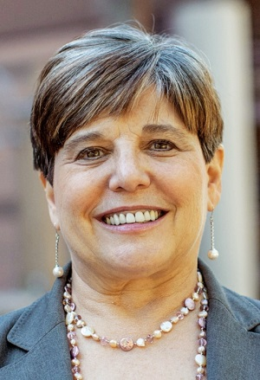
Support for Local Sections
Committee on Local Section Activities—Executive Committee
Jason Ritchie, LSAC Chair, jritchie@olemiss.edu
Greg Milligan, Subcommittee Chair, Grants & Awards, gmilligan@stmartin.edu
Tracy Hamilton, Subcommittee Chair, Operations & Support, hamilton@uab.edu
Charles Cannon, Subcommittee Chair, Communications, ccannon@colum.edu
Ellen Stechel, Subcommittee Chair, Technology & Tools, ellen.stechel@asu.edu
Notes:
Here is the 2018 executive committee of LSAC. Jason Ritchie is chair this year.
Greg Milligan is the chair of the Grants and Awards subcommittee of LSAC
Ellen Stechel is chair of the Technology and Tools subcommittee,
Charles Cannon is the chair of the Communications Subcommittee,
And Tracy Hamilton is the Chair of the Operations and Support Subcommittee,
All of the LSAC Executive Committee are here to assist you.

Slide 4
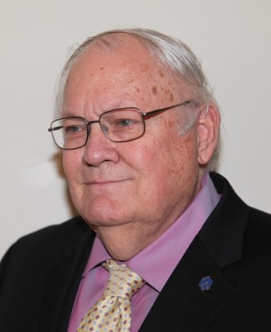
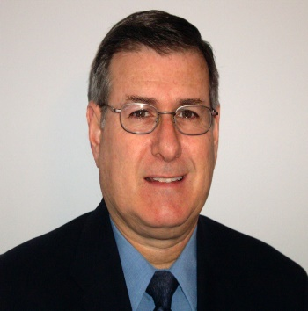
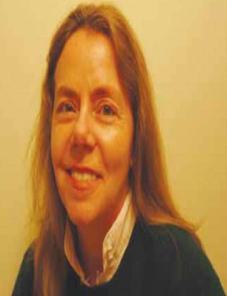
Support for Local Sections
Committee on Local Section Activities
Gary Anderson Grants and Awards Subcommittee
Alan Cooper Committee on Committee Liaison
Barbara Hillery, Operations and Support Subcommittee
Notes:
In addition, we have others in support from LSAC,; Gary Anderson, Vice Chair of the Grants and Awards Subcommittee from the Central Ohio Valley local Section; Louise Lawter, Vice Chair of the Operations and Support subcommittee and a member of the Princeton Local Section, Lorena Tribe, Vice Chair of the Communications subcommittee and from the Lehigh Valley local section; and Barbara Hillery, also on Operations and Support subcommittee and from the New York local section.
If other members of LSAC are present, would you please stand so that I may introduce you?
You will have an opportunity to interact with many listed here in the workshops this afternoon which will begin at 2:45 PM today.
There are also many ACS Staff Members whom you’ll get the opportunity to meet during the weekend as well as interact with on a regular basis as you carry out your Local Section duties. Will the staff in the room please stand so that we can see who is here with us in Dallas this weekend? We have Debbie Fillinich, Chris McCarthy, Angela Morris, Lily Raines, John Goodloe, and Aviva Westheim (up to you if you want to call names or not).

Slide 5
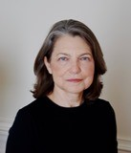
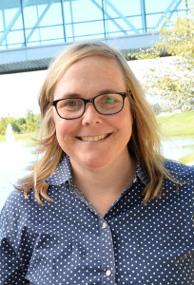
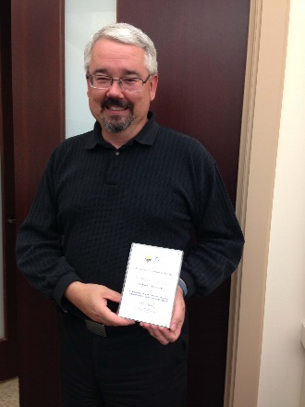
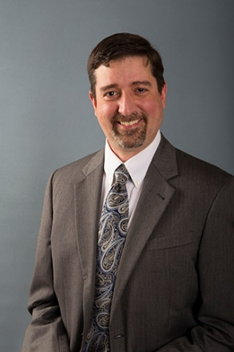
Support for Local Sections
Louise Lawter, Operations and Support Subcommittee
Beth Lorsbach, Grants and Awards Aubcommittee
Michael Mautino, Technology and Tools Subcommittee
Matt Reichert Technology and Tools Subcommittee

Slide 6
Get Acquainted/Network with Sections in Your Region
Jason Ritchie, 2018 LSAC Chair

Slide 7
Instructions
Introduce Yourself to Everyone at the Table and answer one of the questions on the Rules of Engagement Sheet. This should take no more than 15 minutes.
For the remaining 30 minutes and throughout the weekend:
Share how your section has worked with its neighboring sections
Brainstorm about possible joint activities for 2018 and beyond.
Work together to develop a project concept throughout the weekend and before March 1st.
Submit a proposal for a joint activity/event to LSAC lsac@acs.org by March 1st for an opportunity to receive seed funds to assist you with carrying out the project.
REVIEW THE INSTRUCTIONS ON YOUR TABLE
Notes:
Review the handout

Slide 8
2018 Leadership Institute Goals
The goal of the 2018 Leadership Institute is to support and enhance the development of ACS leaders. Attendees will have the opportunity to:
Learn the responsibilities of a new volunteer role
Share best practices
Develop leadership and management skills
Engage with other attendees to foster new peer-to-peer networks
Notes:
Now I would like to say a few words about goals for the LI and our local section track
The ACS Leadership Institute was created to support and enhance the professional development of ACS leaders. It is designed to afford you the opportunity to:
READ LIST
Learn the responsibilities of a new volunteer role
Share best practices
Develop leadership and management skills
Engage with other attendees to foster new peer-to-peer networks NEXT SLIDE

Slide 9
2018 Local Section Track Goals
Provide local section chair-elects and leaders with
tools and resources to be successful
examples of successful activities
an opportunity to generate ideas about an activity and develop it
instruction on using social networking in your local section
guidance to obtain help and what grants are available
a forum to connect with other local section leaders
a venue to discuss common concerns and how to measure your successes
networking opportunities to identify and evaluate best practices from other section leaders and ACS staff
Notes:
The local section track is designed around supporting the LI goals.
Specifically, we have designed the local section track to provide. Talk about list.

Slide 10
Things You Need to Know
Notes:
Let’s start your learning now –

Slide 11
What local section office have you held?
Chair
Treasurer or Secretary
Committee Chair
Councilor
None of the Above
American Chemical Society
Notes:
By a show of hands, let’s see how many of you have served as [READ SLIDE AND GIVE FOLKS A CHANCE TO REPLY FOR EACH POSITION],
From the show of hands, we have a wealth of knowledge in the room that can be shared with each other and, we all are in a position where we can learn more. What I would like to express is that we will not be able to provide the answers to all of your questions because obviously some of the questions have not come to you yet. However, it is important that when you leave here this weekend, you will have the contact information for LSAC members, staff as well as some of your colleagues attending this conference so that we can continue to learn from one another as well as to share resources.

Slide 12
Local Sections
Currently there are 185 local sections located across the United States and 19 International Chapters
145 Delegates Representing 117 Local Sections registered for this weekend’s Leadership Institute
Smallest (@ Leadership Institute): Panhandle Plains
Largest (@ Leadership Institute: Northeastern
Notes:
To provide you with some insight of who is in the room, {READ SLIDE}
Dec 31, 2017
Panhandle Plains 87 members
NE: 5,875 Members

Slide 13
My Local Section size is:
Small (50-199)
Medium Small (200-399)
Medium (400-799)
Medium Large (800-1599)
Large (1600-3199)
Very Large (3200+)
Notes:
Local sections range in size from 50—over 6000 members. Let’s do a check on the variety of local section sizes here at the Institute. By the sounds/cheers of your voices and applauses, let’s do a roll call. When the size of your local section appears on the screen, let’s hear a shout out for your section size……
If you don’t know the answer, we will be sharing resources this weekend on that and much more.

Slide 14
Local Section Tidbits
Some sections are: Single County, Whole State, Multi-States
First local section: Rhode Island (1891)
Youngest local section: Snake River (2007)
Sections celebrating milestone anniversaries in 2018:
125 years: Chemical Society of Washington, Lehigh Valley
100 years: None
75 years: Carolina-Piedmont, Lake Superior, Sabine-Neches
50 years: Heart o’Texas, LaCrosse Winona, Northeast Georgia
Notes:
A few other local section facts……
Minimum Membership to start a local section is 50. A local section must maintain a minimum for 50 members to be considered active. LSAC monitors the increase and decrease in section membership on a regular basis.
Please join me in celebrating the following sections that are celebrating anniversaries in 2017. If representatives from these sections are present, please stand so that we can applaud your success.

Slide 15
Where to find information for Local Sections and Local Section Resources
Volunteer Support and Engagement Group within the ACS Network Group
An open group for local section and division resources
Volunteers are encouraged to share ideas and exchange best practices
Timely and relevant news for local sections and divisions are also included
Notes:
READ SLIDE
If you attend the Communicating with Your Local Section workshop you’ll hear more about the ACS Network and how it can be used to assist with communicating with your members.

Slide 16
eRosters
Three Files
Local Section Roster
(Name, Addresses, Email, Demographic Data)
Activity Report
(Address Changes, New/Deceased Members, etc.)
Demographic Report
(Age, Years of Service, Education, Gender…)
NCOA (National Change of Address) Compliant
Updated Monthly/Email Notification
Sign-up for Access by emailing olsa@acs.org
Demo during ACS Resource Fair Saturday, 5:30 - 7:30pm
Notes:
One of the most important files that you and other members of your Executive Committee will work with are the eRosters. The screen provides you with some important items to note about the eRosters. There will be a booth at the Resource Fair tomorrow night for you to learn more about the eRosters.

Slide 17
Our Local Section conducted its election for 2018 Officers electronically.
Yes
No
Did we have an election?
Notes:
By a show of hands, how many sections conducted their elections electronically?
How many of you did not conduct an election?
How many of you do not know if an election was held?

Slide 18
Local Section Elections
All local sections must conduct officer elections
All candidates must be ACS members
Local section bylaws outline procedures for valid elections
Electronic elections require bylaw amendment
More information on electronic election procedures www.acs.org/getinvolved
Election Only List Requests
Guidelines, Procedures, Best Practices Teleconference
Bylaw Amendment Process
You CANNOT use the eRoster for Elections.
Request special Election Only List at least two weeks in advance.

Slide 19
Local Section Bylaws
Name, Territory
Manner of Election, Terms of Office
Awards
Duties of Officers
Committees
Meetings
Links to certified copies of all local section bylaws, as well as guidelines for amending bylaws can be found on www.acs.org/getinvolved.
Notes:
How many of you have seen your section’s Bylaws? How many of you know where to get a copy?

Slide 20
FORMS
FORMS—Forms Online Reporting Management System
Sections have access 365/24/7
All officers of the section have access
Serves as a repository for annual reports
Annual Reports are due February 15th
www.acs.org/forms
Notes:
Things to note—the report does not have to be completed by one person. Here’s an opportunity to delegate. The entire Executive Committee as well as Councilors have access to FORMS. You can also request permission to have up to three other people assigned to FORMS so that they can assist with completing the report.

Slide 21
Purpose of the Annual Report
Drives the disbursement of your section’s allotment
Allows you to nominate for ChemLuminary Awards
Provides a historical record for your Local Section
Allows LSAC to monitor the health of your Local Section

Slide 22
Reporting Events
Within the FORMS system, Events are comprised of all activities and meetings carried out by your section.
Events should be inclusive and should represent the depth and scope of the activities that your section plans, leads or participates in throughout the year.
You can add Events to FORMS as they occur, while you are planning them or after they have been completed.

Slide 23
Why does LSAC ask about the number of participants and people served for local section events?
The committee is nosey
The committee needs more information to read
The committee has to present to the ACS Board of Directors the impact of the work completed by the local sections.
The information is shared with other local sections.
Notes:
How many of you think LSAC asks about the number of participants and people served during your events?

Slide 24
Reporting the Impact of Local Section Events
The Committee on Local Section Activities provides the ACS Board of Directors as well as the ACS Council with reports about events going on within ACS local sections.
The data is also used to help the Society to achieve Goal 4 of its Strategic Plan: Communicate with the Public.
LSAC and the programs of the staff unit are also interviewed every four years by a subcommittee of Budget and Finance to determine the effectiveness of its programs. Sharing the impact of the sections’ activities is a major component of this interview.
We need your data.
Notes:
READ SLIDE
* Use the Meetings and Events tab – its searchable, can be a source of information of the section and as best practices.

Slide 25
ACS Speaker Directory
Located in the ACS Network
90+ profiles of speakers who give a variety of technical talks and administer LDS courses
Speaker Profiles include:
Contact Information (i.e. name, address, phone number(s), email)
Talking Points and Categories (i.e. biochemistry, etc.)
Short Bios
Speaker Planner materials, including a “how to” document

Slide 26
Local Section Finances
Local Section Allotments (Base and Per Capita) $5,059 - $35,833
LSAC Allotment Calculator
49% --Local Section Base Allotment
43%--Local Section Per Capita (based on prior two years member count)
8%--Discretionary Funds
Local Section Voluntary Dues ($2-$30 per member)
LSAC encourages Local Sections to maintain a minimum of 1.5 times the allotment in reserves
Treasurers Handbook is available on www.acs.org/getinvolved.
Notes:
READ SLIDE
Speaking of finances, there will be a workshop after this on Funding but I do want to remind you about the Innovative Project Grants.

Slide 27
Innovative Projects Grants
Up to $3,500 for a New Section Activity
2 Page Grant Application
Examples of Funded Projects Available On-Line
Deadlines January 18th and June 30th
Notes:
[YOU MAY WANT TO GET A SHOW OF HANDS OF SECTIONS WHO’VE RECEIVED AN IPG in the past]—if time allows, you may even be able to have 1-2 people to talk about their projects
I hope this information as well as the pre-Leadership Institute webinar has provided you with a good introduction into what you need to know to be successful as a leader of your local section. If you still have questions, please remember to post them on the boards so that we can be sure to answer them, along with other questions, on Sunday. Now, it’s time for your breakout sessions {NEXT SLIDE}

Slide 28
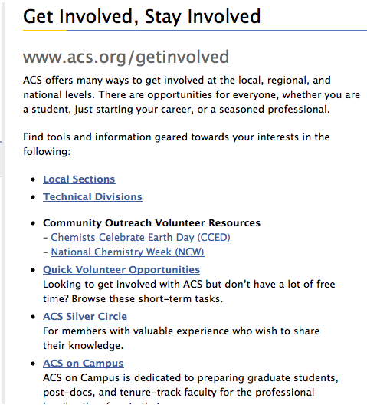
Get Involved, Stay Involved
Use the ACS FREE service—Webs.com—to develop a website
Visit www.acs.org/getinvolved (great page to bookmark )
Visit the ACS Network (Volunteer Support and Engagement)
Various social media accounts
Notes:
Setting up a local section website is easy using ACS FREE Service, webs.com.
Additionally, an excellent, feature rich website at www.acs.org/getinvolved has links for local section leaders and resources for community outreach volunteers.
Using the ACS network with your ACS login and password will lead you to more opportunities especially for engaging volunteers
Learn how to effectively use Social Media strategies for communicating with your members on Friday afternoon at the Leadership Institute.
Resource for Annual Reports, section size, Treasurer and other webinars, and much more.

Slide 29
Time for Breakouts
Please review your personalized Itinerary and the Local Section Track Agenda in your folder for a list of available workshops.
Room Locations (If you are unsure of where to go, please see ACS staff
Planning Successful Activities—in this room
Crystal I—III are located out the side doors to my right.
Crystal VII is located out the side doors to my left.
Getting Back on Track, Crystal VII (invitation only )
Funding Workshop, Crystal III
Social Media Strategies for Local Sections Workshop, Crystal II
Communicating with Your Members Workshop, Crystal I
After the mid-afternoon break please return to your workshops. After dinner, everyone should return to this room.
Notes:
Now it’s time to break out into workshop sessions..
Here’s how the next few hours are scheduled. We’ve divided the group in half, so if your personalized itinerary says Planning Successful Activities I, you can stay in this room. Otherwise, please refer to the local section track agenda in your blue folder and choose two of the three optional workshops:
Funding Social Media Strategies
Communicating with Your Members
Please note that while each workshop will be repeated, the Social Media Strategies workshop will be offered as both a beginner and intermediate track.
Using Social Media for Your Local Section: Beginner Track
Social media tools like Facebook, Twitter, and LinkedIn can help you engage your local section members and promote activities to a wider audience, but where do you start? This workshop is an introduction to these platforms and how ACS local sections are using them. It is geared toward leaders with limited experience using social media, either personally or professionally.
Using Social Media for Your Local Section: Intermediate Track
Does your local section currently use social media to promote activities and connect with members? Are you looking for ways to increase engagement; manage multiple platforms; or experiment with tools beyond Facebook, Twitter and LinkedIn? This workshop will share strategies for taking your social media activities to the next level. It is designed for leaders who have basic knowledge and experience using social media, either personally or professionally

