Slide 1
ACS Membership
American Chemical Society
Notes:
THIS IS A TEMPLATE
*As of July 2023
Check the slide content and notes section on each slide – We will do our best to keep this up to date but inevitably there will be outdated information at certain points
Feel free to include/insert other relevant content for your audience
Questions? Contact Andrew Miller at a_miller@acs.org
Questions about individual member’s memberships? Contact Membership Services at service@acs.org, Toll Free in the U.S.: 1-800-333-9511; International: +1-614-447-3776

Slide 2
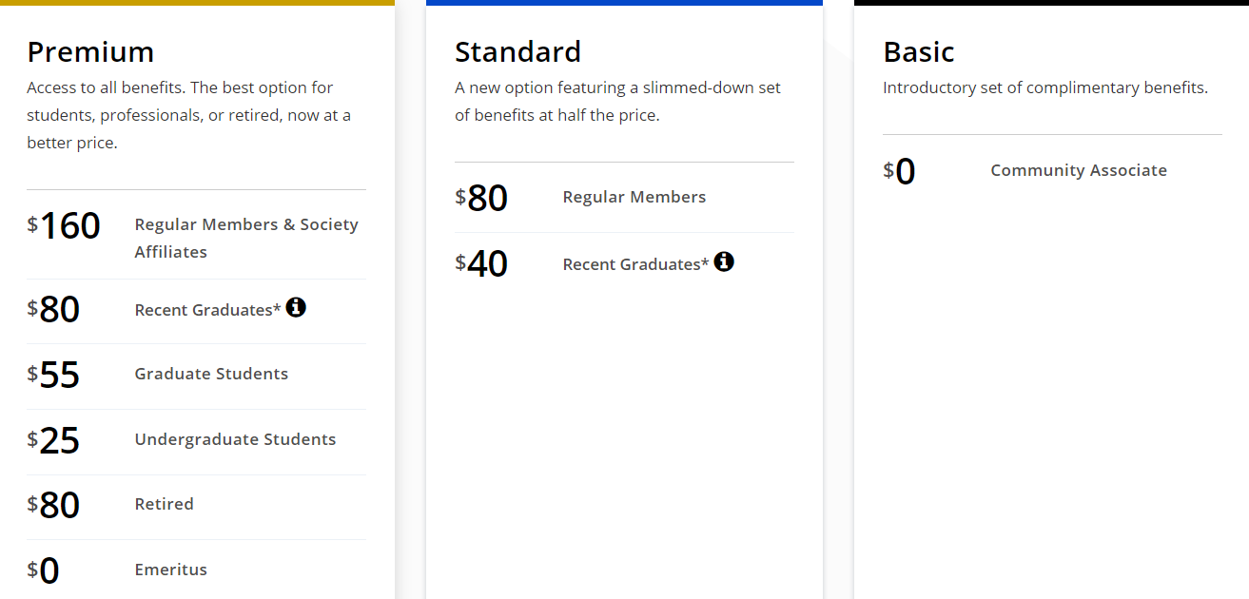
ACS Membership Choices
*Country-specific discounts may also reduce the cost of the Standard and Premium Package.
Contact service@acs.org for more information
Visit
www.acs.org/membership
Notes:
These are the three benefits packages and costs.
Our global member community consists of “Members” (Premium and Standard package holders who have paid membership dues) and “Community Associates” (Basic package holder who have not paid membership dues)
As of June 2023: Country-specific discounts are determined by the specific country’s World Bank socioeconomic tier classification AND the existence of either/or an ACS international student chapter/international chemical sciences chapter within that country

Slide 3
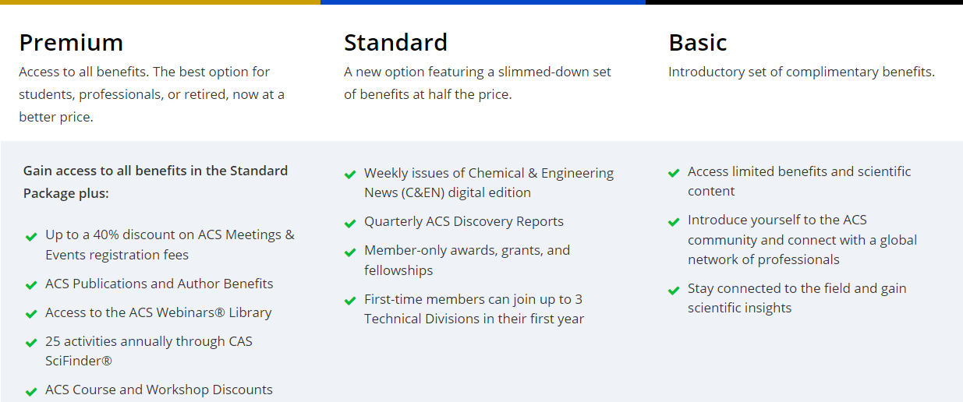
ACS Benefits Summary
www.acs.org/membership
Notes:
The complete listing of ACS benefits can be found at www.acs.org/membership. We recommend downloading the Guide to ACS Membership pdf.

Slide 4


www.acs.org/Link
Notes:
New as of 2023 –ACS link is open to members and community associates at any package level. They just need to at least be a Community Associate.
How it works:
As part of the ACS global membership community, you can ask a question privately, via a short form.
The system links you to others in the ACS global membership community who can best answer your question, based on their interests and expertise.
Subject matter experts reply and you receive responses privately via email.

Slide 5




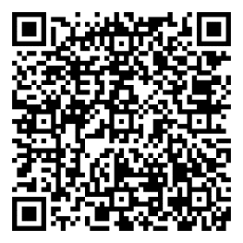
Access thousands of expert-led courses, available to ACS Members with a Premium Package.
Take your professional development into your own hands. Access high-quality, online, and self-paced courses on various topics, including:
Data Science
Communication
Project Management
Public Speaking
And more…
Learn more at acs.org/linkedinlearning
Notes:
LinkedIn Learning is now included as a benefit, only to ACS members who have the Premium package of benefits.
LinkedIn Learning currently retails for $19.99/month – this is ~$240 of annual value included with the Premium package ($160 / $80 / $25)
LinkedIn Learning is an online provider that offers thousands of on-demand business, technology, creative and personal development courses.
LinkedIn Learning offers the ability to learn when and where it works best for you. The platform offers options from short, bite-sized modules on specific topics, to longer courses, to curated learning paths. Content is available in English only.
The QR Code on this slide links directly to acs.org/linkedInlearning where you will find more details about the ACS LinkedIn Learning benefit for ACS members, including a link for eligible members to obtain a LIL license.
Some of the top skills ACS members are learning via LinkedIn Learning are: Python Programming, Microsoft Excel. Public Speaking, Presentation Skills & Project Management.
LinkedIn Learning is not currently available to ACS members in Russia
Questions? Email linkedInlearning@acs.org.

Slide 6
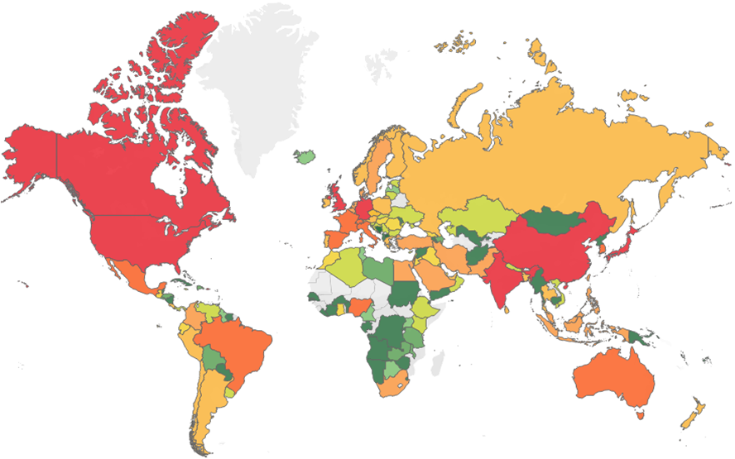
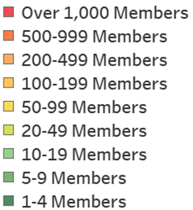
ACS Global Membership
41,600+ international membership count (~27% of membership)
Notes:
This information is as of the beginning of 2023. Depending on timing, you may want to omit it if you cannot get an updated count/map quickly.

Slide 7
Publications & CAS
Chemical & Engineering News (C&EN) - Stay up to date with the latest news about the chemical enterprise.
ACS Publications - 50 free articles per year from the most trusted and cited collection of scientific publications in the world. (Premium Package holders)
SciFinder® - 25 free activities through the CAS (Premium Package holders). To access this benefit, please contact Membership Services.
ACS Discovery Reports - special reports written and published by C&EN on current topics in the chemical sciences and distributed online every 3-4 months. ACS Members also have access to all the reports published to date at www.acs.org/discoveryreports.
Publish open access in any ACS journal with member only discounts. (Premium Package holders)
Notes:
Members and Community associates receive varying levels of C&EN content. Non-student Premium package holders currently have the ability to opt into a paper copy. All other members and Community Associates receive access digitally via a weekly email, https://cen.acs.org/, and/or through the C&EN App
SciFinder is currently available to members with a Premium package
*E-Subscriptions are available to emeritus, retired, and unemployed members at a uniform price of USD $131 per year for ACS Journal and Archive E-subscription titles*. Qualified members have access to 250 articles per journal, per subscription term, and may subscribe to a total of five (5) E-Subscriptions.
https://www.acs.org/membership/member-benefits.html has extensive information on these benefits and more

Slide 8

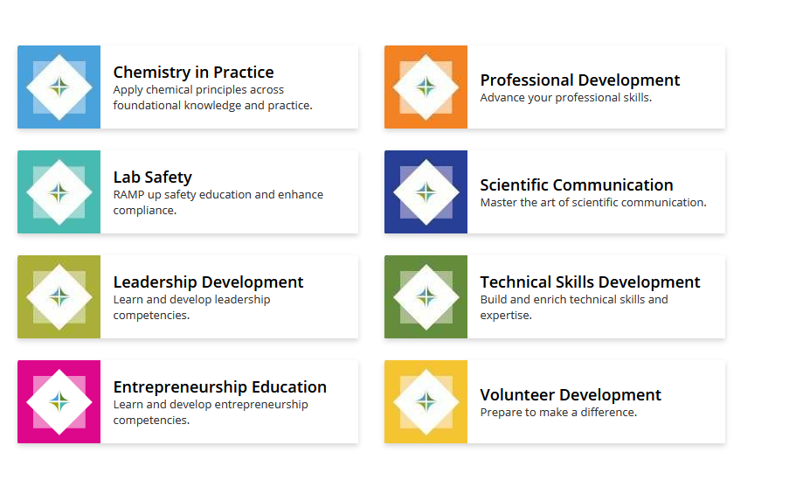

A comprehensive and authoritative learning portal supporting the professional development of chemists throughout their education and career journeys:
Competency-based learning and training offerings across ACS
Content and training developed and rigorously reviewed by SMEs
Seamless access to content spanning a broad spectrum of skills and competencies
Organized into eight (8) topical centers for ease of discovery
Institute.acs.org
Notes:
Free courses and/or discounted pricing for ACS Members with the premium package of benefits

Slide 9
ACS Events
Search for meetings happening in your area
Browse upcoming webinars
Search for workshops and career development opportunities
acs.org/events
Notes:
All ACS events in one place. Live and on-demand.
The ACS Events Hub collects all ACS events from webinars to in-person meetings and allows users to search for specific topics or content delivery methods. ACS members with a Premium package attend events at a discounted registration rate, and receive full access to the webinar archive

Slide 10
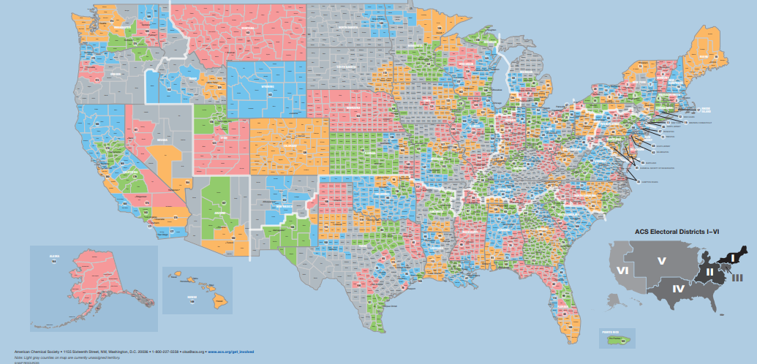
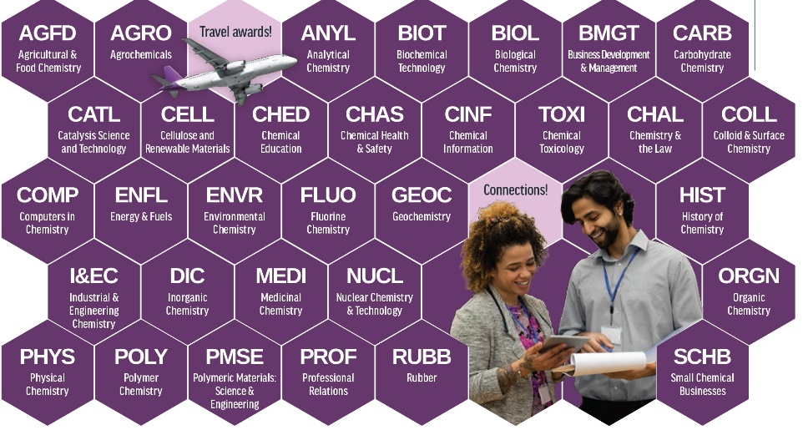
ACS Components
Notes:
There are several component groups within ACS:
Domestic Local Sections
Domestic student chapters (undergrad) and graduate school organizations (GSOs)
International chemical sciences chapters and student chapters
32 Technical Divisions
Up to three (3) Technical Divisions are included with your first year of ACS membership at the Premium package level. You can add these memberships during the joining/renewing process. Maintenance of Technical Division membership after the first year will require an additional membership fee that goes directly to the Division(s) you opt into.
Details on how to connect with a local chapter or section are at www.acs.org.

Slide 11
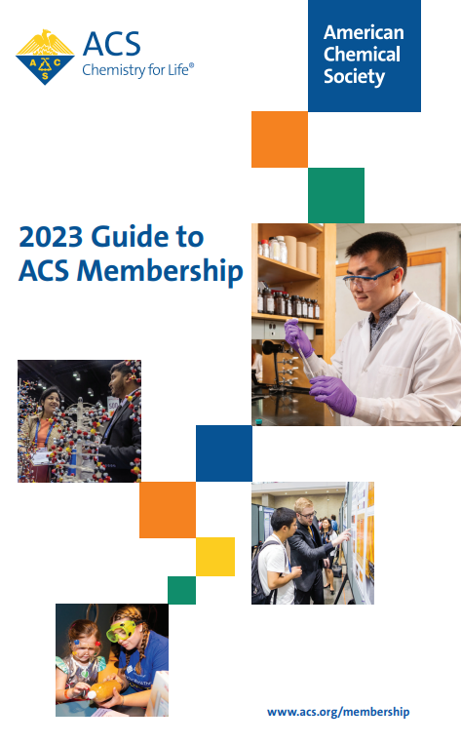
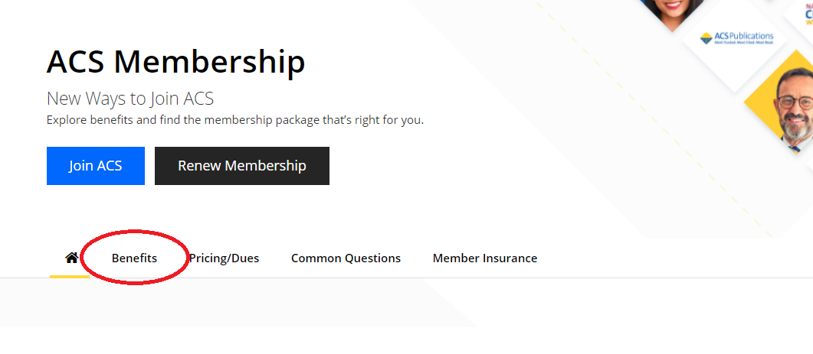
Resources
www.acs.org/membership
Notes:
Visit acs.org/membership to find out more about pricing, benefits, waivers and discount opportunities for select individuals, and more
You can download and/or print a copy of the comprehensive Guide to ACS Membership from this page that also lists out all of the benefits ACS offers to its members
Members receive a copy of the Guide to ACS Membership when they join in their welcome packet, but we review and update it annually

Slide 12

Not an ACS Member?
BECOME A MEMBER TODAY!
Your Premium Package includes:
Weekly issues of Chemical & Engineering News (C&EN)
ACS Webinars® Library
ACS International Chemical Science Chapter membership
50 free Publications article accesses per term
First-time members can join up to 3 Technical Divisions in their first year
LinkedIn Learning
And more!
SCAN ME
Notes:
Individuals who are joining, renewing, or upgrading will need to have or create and ACS ID (Login Profile)

Slide 13
Not an ACS Member?
BECOME A MEMBER TODAY!
Your Standard Package includes:
Weekly issues of Chemical & Engineering News (C&EN) digital edition
Quarterly ACS Discovery Reports
Member-only awards, grants, and fellowships
First-time members can join up to 3 Technical Divisions in their first year
And more!
SCAN ME
Notes:
Individuals who are joining, renewing, or upgrading will need to have or create and ACS ID (Login Profile)
The Standard Package starts at $80 (discounts may apply) and does not include the SciFinder, Publications, Webinars Archive Access, or Meetings Discount benefits.
Standard package holders get C&EN, but only in digital format

Slide 14

Introducing a No-Cost Option to Join ACS
BECOME A COMMUNITY ASSOCIATE TODAY!
Your Basic Package includes:
Weekly delivery of the Chemical & Engineering News (C&EN) Essential and ACS Matters newsletter
Access to six digital C&EN articles per month
Endless opportunities to engage with the global chemistry community
ACS Link
And more!
SCAN ME

Slide 15
Thank you!

