Slide 1
CEPA Mission and Vision Statements
Mission Statement
The Committee on Economic and Professional Affairs empowers ACS members to continuously develop professionally.
Vision
The professional lives of ACS members will be thriving because of ongoing career planning and sustained use of the best available tools that meet their needs at every stage of life.

Slide 2
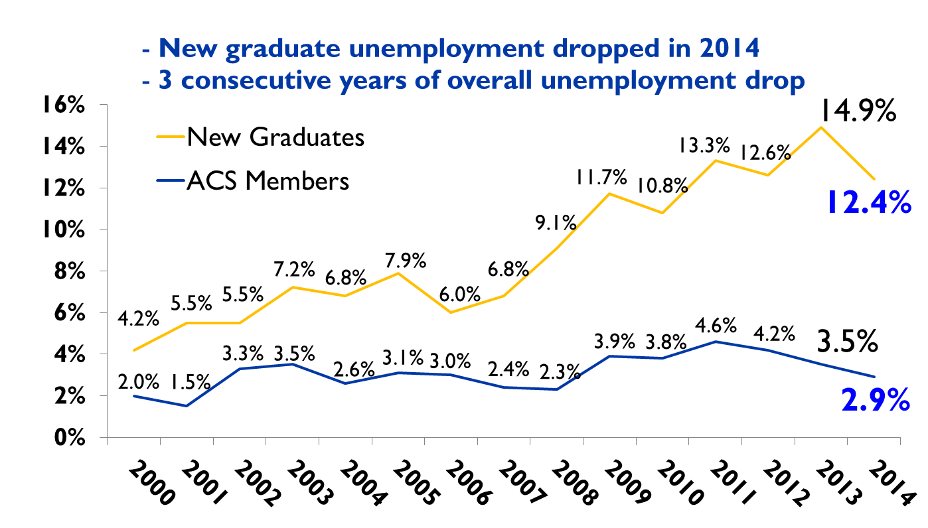
New Chemistry Graduates and ACS Member Unemployment (2000-2014)
Adapted from ACS Comprehensive Salary and Employment Survey and ChemCensus 2000-2014 and ACS Survey of New Graduates in Chemistry, Chemical Engineering and Related Fields 2000-2014
Notes:
Have stats on studies looking at unemployment among new grads in other degree fields

Slide 3
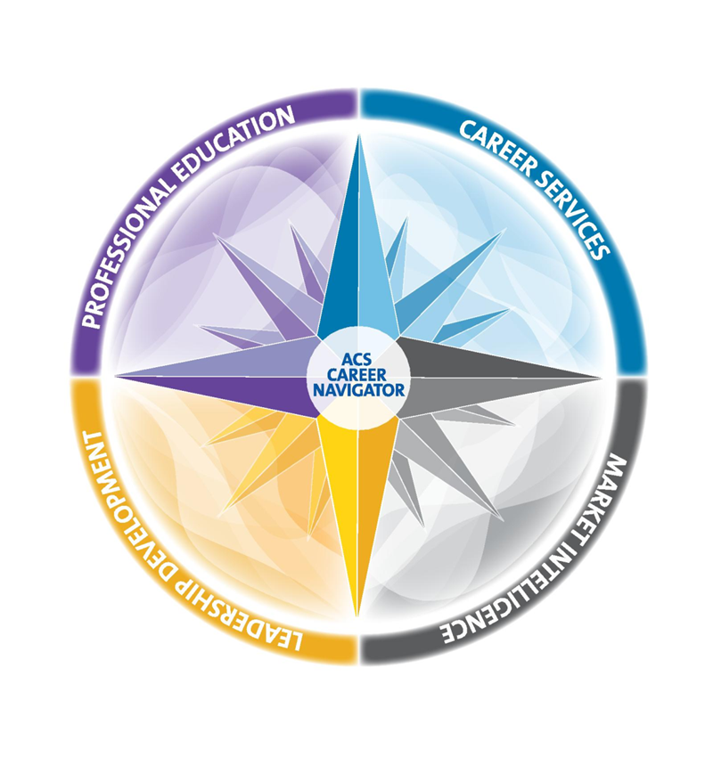
ACS Career Navigator™
Professional Education
Short Courses
Online Courses
OnDemand Modules
Careers Services
Career Consulting
Career Fairs
Virtual Career Fairs
Career Pathways
Market Intelligence
Employment Dashboard
Salary Calculator
Employment Reports
Chemical labor market tracking
Leadership Development
Online Courses
Facilitated Courses
www.acs.org/careernavigator

Slide 4
ACS Denver Onsite and Virtual Career Fair Statistics
ACS Career Fair (Onsite):
Job Seekers 715
Employers 27
Number of Positions 85
Recruiters Row Booths 10
Virtual Career Fair (Online):
Job Seekers/Attendees 918
Employers 6
Number of Positions 38
(Final, as of March 25, 2015)

