Slide 1
Social Media Workshop for Local Sections
ACS Leadership Institute ● Dallas, Texas
January 22, 2016
Chris McCarthy, Social Media Manager, ACS Membership & Scientific Advancement
Jason E. Ritchie, Associate Professor of Chemistry & Biochemistry, The University of Mississippi

Slide 2
Goals for Today
You should come away from this workshop with…
a greater understanding of the variety of social tools
practical applications for social media in local section activities
ideas for how your section can begin to use or improve its use of social media

Slide 3
What Do We Mean by Social Media?
User-generated content (status updates, photos, videos)
Interactive (like, share, comment)
Relationships (friends, colleagues, communities, organizations, causes)
Increasingly mobile (check-in, location-based)
Immediate (real-time interactions, live-blogging/live-tweeting)
Notes:
There are many definitions of social media, but these are the usual characteristics of social content.

Slide 4
Goal for Social Tools and ACS
Social tools extend the existing activities of ACS and the chemistry community to a virtual space, leveraging benefits of efficiency and inclusiveness.
These tools are an additional way to develop relationships, to have dialogue, and to foster loyalty among ACS members.

Slide 5
Social Media & Local Sections
Local sections help chemists stay active and involved in their communities by providing a forum for networking and collaboration and by supporting chemists’ efforts to educate their community about chemistry.
Social media can enhance existing offerings
promote in-person outreach events and networking opportunities
and create new avenues for interactions
groups to share info about chemistry news, the profession, jobs in your area
increase reach for geographically-dispersed sections
lower barrier for participation

Slide 6
How Can Social Media Help With My Local Section Activities?

Slide 7
Promote Local Section Events
Social media is a great way to inform people about events, such as National Chemistry Week outreach or local section meetings
You can tweet about events and even have conversations with attendees in real time

Slide 8
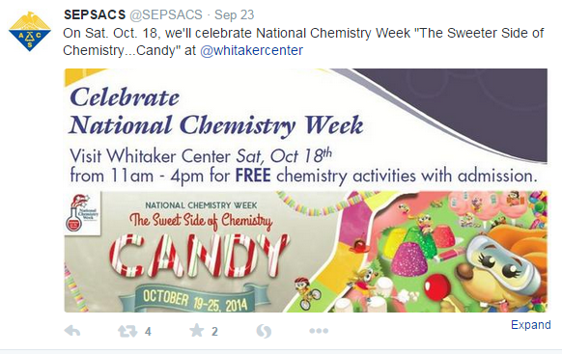
Promote Local Section Events

Slide 9
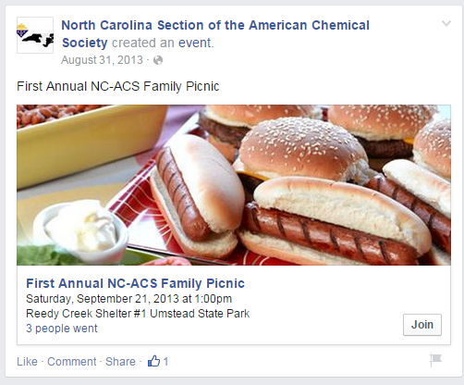
Promote Local Section Events
Facebook allows you to post events and invite fans of your page.

Slide 10
Promote Local Section Events
Mentioning other organizations on Facebook in a post can allow it to be seen on their page, extending the reach to their audience as well as your own.

Slide 11
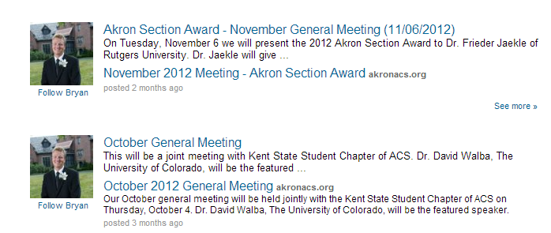
Promote Local Section Events
LinkedIn Groups also allow you to post updates about events. LinkedIn no longer allows you to post events as content group members can RSVP to, only updates.

Slide 12
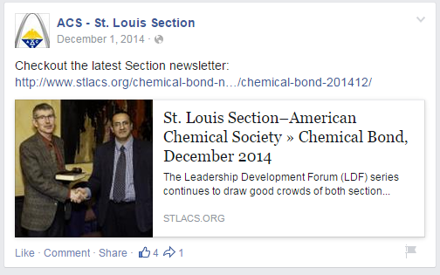
Communicate with Members
If you have an existing email newsletter, post a link on Twitter, Facebook or LinkedIn when a new issue is published.
You can also use these tools to drive members to new content on your websites.

Slide 13
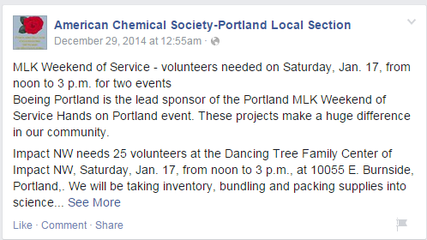
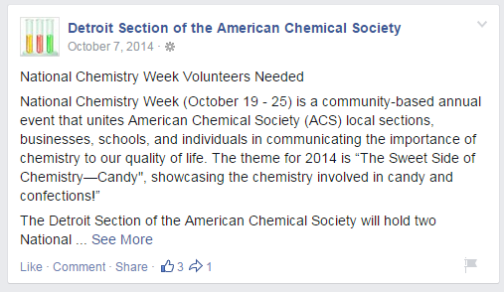
Communicate with Members
Request volunteers to help with events via social media.

Slide 14
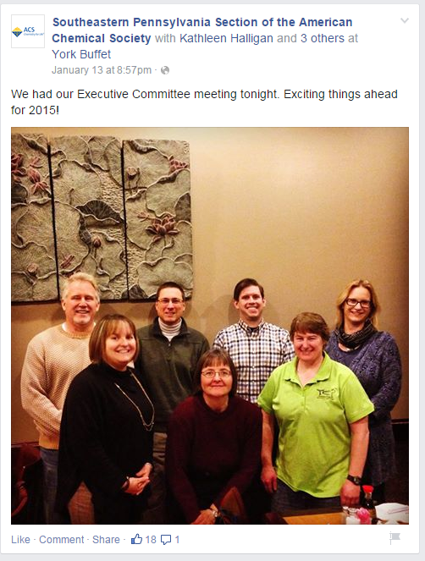
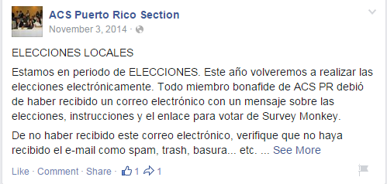
Communicate with Members
Keep your members aware of important dates/deadlines and use social media to personalize the section’s leadership.

Slide 15
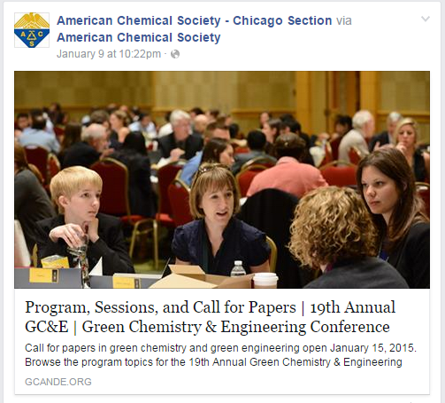
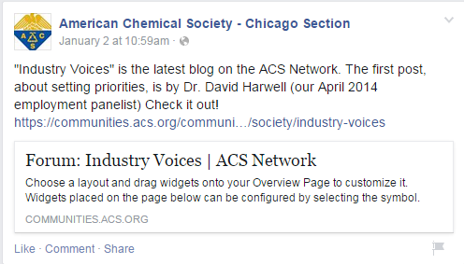
Communicate with Members
Share other ACS content of interest for chemists in your section.

Slide 16
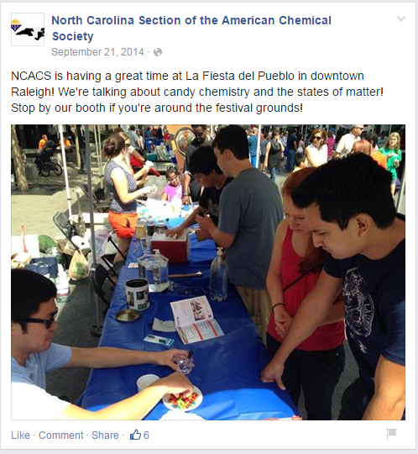
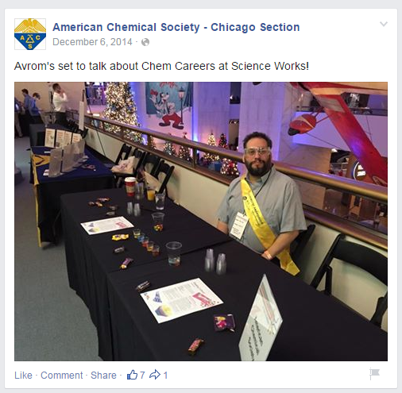
Share Successes
Post photos before, during, and after events.

Slide 17
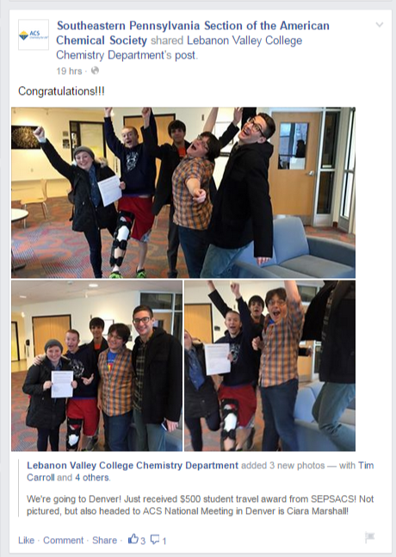
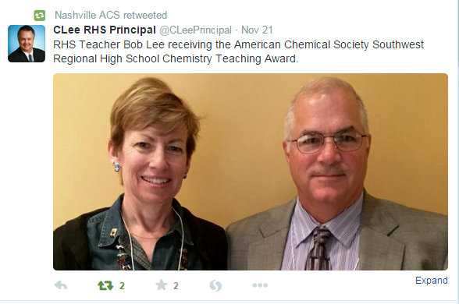
Share Successes
Show the impact of your local section in the community.

Slide 18
MORE ON SOCIAL MEDIA PLATFORMS AND SOME BEST PRACTICES FOR USING THEM
What Exactly Is A “Tweet”?

Slide 19
Social Networking Tools
Facebook
More than 1.55 Billion monthly active users; 2nd highest page rank on the web.
Social utility that connects people, to keep up with friends, upload photos, share links and videos.
Twitter
320 Million monthly active users; 10th highest page rank on the web.
Social networking and microblogging service using instant messaging, SMS or a web interface. (Tweets are 140 characters or less.)
LinkedIn
100 Million monthly active users; 22nd highest page rank on the web. (400M+ registrants)
A networking tool to find connections to recommended job candidates, industry experts, and business partners.
Notes:
Show of hands to see how many in room are on each service.
Other social networking sites in top 25 include Chinese language services like Renren (~Facebook) and Weibo (~Twitter).

Slide 20
Other Social Media Tools
Notes:
There are even more tools, some growing in popularity while others are on the decline.
A lot of these other tools focus on narrower areas—video or photos. Blogging, events, some are very science-specific, some are social bookmarking sites that allow you to share within a community other sites you’ve found online.
YouTunbe is the 3rd most popular site on the net. Reaches more adults in the US than cable.
Pinterest, Tumblr, Instagram are in the top 50 sites. These are very visual tools—which have great deal of international appeal (images vs. language barrier)
Google+ is growing, with some forcing of use by google (recently made it the comment system for YouTube). Definitely has impact on search engine optimization.

Slide 21
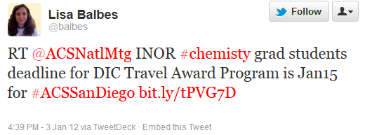
Twitter Basics
A “tweet” is a post from an individual twitter account.
Tweets starting with “@__” are comments/questions directed to that user
Ex. “@ACS_NCW What is this year’s theme for National Chemistry Week?”
A hashtag (#NCW, #ACSdenver #ChemChamps) is a way of indicating a tweet is related to a particular topic. Using them especially enhances conversations around events.
RT – ReTweet, resending another person’s tweet to amplify its message.
Twitter can be accessed at twitter.com, via mobile apps, via text messages, or through dashboard tools like TweetDeck or HootSuite.

Slide 22
Facebook Basics (Pages vs. Groups)
Pages:
Posts come from Brand vs. Person
Posts show up directly on fans’ walls, more public (opportunities for sharing, liking, and commenting)
Can add applications; can see extensive analytics
Groups:
Posts come from Person vs. Group
More insular; private.
Content only shared in group among members

Slide 23
LinkedIn Basics
Primarily used for professional networking and job searches
Has two types of groups: standard or unlisted
Employment-related or with a focus on career specialties
Corporate and university alumni
Related to professional associations, special interest groups
Group functionality limited to discussions, moderated by group owners and managers

Slide 24
What Makes a Good Post?
Keep it short—messages under 100 characters are far more likely to be liked, commented on, and shared. TL;DR
Timing matters—depending on your audience, posts on weekdays may be more popular than on weekends or weeknights. Experiment to learn when your messages have the most traction.
Questions, especially yes/no or short answer ones, get more traction.
The 2016 Chemists Celebrate Earth Day theme is “The Great Indoors—The Home Ecosystem.” What steps do you take to ensure good indoor air and water quality in your home?
Ask for tips—social media users, like anyone, love to share personal experiences and insights.

Slide 25
How they work together
Social media works best by using multiple channels to reach out to your audience.
You could have a poll on the ACS Network that you link to from your Facebook page or Tweet about or share with a group on LinkedIn.
Different content makes more sense for different tools. Think about your audience, your content, and your desired results.
Leverage other relevant organizations or individuals by mentioning them—they may share your content with their audience (going viral).

Slide 26
How to Get Started
If you’re interested in using social media professionally, try using it personally first to get your feet wet.
Don’t spread yourself too thin. Focus your attention on the platforms that make sense first.
Listen!
Find out where your members are.
Hear what they’re talking about.
See what you can add to the conversation.

Slide 27
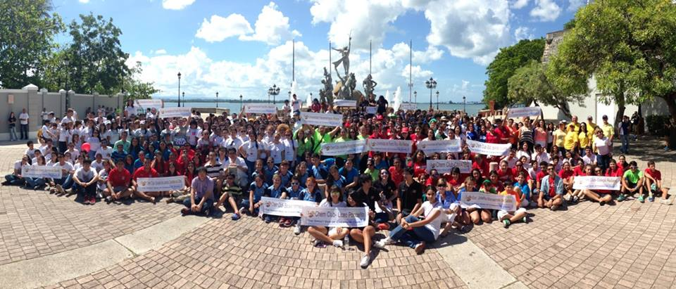
Seeing is Believing
“We had a great time at the outreach event in San Juan.”

Slide 28
If You Build a Garden, You Need To Tend To It
Social media presences that aren’t active for a couple of weeks seem dormant, more than a few months seem dead.
Answer questions. Just as in real life, ignoring people online is rude.
Answer most questions publically—for every person who asks there could be a dozen or more who have the same question but don’t bother posting it.

Slide 29
Avoid Controversy and Keep Things Civil
If you set up a social media presence for your local section, remember you are communicating on behalf of ACS.
Keep your message positive.
Avoid political statements, especially partisan attacks or endorsements.
Some topics may be appropriate for you to comment on as an individual chemist but not as “official spokespersons for ACS.” (Research findings, accidents, etc.)
Moderation may be necessary with a group or in a comment section
Consider a policy to keep your group free from personal attacks, offensive language or imagery, or inappropriate commercial content.
Notes:
Difference between advocacy and partisan politics (okay to encourage people to write their representatives about science funding, not okay to badmouth a specific party or politician)
Avoid posting confidential member info that you have access to as a local section leader without permission (email addresses, phone #, etc.)
Mention American Chemical Society PR Guidebook as resource for official spokesperson info.
Spam – some commercial messages may be of interest to a group, can be a judgment call.
Where possible, it’s good practice to let the person know why their comments are being moderated. Transparency can help engender more civil discussions and also prevent retaliatory comments about moderation.

Slide 30
Learning Activity
Break into groups of 4-5 people
We’ll give you a piece of local section business, you brainstorm ways that social media could be used to complete the activity

Slide 31
Final Thoughts
Social media doesn’t replace other forms of communication with your members.
If you already have a presence on the Facebook, LinkedIn, Twitter, or any other platform, let us know. ACS can help promote it.
Looking for content? Consider following other ACS social accounts. Visit www.acs.org/social for a comprehensive list.
Not sure where to start? ACS staff are happy to help you brainstorm how to use social media tools to enhance your local section’s programming, community outreach, and other activities.

Slide 32
Need more?
Chris McCarthy Social Media & Multimedia Manager, Membership & Scientific Advancement c_mccarthy@acs.org @CMcCinDC

