Slide 1
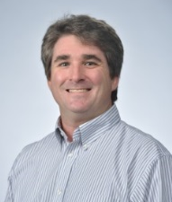
American Chemical Society
Local Section Track
Sunday Morning
Agenda:
8:00 – 8:15 AM Welcome and Agenda for the Day
8:15 – 9:30 AM Team Project: Pulling it Together
9:30 – 10:15 AM Collaborative Projects Reports
10:15 – 11:00 AM Town Hall Meeting and Wrap-Up
Jason Ritchie,
2018 Chair,
Committee on
Local Section Activities (LSAC)
January 21, 2018
Notes:
1

Slide 2
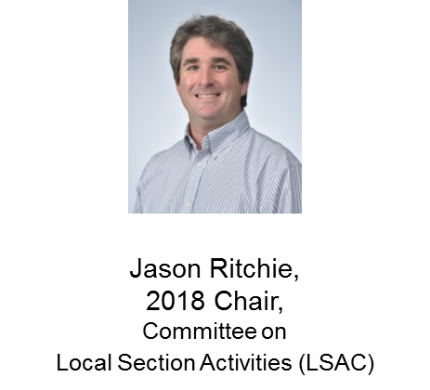
American Chemical Society
Local Section Track
Team Project:
Pulling it all Together
January 21, 2018
Notes:
2

Slide 3
American Chemical Society
Local Section Track
Town Hall Meeting
and
Wrap Up
January 21, 2018
Notes:
3

Slide 4
How are section territories determined?
Local section territories are formed by petition to Council.
Existing territory can be annexed or reassigned between sections and local sections can petition to annexed unassigned territory.
Territory is assigned at the county level.
Members residing in affected territory must be notified; adjacent sections should be notified as well.
Staff will work with local sections that seek to change territory.

Slide 5
Do you have to be a member of ACS to be a member of a local section?
Local section may have local section affiliates that are not members of ACS.
Your bylaws should indicate if you may have affiliate members.
A high school teacher is an example of an affiliate member.
Affiliates do not appear on your eRoster.
Section Affiliates can not vote or hold elected office.

Slide 6
What’s the difference between an eRoster and the Election Roster
The eRoster contains a list of all members and includes their membership status.
The election only roster filters out members that are ineligible to vote. This include society affiliates, members with unpaid dues or members that are in grace status.
All active (paid) members in the local section and are eligible to vote.
Local section society affiliates and division affiliates can not vote or hold an elected position.
Ballots should only be sent to members of the local section or division, as they are the only ones eligible to vote.

Slide 7
Are there guidelines for Executive Committee expenses
In formulating fiscal policy, sections should evaluate their activities to be certain they are in agreement with their mission, which is the basis for their tax-exempt status.
Generally, if the activity is appropriate, the necessary expenditures to promote that activity will also be appropriate.
In general, the Society and its local sections are prohibited from making expenditures that benefit individuals or profit-making organizations, promote legislation, or support or oppose a candidate for public office.

Slide 8
What’s the difference in a district and a region?
Districts are drawn and approved by Council based on ACS Bylaws and populations within each District.
Districts appear on the Local Section Map (see acs.org/getinvolved)
Members and Local Sections are represented by there District Director on the ACS the Board of Directors.
Regions are historic and can be changed by request to M&E.
Regional meetings are often rotated within regions.
Notes:
Review the hand

Slide 9
Who is involved in preparation of the annual report?
Local Section officers and Councilors listed in the Yellow Book as officers for the reporting year are authorized users for FORMS. Access FORMS with ACS ID
(Reporting Year) Chair and Treasurer complete; Councilor approves.
In addition, a maximum of 3 non-officers can be added to access your group’s annual report.
To assign a non-officer access to FORMS, please ask your chair to send the non-officer's name and ACS ID to forms@acs.org.
Notes:
Review the hand

Slide 10
How can we form a working group across sections for the purpose of planning activities?
Reach out to the officers of neighboring local sections via Yellowbook or local section lookup on acs.org.
Follow-up with your table mates and others you met this weekend to plan collaborative events.
Yellowbook.acs.org
.
Notes:
Review the hand

Slide 11
How do we increase engagement with our members?
Find out what your members are interested in.
Consider a town hall meeting or member survey.
Plan social events/outings where members can bring families.
Consider planning events that appeal to specific demographic audiences.
Look at what other sections have done – imitation is sincerest form of flattery.
Get the word out. Website or email communications may not be enough.
Consider social media as part of your communications strategy.
Notes:
Review the hand

Slide 12
How many IPGs were submitted/funded in 2017
There were 43 submitted; 36 were approved.
Total funded in 2017 = $72k.
$80k allocated in 2018.

Slide 13
How do I encourage our board to do something more progressive?
Direct and respectful communication.
Volunteer to lead new initiatives.
Cite examples of other local section successes.
Apply for an IPG.

Slide 14
How can ACS help with virtual meetings?
There are free and low cost services streaming and conferencing services.
ACS does not provide this type of service.
A technology resource guide will be available on acs.org later this week.
ACS does not endorse any particular service provider

Slide 15
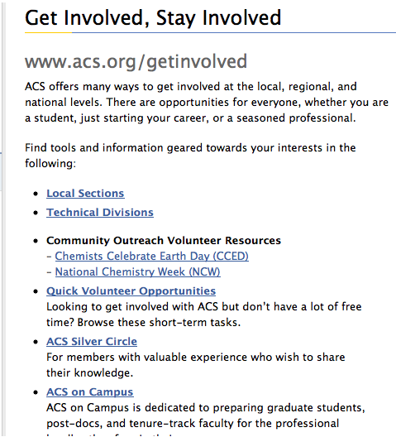
Sources of Information…
Great first place to look for your answers (bookmark):

Slide 16
Sources of Information…
Headquarters listing in your folder. If you don’t know who to call, contact local section support!
LSAC@acs.org – Committee on Local Section Activities
OLSA@acs.org – Office of Local Section Activities
FORMS@acs.org – Annual Reports
Rosters@acs.org – eRosters
m_Obrien@acs.org – Mark O’Brien, LSAC staff liaison

Slide 17
Sources of Information…
Contact each other! All ACS officers, including local section officers, are included in an annual directory which has come to be known as the Yellow Book.
By virtue of your office you have access to the contact information of all other ACS officers and the staff that support national governance committees like the Committee on Local Section Activities.
Search ACS Yellow Book, you will be asked to verify using your last name and ACS membership number or your ACS ID.

Slide 18
ARE THERE ANY OTHER QUESTIONS

Slide 19
American Chemical Society
Town Hall Meeting Wrap Up
What can we do to make your local section successful?
January 21, 2018
Notes:
19

