Slide 1
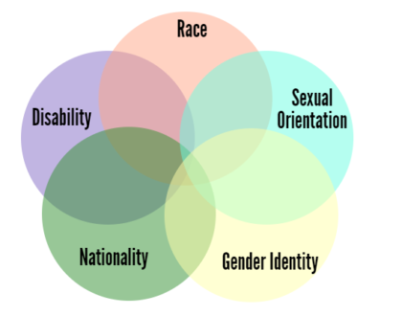
Social Media & Informational Links of the Committee on Minority Affairs
● http://www.ChemDiversity.org
● www.facebook.com/ACS.CMA
● Twitter @chemdiversity
● www.linkedin.com/company/chemdiversity-acs-cma
● www.merriam-webster.com/words-at-play/intersectionality-meaning

