Slide 1
Unemployment Rates for ACS Chemists and New Graduates
14.9%
New Chemistry Graduates
12.6%
ACS Members
Notes:
The production of new chemistry bachelors began to outpace demand in 2008, and with it, the unemployment rate has grown. The unemployment rate for new chemistry graduates is currently at 14.9%. This is by far the highest unemployment rate for new graduates in the thirty-year history of our survey.
This is not a new problem. The unemployment rate for new graduates has been growing steadily for the past 6 years, and we need to reverse it quickly.
The onset of the glut in bachelors degrees corresponds with the start of the Great Recession.
Even though the unemployment rate for chemists has decreased as a whole, the plight of new bachelors level graduates remains perilous.

Slide 2
Bachelor’s Degrees Granted in the United States

Slide 3
CEPA Strategic Plan
CEPA empowers ACS members to continuously develop professionally.
Annually evaluate the portfolio of career-related programs, products and services.
Increase awareness and usage of programs and services overseen by CEPA.
Recruit, approve, review, and recognize Career Volunteers.

Slide 4
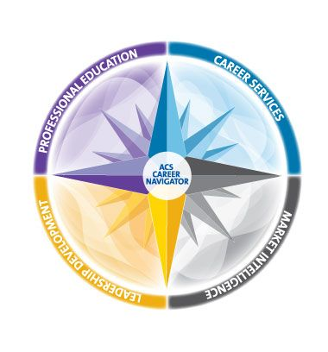
ACS Career Navigator
Careers Services
Career Consulting
Career Fairs
Virtual Career Fairs
Career Pathways
Professional Education
Short Courses
On Demand
Online Courses
Sci-Mind™
Leadership Development
Online Courses
Facilitated Courses
Market Intelligence
Employment Dashboard
Salary Comparator
Employment Reports
Ethics & Professional Guidelines
Chemical Labor Market Tracking
www.acs.org/careernavigator

Slide 5
For Council Action:
Professional Employment Guidelines
Council Agenda Book, pages 80-87

Slide 6
ACS Dallas and Virtual Career Fair Statistics
ACS Career Fair (Onsite):
Job Seekers 651
Employers 38
Number of Jobs 95
Recruiters Row Booths 13
Virtual Career Fair (Online):
Job Seekers/Attendees 720
Employers 11
Number of Jobs 36
(Final, as of August 12, 2014)

