Slide 1
Teaching in the time of COVID-19: ACS postsecondary educational resources
American Chemical Society
Updated August 23, 2020

Slide 2
ACS Efforts and Resources on COVID-19
YOU MAY RECEIVE A ONE-YEAR WAIVER ON YOUR NATIONAL DUES If your membership is up for renewal, but you’re experiencing a special hardship, such as unemployment, furlough, reduced wages or illness.
RECEIVE ACCESS TO LINKEDIN LEARNING THROUGH THE END OF THIS YEAR This powerful resource includes over 15,000 on-demand courses to support your continued learning and career advancement for active ACS members.
INOVA EAP/WORK-LIFE ASSISTANCE PROGRAM 24/7 assistance on a wide range of issues, such as emotional, relationship, major life, health, wellness, educational and more for ACS members based in the United States. Confidential services are provided via telephone or comprehensive online resources.
Browse ACS Resources and Initiatives!
www.acs.org/covid-19

Slide 3
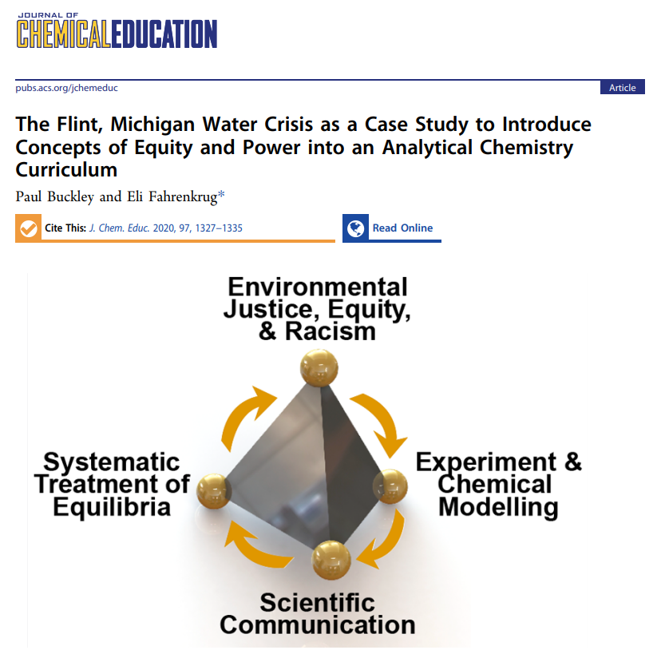
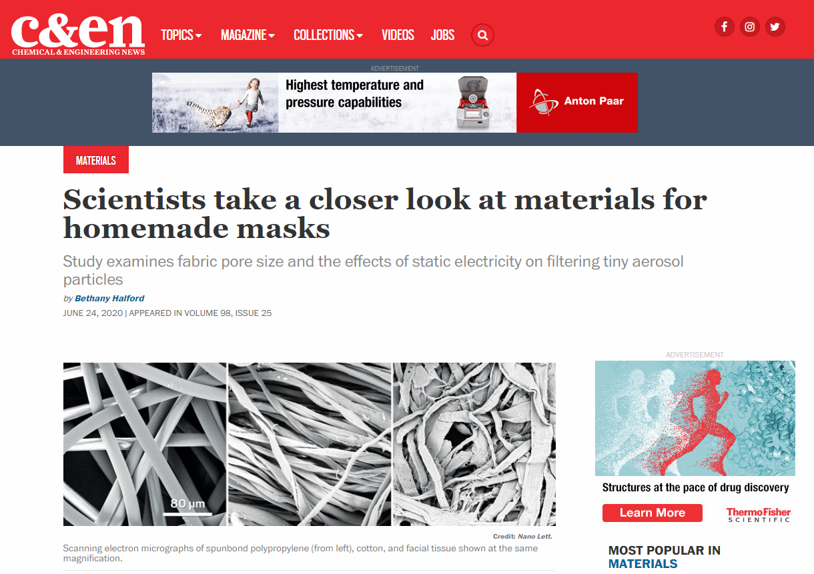
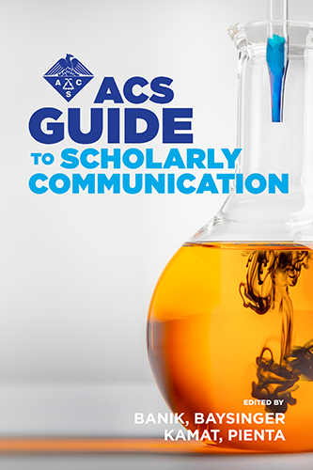
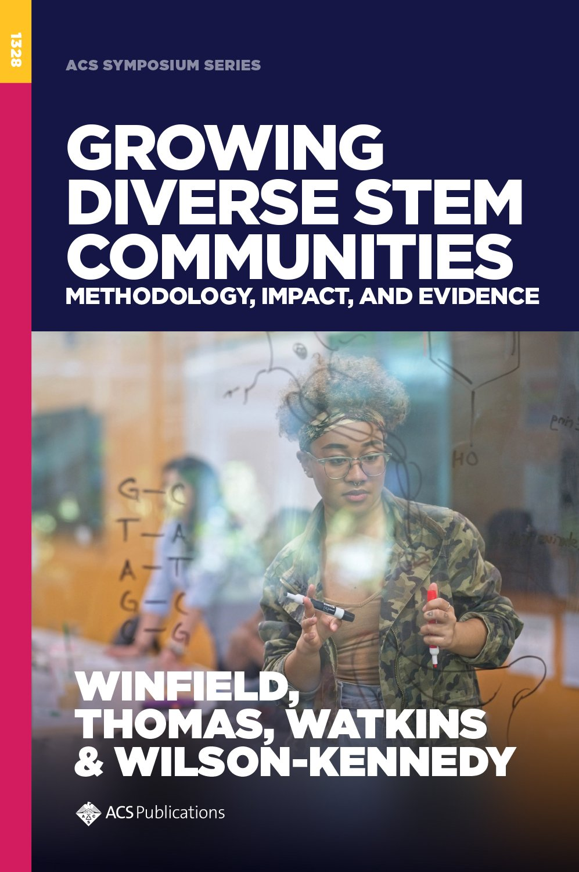
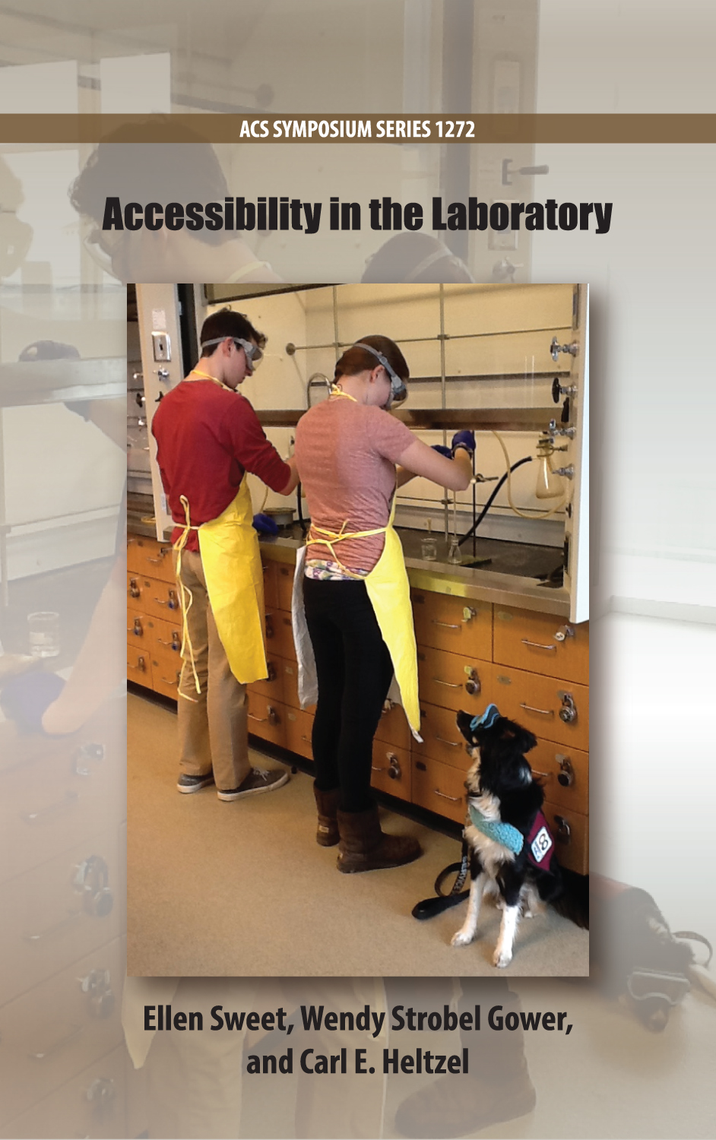
ACS Publications Journals, Books and News
an indispensable resource for educators
Prepare lecture and lab curriculum
Increase diversity in STEM education
Support accessibility
Teach by example
Assign supplemental reading
Build communication skills
Connect concepts to current events
Add historic context
To get access at your school, visit:
connect.acspubs.org/getaccess

Slide 4
Available Now! In support of educators keeping their students’ chemistry education moving forward ACS Publications & the ACS Division of Chemical Education are sharing a collection of free to read articles from the Journal of Chemical Education.
Available Now! Laboratory teaching continues to evolve and face new challenges in today’s world. To help share the broad approaches to laboratory education, the journal has provided a collective resource of articles on laboratory learning and understanding, inquiry methods, student preparedness, assessing the lab, and faculty goals and professional development for laboratory teaching.
https://pubs.acs.org/journal/jceda8
Coming in September 2020!
See ASAP Articles for submissions already published!

Slide 5
Chemical & Engineering News
C&EN coverage of undergraduate chemistry education, particularly during the COVID-19 pandemic, could also help inform the next steps of chemistry departments.
Helping students (re)think of themselves as scientists, Claire L. Jarvis, C&EN, July 18, 2020
Freshman chemistry is an exit point for many underrepresented STEM students, study shows, Celia Henry Arnaud, C&EN, June 10, 2020
Block plan compresses one class into a few weeks for deeper learning, Celia Henry Arnaud, C&EN, July 3, 2020
Questioning the value of general chemistry labs, Celia Henry Arnaud, C&EN, May 10, 2020
Considering ethics during a time of crisis, Judith N. Currano, C&EN, April 25, 2020

Slide 6
Chemical & Engineering News (cont.)
Tips for teaching in the time of coronavirus, Celia Henry Arnaud, C&EN, March 19, 2020
The flip side of flipped classrooms, Claire L. Jarvis, C&EN, January 17, 2020
Major in chemistry? Physics? Nah. With these programs, students can major in ‘science’, Celia Henry Arnaud, C&EN, October 19, 2019
Chemistry class as art gallery, Celia Henry Arnaud, C&EN, July 20, 2019
Open-access chemistry textbooks gain popularity, Celia Henry Arnaud, C&EN, March 18, 2019
Stop. Draw. Discuss: How high school approaches are helping fix undergraduate chemistry, Megha Satayanarayana, C&EN, January 27, 2019

Slide 7
ACS Webinars recording
Related articles
Questioning the value of general chemistry labs, Celia Henry Arnaud, C&EN, May 10, 2020
Evidence for the Importance of Laboratory Courses, Stacey Lowery Bretz, Journal of Chemical Education 2019 96 (2), 193-195, DOI:10.1021/acs.jchemed.8b00874
Investing in Laboratory Courses, Rebecca Sansom and Joi P. Walker, Journal of Chemical Education 2020 97 (1), 308-309, DOI:10.1021/acs.jchemed.9b00714
Establishing the Laboratory as the Place to Learn How to Do Chemistry, Michael K. Seery, Journal of Chemical Education 2020 97 (6), 1511-1514, DOI:10.1021/acs.jchemed.9b00764
https://www.acs.org/content/acs/en/acs-webinars/popular-chemistry/future-lab.html
www.acs.org/acswebinars

Slide 8
ACS Webinars recording and resource list
https://www.acs.org/content/acs/en/acs-webinars/popular-chemistry/teaching-remote.html
The chemistry community has a wide range of resources to assist with teaching remotely in various and changing circumstances. Organized into six categories, this list was updated with additional resources from attendees.
http://www.acs.org/content/dam/acsorg/events/popular-chemistry/Slides/2020-06-30-remote-teaching-resources.pdf
www.acs.org/acswebinars

Slide 9
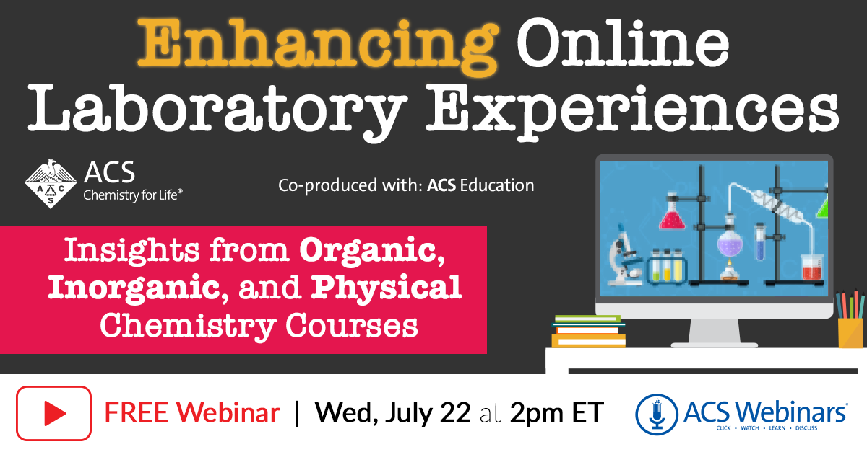
ACS Webinars recording and resource list
https://www.acs.org/content/acs/en/acs-webinars/popular-chemistry/online-lab.html
The list of resources provided by the panel was updated with additional tips and resources shared by the attendees.
http://www.acs.org/content/dam/acsorg/events/popular-chemistry/Slides/2020-07-22-resources.pdf
www.acs.org/acswebinars

Slide 10
inChemistry magazine

