Slide 1
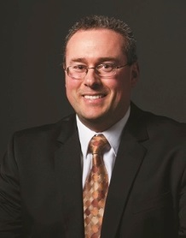
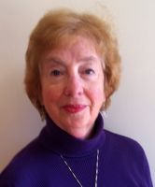
Leading Your ACS Local Section
Martin Rudd, 2015 Chair,
Committee on Local Section Activities (LSAC)
2015 Pre-Leadership Institute Webinar: Preparing You to be a Successful Chair/Officer
January 15, 2015, 3:00—4:00 p.m.
This webinar transcript and slides and will be posted to www.acs.org/getinvolved.
Lucy Eubanks,
Subcommittee Chair,
Technology, Tools and Operations
(TTO)
Notes:
Good Afternoon. (From Martin)
Welcome to Leading Your ACS Local Section webinar, the 2015 Pre-leadership Institute webinar to prepare you to be a successful Chair or Officer
My name is Martin Rudd, I am Chair of LSAC again in 2015 and will leading the LSAC track at the Leadership Institute. Also on this webinar is Lucy Eubanks, who is Chair of the Technology, Tools, and Operations subcommittee of LSAC. This webinar has been established to provide you with important and vital information about local sections. A significant portion of the information in the webinar will not be repeated during the leadership institute so we very much appreciate your attendance today because your participation today will contribute to the success of the Leadership Institute this year. There will be an opportunity for you to ask questions during the webinar.
Finally, a link for the audio portion and the slides for this webinar will be sent to you as a resource before the LI.
So let’s get started.

Slide 2
WEBINAR AGENDA
Martin Rudd:
The Committee on Local Section Activities
“Nuts and Bolts” for Leading Your Section
Lucy Eubanks:
Local Section Leadership
Martin Rudd:
Local Section Communication and ACS Resources
Marinda Wu
Partners for Progress and Prosperity
Martin Rudd
Leadership Institute Overview
Q&A and Comments
Notes:
The webinar agenda today is as shown. We will discuss the structure and function of the national LSAC committee, an overview of the LI, the “Nuts and Bolts” of leading your section, helpful information about facilitating the growth and vitality of local section leadership, ways of creating effective communication LS, along with additional resources, and opportunities along the way and at the end for asking question.
Now is my great pleasure to turn the next portion over to Martin Rudd, Chair of LSAC to describe the national LSAC committee ands some of the “Nuts and Bolts” of running your local section
Mitchell:
Introduction
Martin:
The Committee on Local Section Activities
“Nuts and Bolts”
Lucy:
Section Leadership
Martin:
Effective Communication and ACS Resources
Mitchell:
Leadership Institute Overview
All:
Q&A and Comments

Slide 3
The Committee on Local Section Activities
Martin Rudd, 2015 Chair LSAC

Slide 4
COMMITTEE ON LOCAL SECTION ACTIVITIES (LSAC)
What: A Standing Committee of the Council
  20 full committee members
  8 associate members
Role: Assist, nurture, inspire, support and recognize Local Sections
  Help local sections to be all they want to be
  Process/Design Annual Reports and assist with mining the data
  Stimulate LS programs and initiatives
  Address general development needs
  Professional development of new leaders
  ChemLuminary Awards
Notes:
ADD

Slide 5
2015 LSAC Organization

Slide 6
“Nuts and Bolts” for Leading Your Section
Martin Rudd, Chair LSAC

Slide 7
“NUTS AND BOLTS” FOR LEADING YOUR SECTION
What is an ACS local section?
  All members are initially assigned (based on zip code) but may opt to join another section
  Local Section dues are set by each section
Every section is different
  Based on size, location, institutions, resources, etc.
  Offers opportunities for uniqueness
Successful sections share common characteristics
  Focus on members, students, community
  Devise programs for each cohort
  Have strong, shared infrastructure
  Provide a local ACS home
Notes:
Organized by zip codes

Slide 8
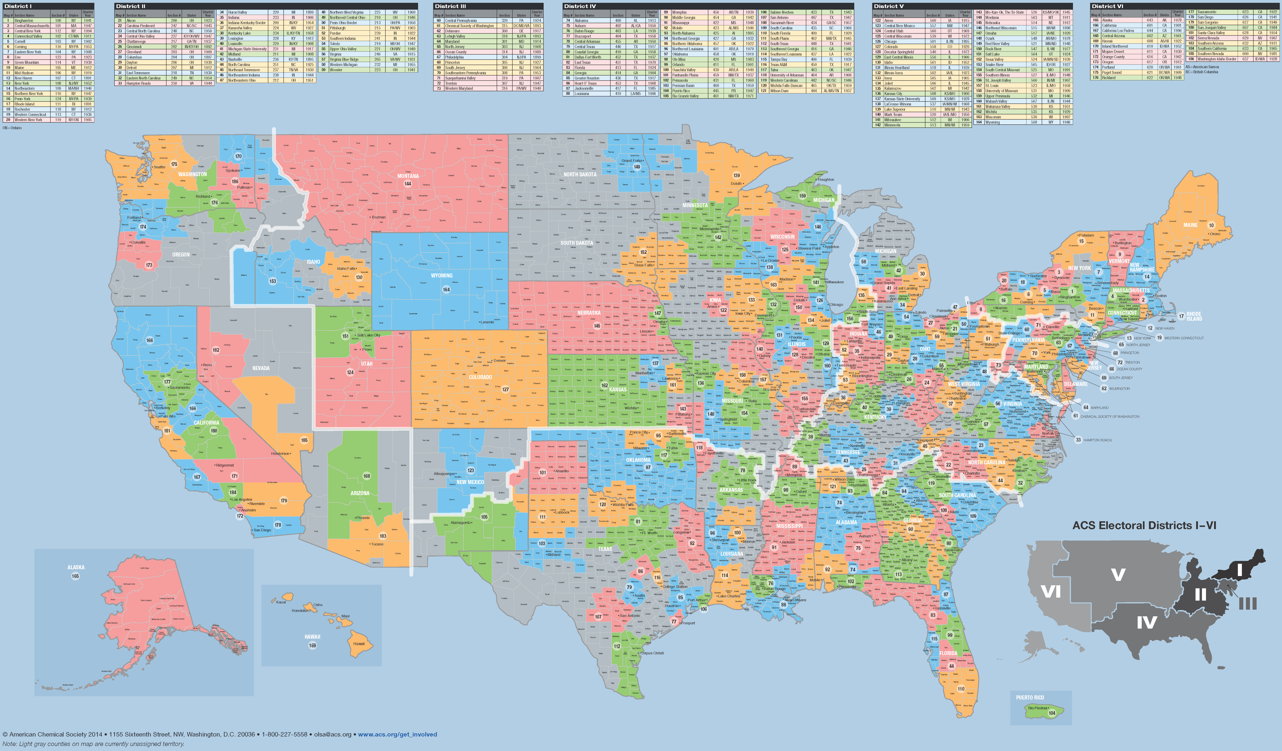
ACS Local Sections: We are EVERYWHERE
Small: 49 Medium Large: 22
Medium Small: 46 Large: 14
Medium: 46 Very Large: 7
Notes:
Highlight the depth and breadth of the sections and how they help ACS to achieve its six strategic goals.

Slide 9
LOCAL SECTION TIDBITS
184 local sections
Smallest: Penn-York
Largest: Northeastern
First local section: Rhode Island (1891)
Youngest local section: Snake River (2007)
Number of sections celebrating milestone anniversaries in 2015:
  100 years: Ames, Virginia
  75 years: Western Maryland
  50 years: Southern Illinois

Slide 10
ACS LOCAL SECTION REQUIREMENTS
  Submit an Annual Report
    February 15th
    Annual Reports are submitted using FORMS (www.acs.org/forms)
    Administration and Financial forms are required
    Event forms are highly recommended
      provide documentation of section activities!
    Event forms are required for awards
    Hold annual elections
      Review your section’s Bylaws for specific processes, dates, etc. for your section
      Report the election results to ACS by December 1st

Slide 11
Local Section Leadership
Lucy Eubanks, Subcommittee Chair TTO

Slide 12
SECTION CHAIR IS A MANAGER
Good training for
  running a research group
  managing a lab
  leading a department
  operating a company
  becoming a governor or president
Build your team by
  creating an executive board
  matching interests and talents with specific needs
  encouraging succession planning
  fostering a team atmosphere
  providing support and back-up
Notes:
Good management skills for running a family too!

Slide 13
EXECUTIVE BOARD
  People you count on
  Those who vote on key issues
  Where many ideas are developed
  Essential participants in long-range planning
  Are willing leaders and workers
  Encourage other volunteers
  Participate in regular meetings
    Face to face encourages interaction; not always feasible
    Use technology - phone teleconference, Skype, Email

Slide 14
Executive Board
Mix it up!
Seasoned section veterans
Young section members
Representation from academia, industry, government, consultants, and others
Seniors and retirees
Underrepresented groups
Former section officers – consider if appropriate
Notes:
Roles for each member of the Executive Committee should be outlined in the section’s Bylaws.

Slide 15
ANNUAL BUDGET
  Sets policies and match with goals
  Provides useful guidance for section
  Shows what is needed to run the section
  Identifies projected income and expenses
  Indicates resources available for programs
  Helps ensure that the minimum treasury requirements are met
  Enables trend comparisons from previous years
Notes:
Guidelines for what programs you are going to do. This should be set in the fall to guide your plans for the upcoming year.

Slide 16
Budgeting - Income
Annual allotment (after Annual Report is submitted by Feb 15)
Voluntary local section dues
Councilor and Alternate Councilor reimbursement
Grants (See www.acs.org/getinvolved for ideas)
Sponsorships
  General for year
  Specific for an event
Shared costs with other groups
Donations
Interest on bank accounts or investments (well….)
Notes:
Budgets are included in your annual report in FORMS.

Slide 17
Budgeting - Expenses
Agreed upon by Executive Board
Guided by policies, matched with goals
Deliver value for intended audience
  Community activity
  Member activity
  Student activity
Modify budget as needed, with appropriate justification
Quick tip: Free food without purpose usually not wise
Notes:
This is where a strategic plan is helpful – good to look at ACS Strategic Plan as well.
A big expense that does not move you towards achieving your LS or ACS goals is not desirable.

Slide 18
ELECTIONS
Start early!
Form Nominations and Elections Committee
Check Bylaws for all requirements
Ease process with succession planning
Use personal contacts to encourage willing nominees – general announcements not usually productive
Start early!
Notes:
Must review Bylaws to determine when the elections should occur, when the slate of candidates should be finalized. The Bylaws dictate the election process. When and how (mail or electronic).
Every section should have a process for people to be nominated using petitions.
If conducting electronic elections, the section must ensure that those without email receive a ballot.

Slide 19
ELECTIONS
Every member needs opportunity to vote
Encourage participation in voting process
Provide members with biographies of candidates
Include a picture with ballot bios
Conduct vote by means consistent with Bylaws
Notify successful and unsuccessful nominees
Certify and announce results to members
Report results to ACS by deadline of Dec 1
Notes:
Make the election process valid and meaningful for your members.

Slide 20
MEETINGS
Your section’s uniqueness is important here
Choices
  monthly, quarterly?
  with dinner?
  at restaurant with charge?
  snacks paid for by section?
  at local university?
  partner with other organizations?
Talks
  technical, general science, pop science, non-science?
  subgroups
ACS Resources for Meetings
  ACS Online Speaker Directory
  ACS Webinars (Thursdays)
  LSAC-sponsored grants
  National Meeting Recorded Content
Notes:
Will consider options more in the Planning Successful Activities Workshop.

Slide 21
MEETINGS
Convenience is critical
  Consider required travel time
  Publicize options for travel
  Plan for adequate free parking
  Choose varied meeting locations
  Consider planning the same program in different locations
  Diversify programming to match the range of member interests
Consider lessons learned from previous meetings
  Review Annual Report from previous year on FORMS.
Notes:
All volunteers (and most members) are busy folks – make your meetings ”user-friendly”.

Slide 22
ACS Resources for Local Section Meeting Content
Online Speaker Directory (speakers@acs.org)
  Contains speakers that have been vetted by LSAC
ACS Webinars (acswebinars@acs.org)
  Held each Thursday at 2pm and are archived
  Archive is available to ACS members, only
Presentations on Demand (POD@acs.org)
  Recorded national meeting presentations available to ACS Members, only
Notes:
Check resources – you don’t have to do it alone!
Martin will talk more about resources in the next section, including www.acs.org/getinvolved

Slide 23
EVENTS
  Annual Meeting (check Bylaws for requirements)
  Chemists Celebrate Earth Day
    April 22nd of each year
  National Chemistry Week
    Held the fourth week of October annually
  Awards dinner
  50/60/70 year member award presentations
  Annual symposium with theme
  Public Outreach Events
Notes:
Just some of the possible ideas…

Slide 24
ACTIVITIES
Advocacy
Student/member interactions
Networking/social events
Organized trips
  museums
  sports events
  wine tasting
  whale watching

Slide 25
SUMMARY – “LOCAL SECTION LEADERSHIP”
Executive Board
Budgeting
Elections
Meetings
Events
Activities
Notes:
Reviewing what we’ve done…and next is Martin talking about communication and more on resources.

Slide 26
Local Section Communications and ACS Resources
Martin Rudd, Chair LSAC

Slide 27
COMMUNICATION
Executive Board
Local Section Members
Public
Other Professional Groups/Companies
ACS National
Notes:
You can develop specific strategies for different constituents. I’ll talk about the executive board and local section members

Slide 28
ACS RESOURCES: eROSTERS
Three Files
  Local Section Roster
    (Name, Addresses, Email, Demographic Data)
  Activity Report
    (Address Changes, New/Deceased Members, etc.)
  Demographic Report
    (Age, Years of Service, Education, Gender…)
Updated Monthly/Email Notification
Demo During ACS Resource Fair Saturday
You will be given access to your eRoster by January 24th and will soon begin receiving communications about using the Roster

Slide 29
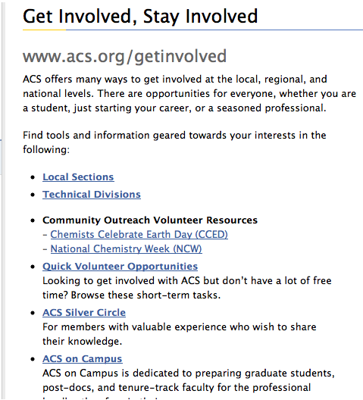
OTHER ACS RESOURCES
Use the ACS FREE service—Webs.com—to develop a website
Visit www.acs.org/getinvolved (great page to bookmark )
Visit the ACS Network (Volunteer Support and Engagement)

Slide 30
OBTAINING HELP:
Email lsac@acs.org or olsa@acs.org
LSAC members
ACS Staff
Notes:
Thank people for being part of this webinar. If we invite 2015 officers to this pre-LI webinar, this is where they leave.
Possibility of having two different endings – one for the newbies, one for those reviewing the presentation?

Slide 31
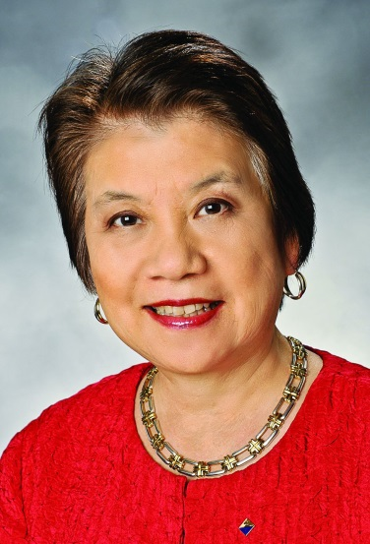


Partners for
Progress and Prosperity
Awards
Dr. Marinda Li Wu
2014 ACS Immediate Past President

Slide 32
Partners for Progress & Prosperity (P3) Award
Purpose & Funding
To recognize successful and exemplary partnerships resulting in impactful outcomes between
  industry
  academia
  government
  small business
  other domestic or overseas entities (e.g., local sections, international ACS chapters, ACS divisions, chemical or other professional societies)
Seed funding from 2014 Immediate Past President Marinda Li Wu’s budget
Notes:
These are the two goals we are trying to accomplish. We’ll share with you today 6 ideas for consideration.

Slide 33
Partners for Progress & Prosperity (P3) Award
Eligible Award Categories
Improving the public perception and appreciation for chemistry
Promoting career advancement opportunities and/or supporting entrepreneurship in the chemistry enterprise
Advancing advocacy efforts government and other thought leaders’
Supporting STEM education and/or research
Notes:
These are the two goals we are trying to accomplish. We’ll share with you today 6 ideas for consideration.

Slide 34
Partners for Progress & Prosperity (P3) Award
Award Nature & Selection Process - Domestic
Local section award
  Selected by each local section
  P3 Salute to Excellence
Regional award (local section winners eligible)
  P3 silver/gold medallion & certificate of recognition for each partner, up to a maximum of $1K split equally among the partners
  Regional awards committee will select recipient
Notes:
These are the two goals we are trying to accomplish. We’ll share with you today 6 ideas for consideration.

Slide 35

Let’s Partner for
Progress & Prosperity!
Need your help and support
  Publicize new P3 award
  Solicit nominations
Thank you!
m.wu@acs.org
Notes:
These are the two goals we are trying to accomplish. We’ll share with you today 6 ideas for consideration.

Slide 36
Leadership Institute Goals
Martin Rudd , 2015 LSAC Chair
Pre-Leadership Institute Webinar: Preparing You to be a Successful Chair/Officer

Slide 37
2015 LEADERSHIP INSTITUTE GOALS
The goal of the 2015 Leadership Institute is to support and enhance the creation of ACS leaders. Attendees will have the opportunity to:
Learn the responsibilities of a new volunteer role
Share best practices
Develop leadership and management skills
Engage with other attendees to foster new peer-to-peer networks
Notes:
Check to see if these are the same LI goals for 2014 (copied from 2013)

Slide 38
2015 LOCAL SECTION TRACK GOALS
Provide local section chair-elects and leaders with
  tools and resources to be successful
  provide examples of successful activities
  an opportunity to generate ideas about an activity and develop it
  instruction on using social networking in your local section
  how to obtain help and what grants are available
  a forum to connect with other local sections leaders
  a venue to discuss common concerns and how to measure your successes
  networking opportunities to identify and evaluate best practices from other section leaders and ACS staff
Notes:
- tools and resource opportunities to be successful
examples of projects that work,
time to develop initial plans for programs, and
practice planning activities; ideas to take home for further development
a forum for local section officers to connect with ACS volunteers from their neighboring local sections
a venue to discuss and address common concerns and successes
networking opportunities to identify and evaluate best practices from other section leaders and ACS staff

Slide 39
Events During the Leadership Institute
Local Section Track Starts at 1:30 PM Friday afternoon!
  FRIDAY
    Get Acquainted/Network with Sections in Your Region: Team Project (starts at 1:30 PM!)
    LSAC Welcome and Introduction
    Workshops (smaller group activities):
    Share Your Story
    SATURDAY
      Leadership Development System Course –homework for the Engaging and Motivating Volunteers course—Volunteer Motivational Factors inventory sheet
      ACS Resource Fair
      SUNDAY
        Team Project: Pulling It Together
        Collaborative Projects Report
        Town Hall Meeting
Everyone: | 2 out of 3:
Planning Successful Activities (90 min.) | Funding (40 min.) Social Media Strategies (40 min.) Communicating with Your Members (40 min.)

Slide 40
YOUR HOMEWORK
BE PREPARED for the Leadership Institute
  Bring an event idea to the Leadership Institute
    One that you are considering for your year as chair; or,
    Think of an activity/event that could be planned in collaboration with neighboring local sections. Identify past regional/joint/collaborative events/activities to share with your colleagues.

Slide 41
Thank You for Participating!
2015 Pre-Leadership Institute Webinar: Leading Your ACS Local Section
Additional Questions?
Martin Rudd, Chair LSAC
Lucy Eubanks, Subcommittee Chair TTO
Notes:
.

