Slide 1
Communicating with the Public about ACS Local Section Events
Presented by:
Jennifer Maclachlan, Northeastern Section
Regina (Gina) Malczewski, Midland Section
Alexa Serfis, St. Louis Section
Additional Comments by:
Martin Rudd, Chair LSAC, Northeast Wisconsin
Section
David Gottfried, Chair CPRC, Georgia Section

Slide 2
Traditional Methods of Communication to the Public
Alexa Serfis, St. Louis Section
By: Jennifer Maclachlan

Slide 3
Communicating about Your Event to the Public: Benefits
Generate attendance
Become better known in the community
Demonstrate chemistry’s relevancy
Encourage youngsters to study chemistry
Attract new members
Energize current members
Spark partnerships with other groups
Help the public learn about the
good work of chemists
Notes:
The most immediate result of communicating with the public about a LS event like NCW, or CCED for example, will be that people learn about our activities and they show up! But that’s just the first of several potential benefits for the LS. When chemists mix with the community, we become better known, which can lead to partnerships with other organizations, the public gains a better understanding of chemistry’s vital role in society, young people may discover a love of science, and our own members can be re-energized. You may even attract new people to the section.

Slide 4
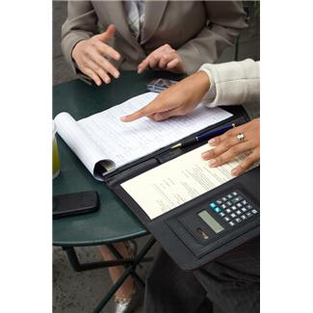
You gotta have a plan
Traditional News Media
Social Media
Working with other groups
Notes:
But nothing comes without planning, and planning early. Your plan should include all the components we’re going to discuss today—traditional and social media, and working with other groups.

Slide 5
Traditional News Media
Who are they?
Newspapers
  print and .com
  large city and community
  daily and weekly
Radio
TV—on air and/or webpage
Make list of all news outlets that might be interested in your event
  Enlist help of university, museum, corp., or ACS Office of Public Affairs: 202-872-6229
Lead times—3 weeks and again a few days ahead
Notes:
In this first session of the webinar, I’m going to focus on some key steps that involve getting the word out through traditional media. I’ve made a list of what those outlets are, just so none are overlooked. When you make a list for your own events, you may need help identifying the right people at each outlet. If you work at a university ask the public information office if they can give you some advice, or even share their list. If you are having the event at museum, they’ll almost always be willing to help you with the publicity. If you work at a company, they may be able to assist as well. One place you can always call, though, is the ACS Office of Public Affairs. With a little lead time and they can pull a media list for any location and advise you on all the things I’m going to cover.
[Let’s go back for a minute to this list. When you think of the newspapers that serve the area where your event will be, don’t overlook the smaller papers. They may be the weeklies. They are very open to covering local events, they usually have a calendar section, but they need to hear from you well in advance if they only publish once a week. Generally three weeks in advance is when you want to send an email to your media list, telling them about the event. Then follow up with a reminder a few days to a week ahead.]

Slide 6
Traditional News Media
How they might cover your event
In advance of the event:
Article or Calendar listing—online or in print. Check websites of newspapers, radio and TV. You may be able to enter the info yourself.
Radio Public Service Announcement
At the event:
Reporters could be on the scene, reporting live with microphone and/or TV camera, or tweeting on social media. Be prepared to help them, introduce them to your spokesperson, offer good photo opps.
After the event:
- There could be a story on that evening’s TV news, the newspaper next day or next weekend.
Notes:
The small papers on your list, or weeklies as they’re often called, usually have calendar sections. Of course that’s a great way to get attention before the event. In fact the websites of all the media on your list may have a calendar section. Definitely take a look. Many times they will allow you to enter the details of your event. It’s fast and easy, and you can be sure that what appears is accurate, because you’re entering it! The earlier you can get your information posted, the greater the number of people who will potentially see it.
The other option, for coverage ahead of time, is that the paper would write a short article to alert readers to the event.
It’s possible that reporters may come to your event. They could be gathering information and interviews to write up for the next day, or they could be reporting live—on radio or TV, or social media. You want to be prepared to make their job as easy as possible. Have a spokesperson from your LS identified in advance—someone who is articulate and excited about the event. Someone who will be there, and who knows the details. Know where you can find this person quickly, in case a reporter does show up. And think ahead of time about what the best photo opps will be. Will kids be doing hands on experiments? Will someone be doing chemistry demonstrations? TV must have “visuals,” and newspapers like to have an interesting photo to run alongside a story. Even Radio can use photos online, and the excitement that comes from something like demos gives them great “audio” for their stories.
If a reporter does come, don’t hesitate to ask him or her when their story will run. It might be several days later or it might be on TV that night. And ALWAYS thank them for coming out and exchange business cards!

Slide 7
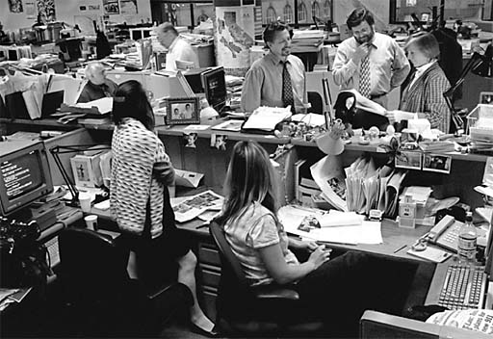
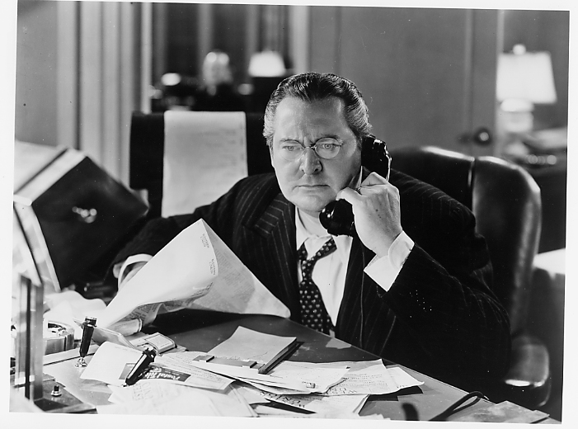

Traditional News Media
How to reach them?
Reporters are busy!
Notes:
So HOW exactly are you going to GET the news media to take notice of your event, so you will have stories before, during and afterwards? Well, you need to be able to boil down the information to the essential facts. Just like all of us, they are very busy with a lot of people and a lot of events competing for their attention.

Slide 8
Traditional News Media
How to reach them
News Release
The 5 W’s and Inverted Pyramid
Who Lead
What
Where O
When D
Why I
and sometimes How
Order of Descending Importance
Notes:
The most common tool for telling reporters about an upcoming event is a news release. It’s usually one page and answers the basic questions, or 5 Ws: Who, What, Where, When and Why. It’s important to get to the point, with the most important information at the top.

Slide 9
News Release
[Section name] Section, American Chemical Society
For immediate release [Date release issued]
Contacts: Name of contact – 800-123-4567; Name of contact – 800-123-4567
Free pizza and a slice of chemistry
Free pizza will be on the menu at Big Mama’s Pizza Parlor, Sunday, May 5, between 3:00–4:00 p.m. during a special public event sponsored by the Woe
Be-Gone Section of the American Chemical Society.
Jack Pepper, one of the country’s leading experts on cheese, will be on hand to discuss what consumers should look for when shopping for top
quality cheeses among the many different varieties. Pepper is a research chemist with the U.S. Department of Agriculture and specializes in investigating
the chemistry of dairy products. He has helped develop a low-fat Mozzarella cheese for the National School Lunch Program and devise methods for
detecting mislabeled cheese for U. S. Customs.
The event, “A Slice of Chemistry,” is part of the Science Café public outreach program organized by the Woe-Be-Gone Section. The program is designed to
demonstrate the relevance and importance of chemistry in everyday life in simple, non-technical language.
Seating and free pizza are limited to 50 people. No reservations are available. Seating is first-come, first-served.
Visit www.acs.org/woe-be-gone/cafe for more information.
###
The Woe-Be-Gone section is one of 187 local sections of the American Chemical Society, the world’s largest scientific society, with more than 163,000 members.
Chartered by the U.S. Congress, the nonprofit organization is a global leader in providing access to chemistry-related research and educational resources.
(Name of section), American Chemical Society
Section address T [123] 123 4567 F [123] 123 4567 Web site url
Notes:
Here’s an example. The title will grab the reader, and most of the information is in the first sentence. But it’s concise. “Free pizza will be on the menu at Big Mama’s Pizza Parlor…” You can find a whole collection of sample news releases at the ACS Chemistry Ambassadors website.

Slide 10
Traditional News Media
Sample news releases
www.acs.org/prguidebook
Notes:
Here is the shortcut URL

Slide 11
Traditional News Media
How to Avoid a Bad News Release
Be concise.
Keep it simple. Avoid science jargon. Use everyday words and phrases.
Be accurate. Spell correctly.
Eliminate acronyms.
Notes:
The best releases also follow these rules, which is advice directly from a reporter.

Slide 12

Traditional News Media
To call or not to call?
Things to know before you call a reporter:
    ̶ What you have to offer
    ̶ Why the reporter should be interested in your story
    ̶ Some knowledge about the particular reporter you are calling
    ̶ Reporters work under extreme deadline pressures (so be brief)
    ̶ They want news of interest to their readers, viewers, listeners
Notes:
Often it’s not sufficient to just email a reporter a news release or a simple message with the facts. You need to call them. But think it through before you pick up the phone. Have all the information at your fingertips. Know what you have to offer and be clear about what’s in it for their readers, viewers or listeners. It’s always nice to start with “are you on deadline,” and then if they say no, you’re free to introduce yourself and explain why you’re calling.
Reporters at large city outlets may be less available for a call. You really just need to give it a try and ask their preference.

Slide 13

Traditional News Media
What if no reporters show an interest?
Take photos at the event and write up simple captions to describe what’s going on.
Offer them to the news media—smaller, weekly papers are more likely than others to accept your offer.
Even if they don’t want them, you can post them on your website or on social media
Notes:
When you’ve done your best to get the word to all the right people, well in advance, you’ve reminded them, you’ve prepared for them, but they s
still don’t respond or come to the event, it can be discouraging. But you can have something of an ‘insurance plan.’ Take photos at the event…
Take questions next or segue to Social Media.

Slide 14
Social Media and the Local Section
Jennifer Maclachlan, Northeastern Section

Slide 15



Local Sections and Social Media
How a Local Section implements a social media strategy will depend on what they are currently doing to promote local section activities
Utilizing social media should increase the circulation of existing methods to “get the word out” but not replace these mechanisms

Slide 16

Local Sections: Getting Started with Social Media
It is critical to have a social strategy
The Local Section is a representative of the American Chemical Society
A rubric needs to be developed of what Local Section administrators will post
Maintaining both professionalism and a consistent voice across all social media platforms is important

Slide 17

Crafting the Local Section Social Media Strategy
Choose the social media platform that you confident using
Develop your Local Section brand and stay consistent across the various social media platforms using your Local Section web site, emails, newsletters etc. to source content from
Set up admins-Note that in order for the “voice” of the Local Section to “sound” consistent it is a best practice to have a primary administrator. Have a secondary administrator to post time-sensitive information in the event the administrator is unavailable
Create your rubric by making a list for yourself and your admin(s) of what IS and what IS NOT acceptable to post on social media

Slide 18


Crafting the Local Section Social Media Strategy
Use short cuts like posting to several networks at once from one console-the one that you are the most comfortable working in. You can use third party clients like Hootsuite
or Social Oomph or you can simply link Facebook to
Twitter and vice versa
6. Set goals for frequency
While social media is an effective marketing & Local Section branding tool, it is NOT just about self-promotion or content creation. It’s about sharing information that has value to your members/followers/fans

Slide 19
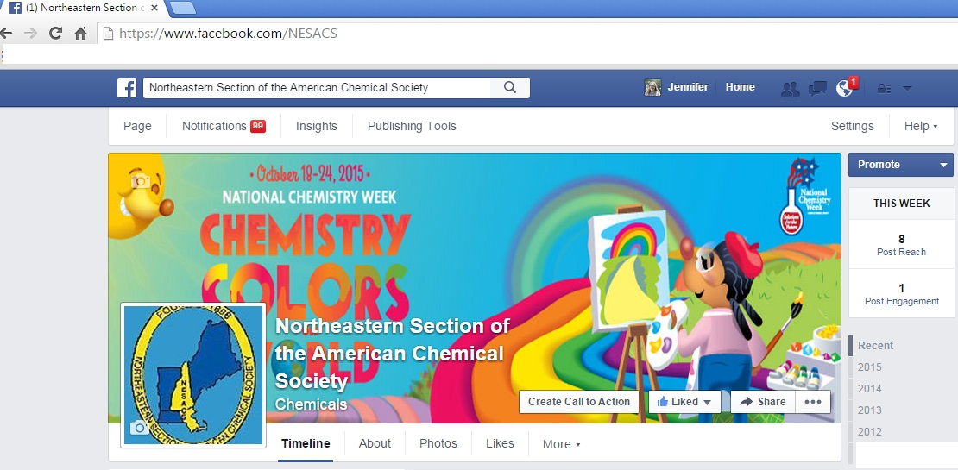
Local Sections: Facebook
For Facebook for the Local Section, it’s best to setup your page as a business or community page rather than a group page and to name it using a customized URL so members and interested people can find you easily on Facebook

Slide 20
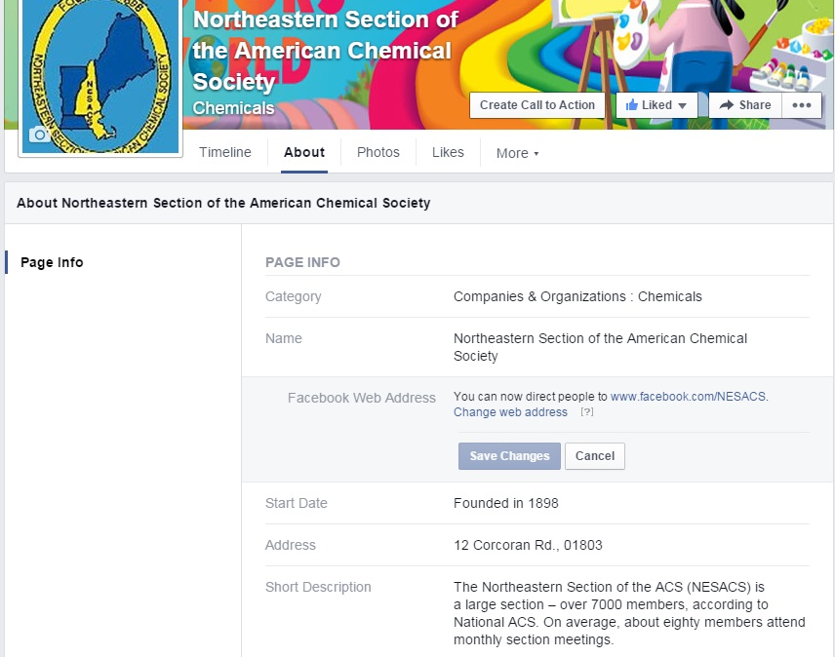
Local Sections: Create a Customized Facebook URL

Slide 21

Local Sections: Twitter
We can apply the same nomenclature rules from the customized Facebook URL to the Local Section Twitter handle
What is the local section abbreviation?
Use it as the Twitter handle
Examples of Local Section Twitter handles: @NESACS @RochesterACS @ECI_ACS @MarylandACS @NashvilleACS @ACS_CSW @ACSGHS

Slide 22


What should Local Sections tweet (about)?
Local Section news
Upcoming deadlines and activities

Slide 23

Local Section Public Relations and Social Media
Have the Local Section Public Relations Chair form a Local Section Public Relations Committee
Appoint a social media administrator(s)
Work with your Local Section meeting organizer(s) to promote your event
Use your community partners to help you promote the event
List it in the “community newspapers” or the city newspapers where you self-enter your event online

Slide 24







Local Section Public Relations and Social Media
Use tags and hashtags whenever possible to increase exposure: Tag on Facebook, Twitter, Linked-In, Google+ and more
Do a short write up of the event with event photos
Pin it on a “Communicating Science” or “Chemistry Outreach” board on your Pinterest
This write up can be used for your Local Section Annual Report and ChemLuminary Award self-nomination

Slide 25
Developing Collaborations for Outreach and Other Programs
Gina Malczewski, Midland Section

Slide 26
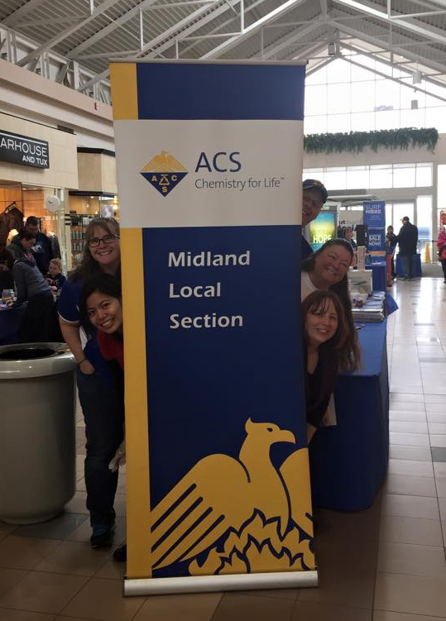
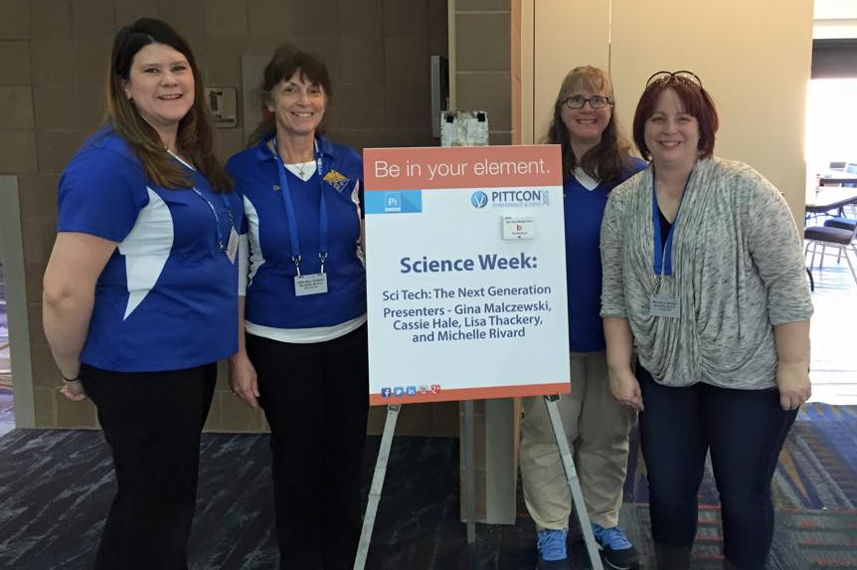
OVERVIEW
What type of collaboration,?
What are areas of overlapping
  interest or unmet need?
Considerations

Slide 27
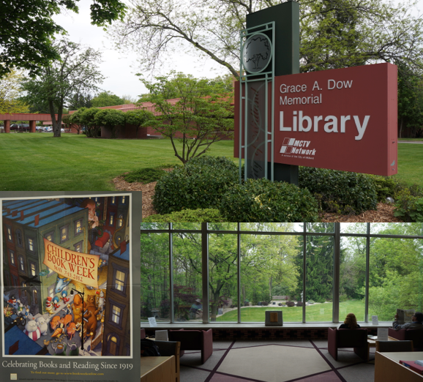
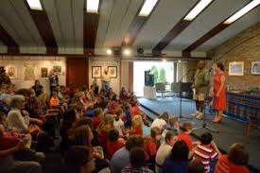
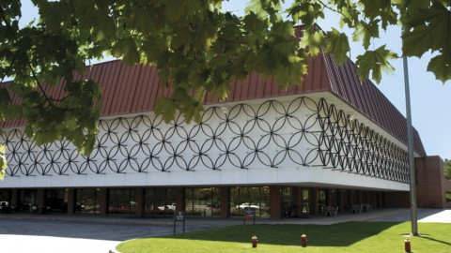
Types of Collaboration
One or the other provides speakers
The collaborator provides a venue
The collaborator provides a support package, including venue, publicity, assistance

Slide 28
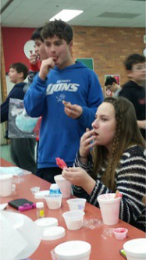
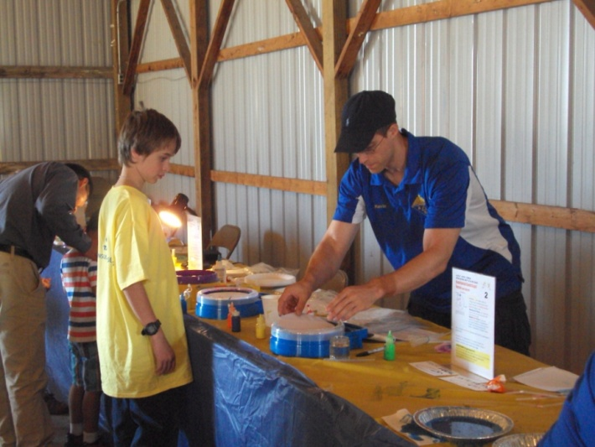
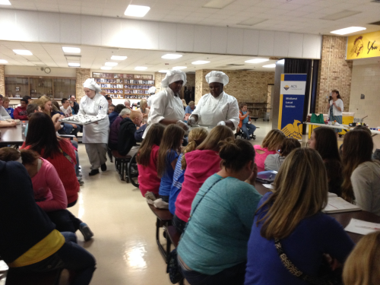
Areas of overlap (continued)
Libraries
  Open-ended
Big Brothers/Big Sisters or After school providers
  Hands-on activities
Community Foundations or large events (malls, fairs) WALK BYs
  Demos
  Hands-on
Individuals
  Science cafes

Slide 29
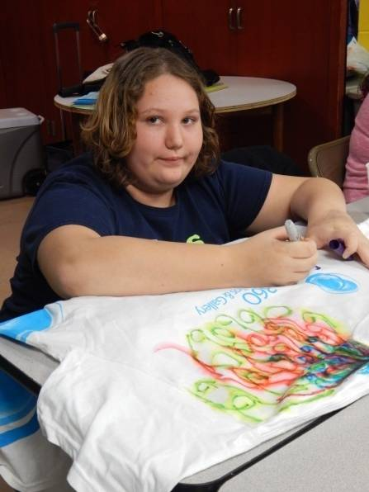
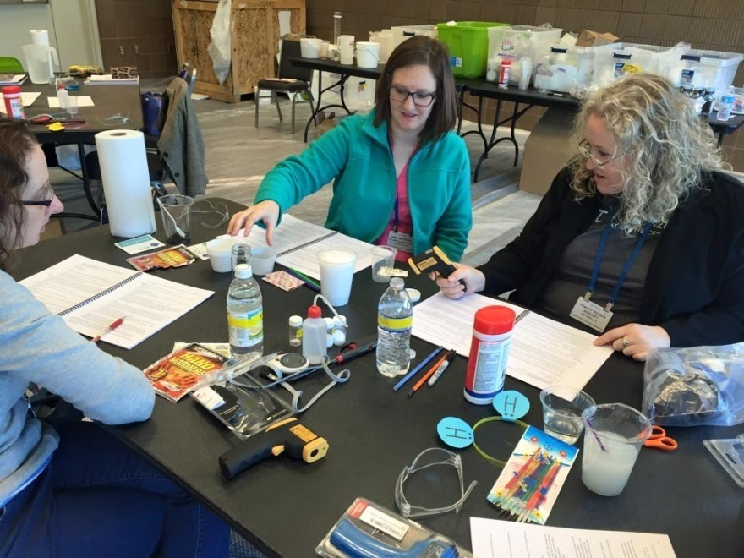
Considerations
Cost
  Schools should be free
  Non-profit fees
  Membership and reduced rates?
  Should you charge?
Insurance (Peggy Jones)
Publicity (can they help?)
  Joint press releases
  Newsletters
  Parent contacts
Themes

Slide 30
SUMMARY
Determine what you need and choose collaborators accordingly (or if they seek you out, what will you get from the relationship?)
Determine cost to do and price to charge
Publicity options
Collaborations are beneficial: can broaden your audience and can save you time, effort and/or money!

Slide 31
Questions?
Thank you for your participation!

