Slide 1
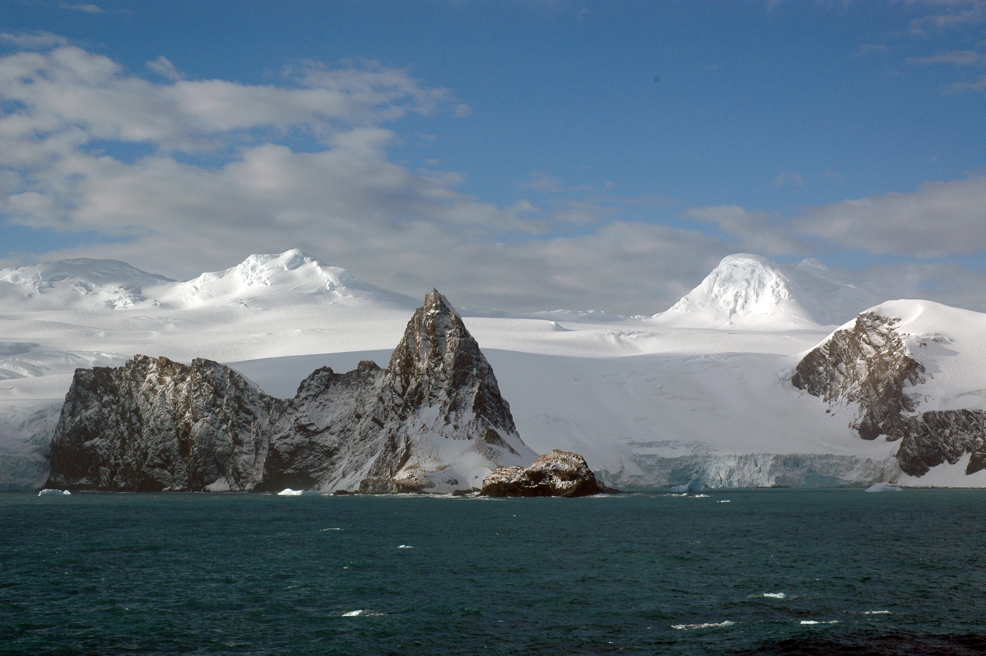
Observed and Anticipated
Climate Change Impacts
James J. McCarthy
Harvard University
23 August 2010

Slide 2
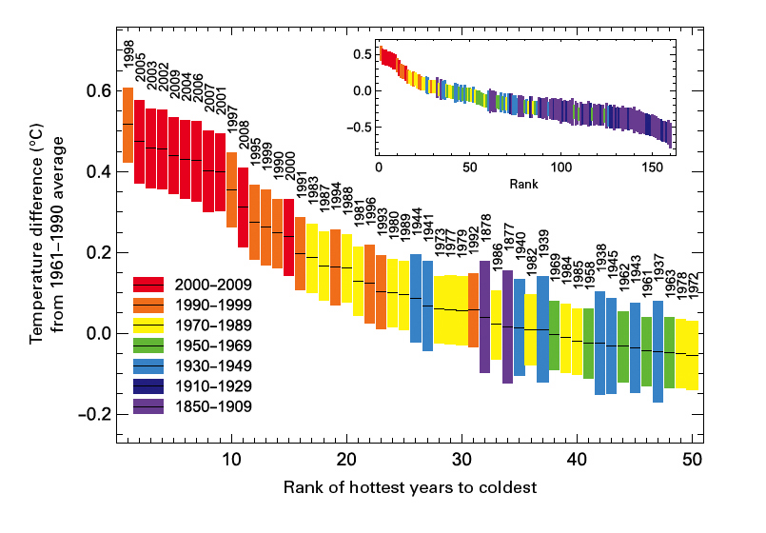
WMO publ #1055, 2010

Slide 3
NYC Average Daily Temperature January – June 2009
NCDC

Slide 4
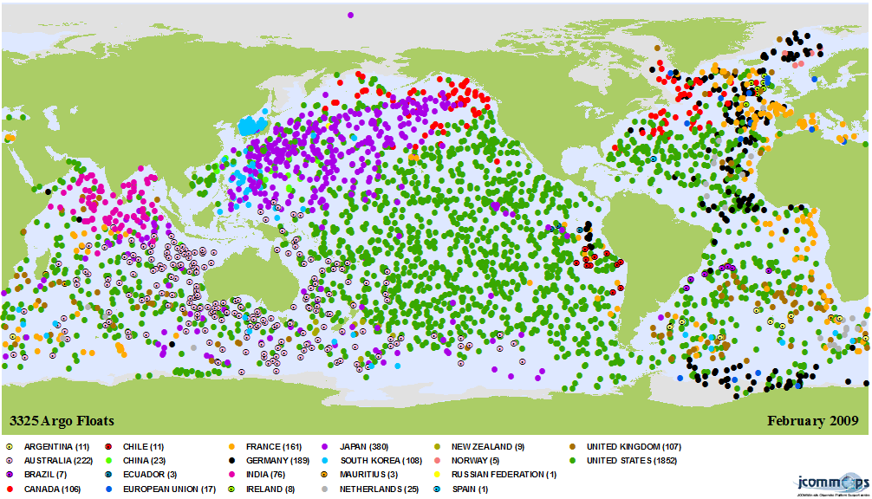
ARGO drifting and profiling instruments
Notes:
Profile upper 2000m every 10 day, 3325 deployed at this time, 22 participating nations

Slide 5
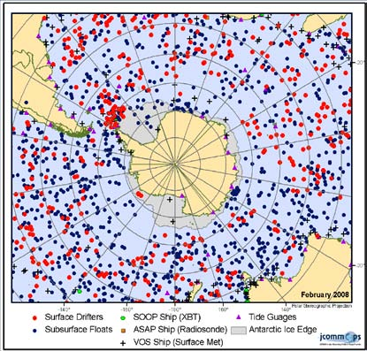
Ocean observing systems February 2008
Notes:
Figure 2.13a Observations available in the Southern Ocean region from JCOMMOPS (as of February 2008).

Slide 6
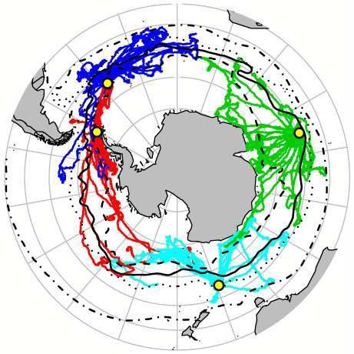
Instruments for Temp and Salinity on Diving Elephant Seals
SCAR 2009
Notes:
300 – 600 m

Slide 7
A warmer Earth will have less ice, less snow
and less frozen ground
• Sea ice is projected to shrink (at different rates) in both
the Arctic and Antarctic under all model simulations.
• There has been a sharp decline in Arctic multi-year sea ice
• Some projections show that by mid century, late-summer
Arctic sea ice will disappear almost entirely.
• Glaciers are shrinking on all continents, and losses of ice
from Greenland and Antarctica have potential to raise sea
level substantially within this century

Slide 8
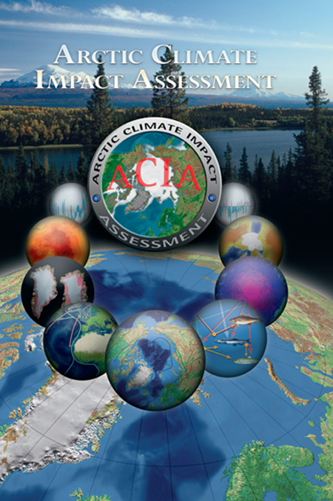
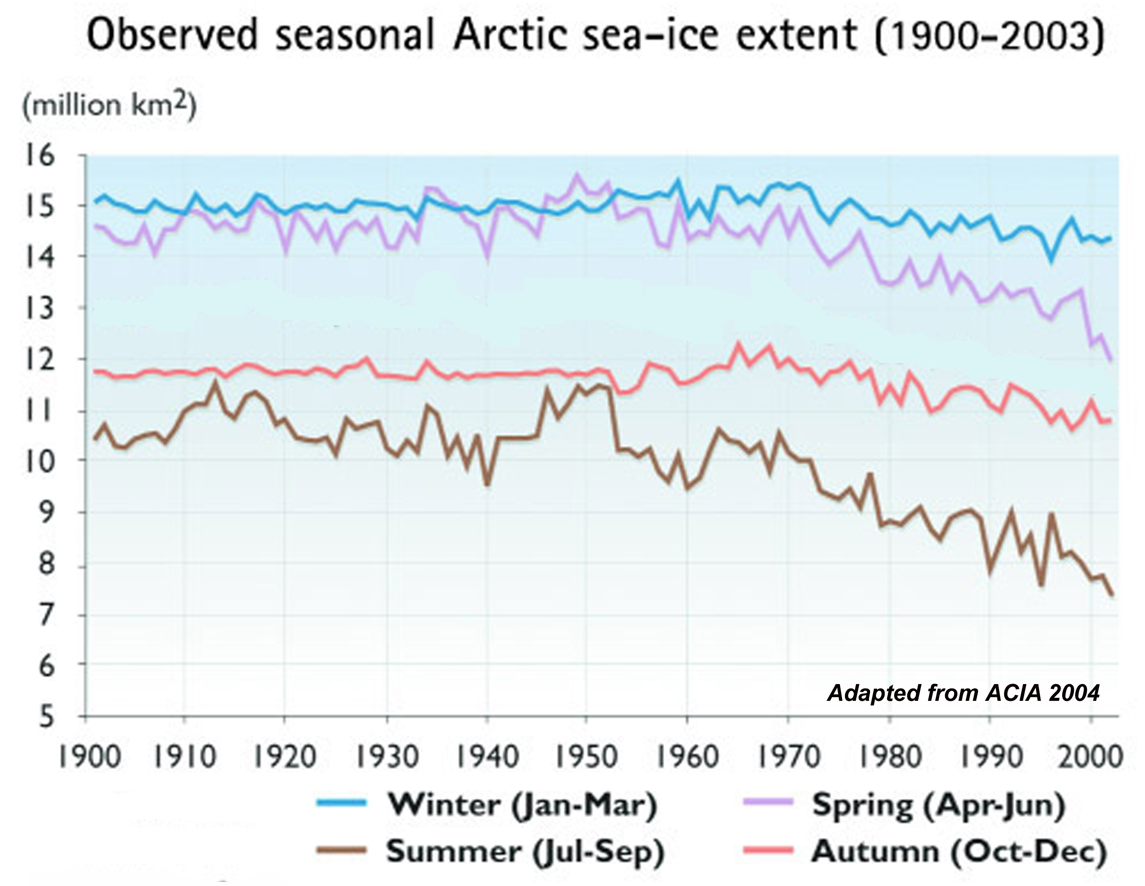
A longer record for Arctic Sea Ice
Decline begins ~ 1950
The Scientific Report

Slide 9
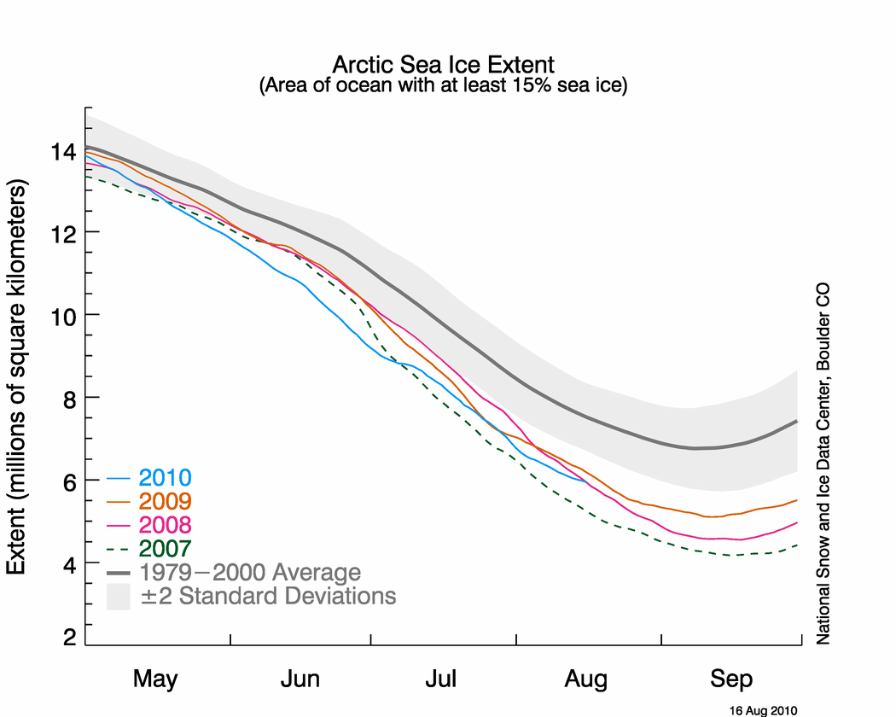

Slide 10
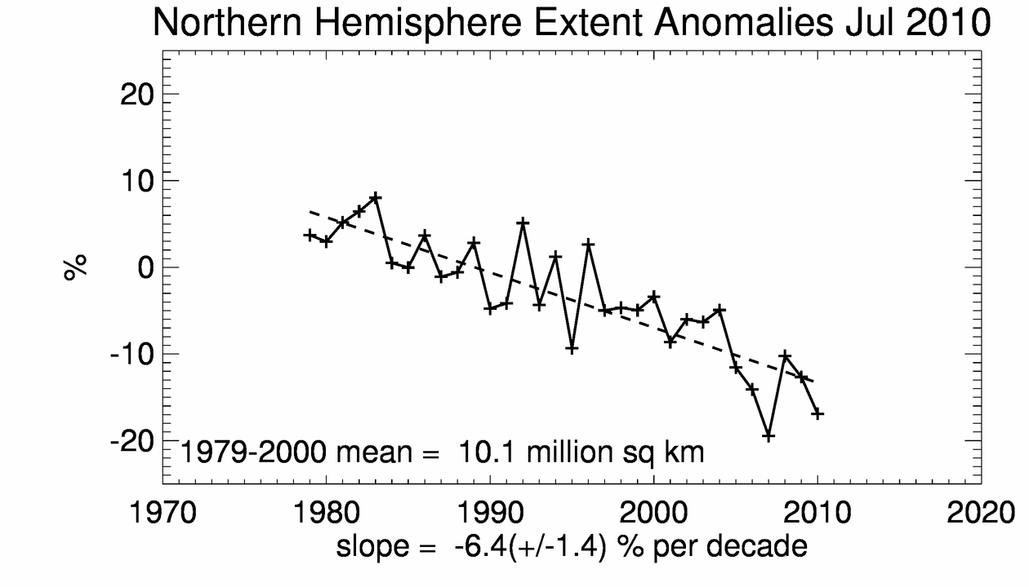
NSIDC

Slide 11
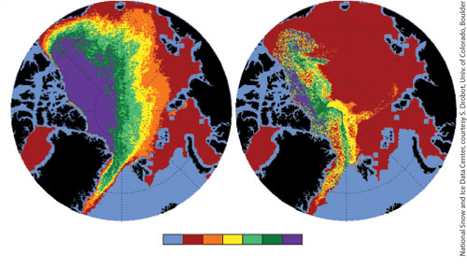
Winter Arctic Sea Ice Conditions
February average conditions
1985 - 2000
February 2008
1 2 3 4 5 6
Sea ice age (yr)
http://www.nasa.gov/topics/earth/features/seaice_conditions_feature.html

Slide 12
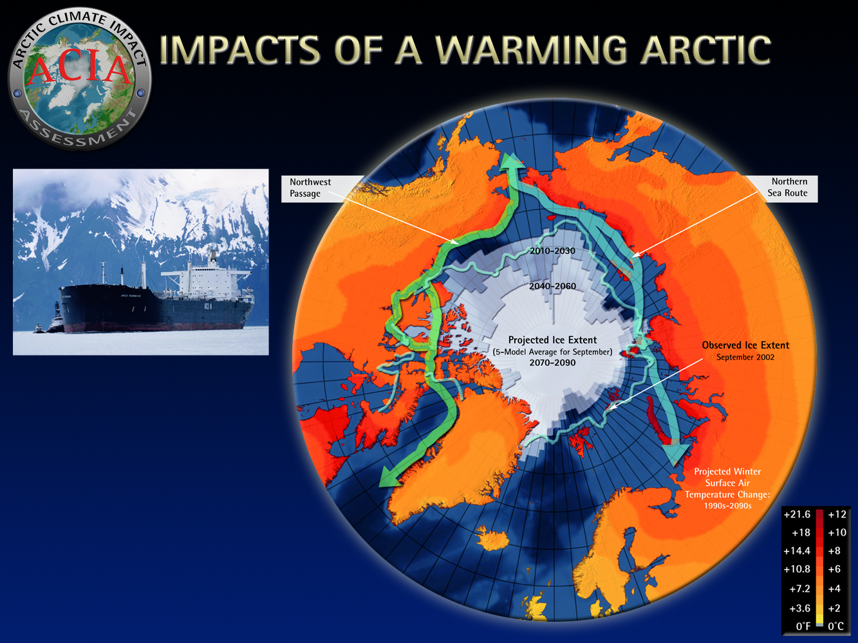

Slide 13
August 2009

Slide 14
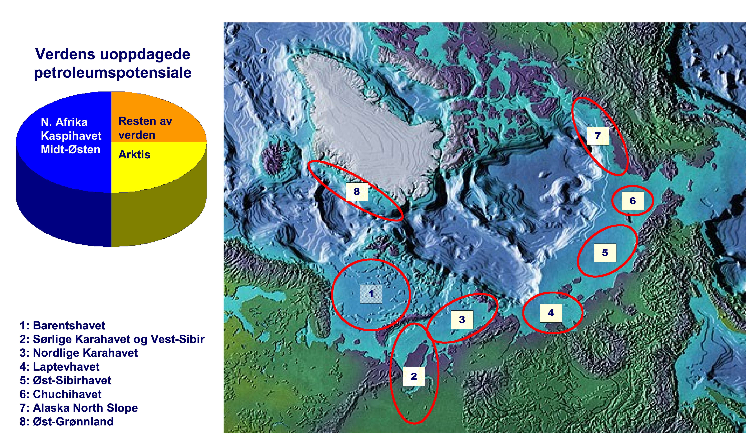
Worlds Petroleum Potential
North Africa, Middle East
Rest of World
Arctic
Barents Sea
Southern Kara Sea and Western Siberia
Northern Kara Sea
Laptev Sea
East Siberian Sea
Chukchi Sea
Alaska North Slope
East Greenland
ACIA
Notes:
Natl Security and Climate Change
Every admiral and general – Navy, Marines, Coast Guard, Army, Air Force…US is disadvantaged in discussions about the future presence in the Arctic because we are not signatories to the Law of the Sea Treaty
Russian ice breakers – now working in summer for oil and gas companies

Slide 15
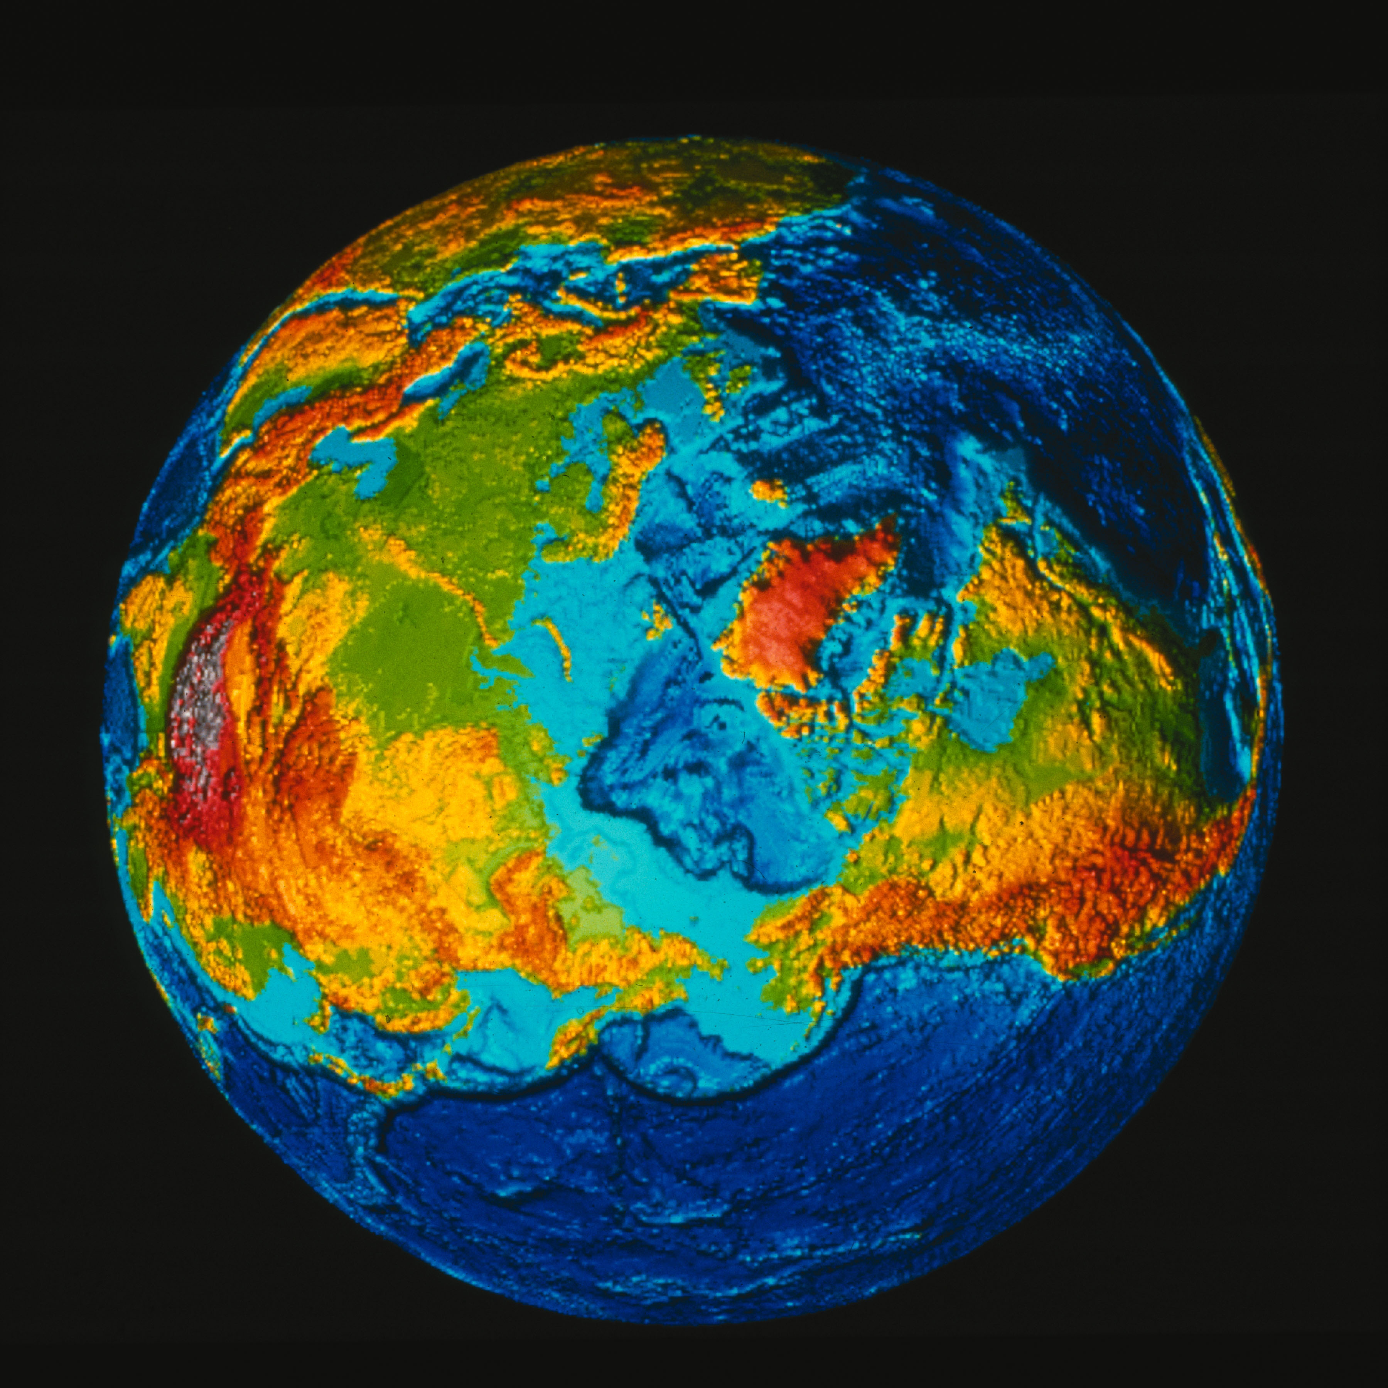

Slide 16
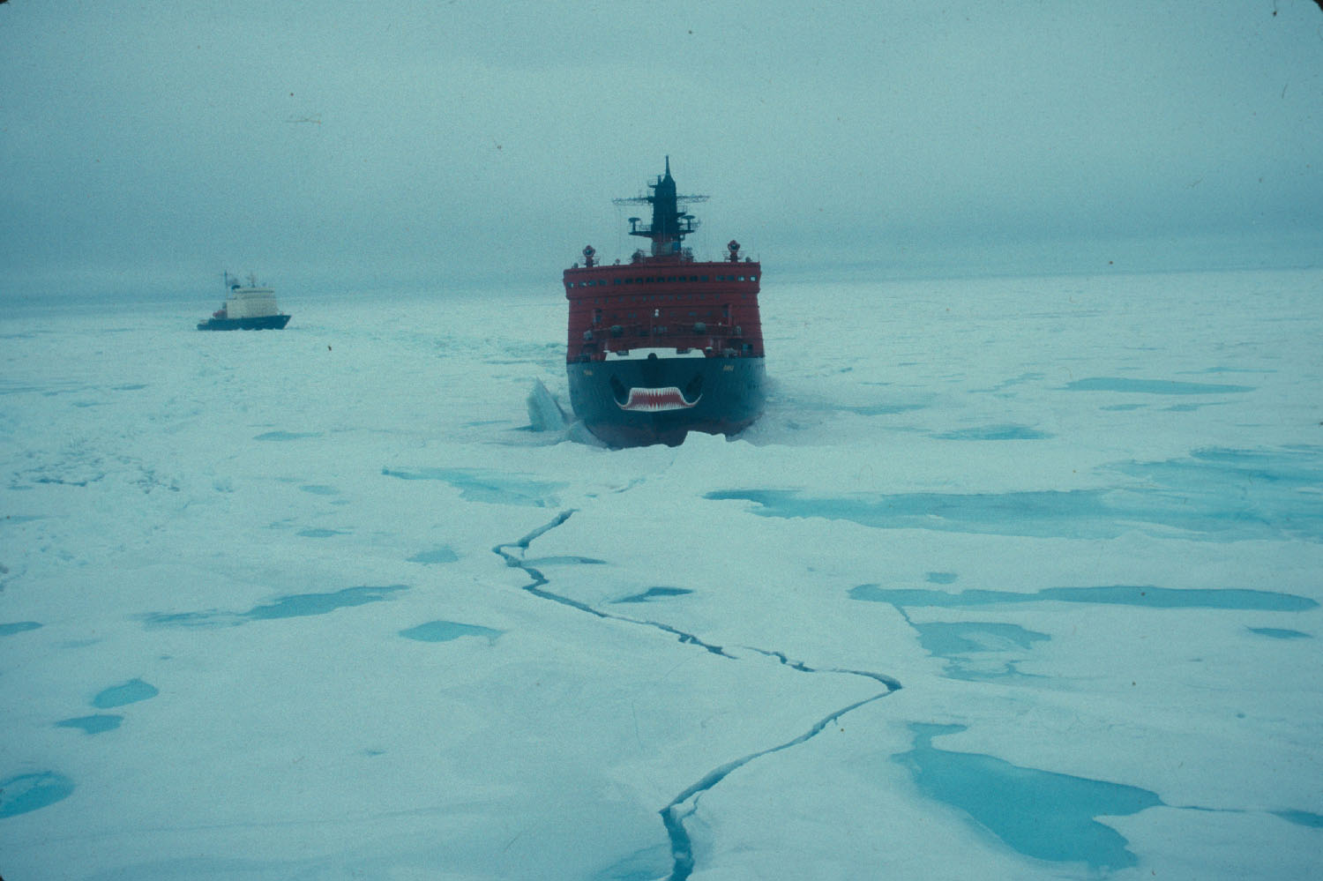
Typical ice in the central Arctic early 1990s

Slide 17
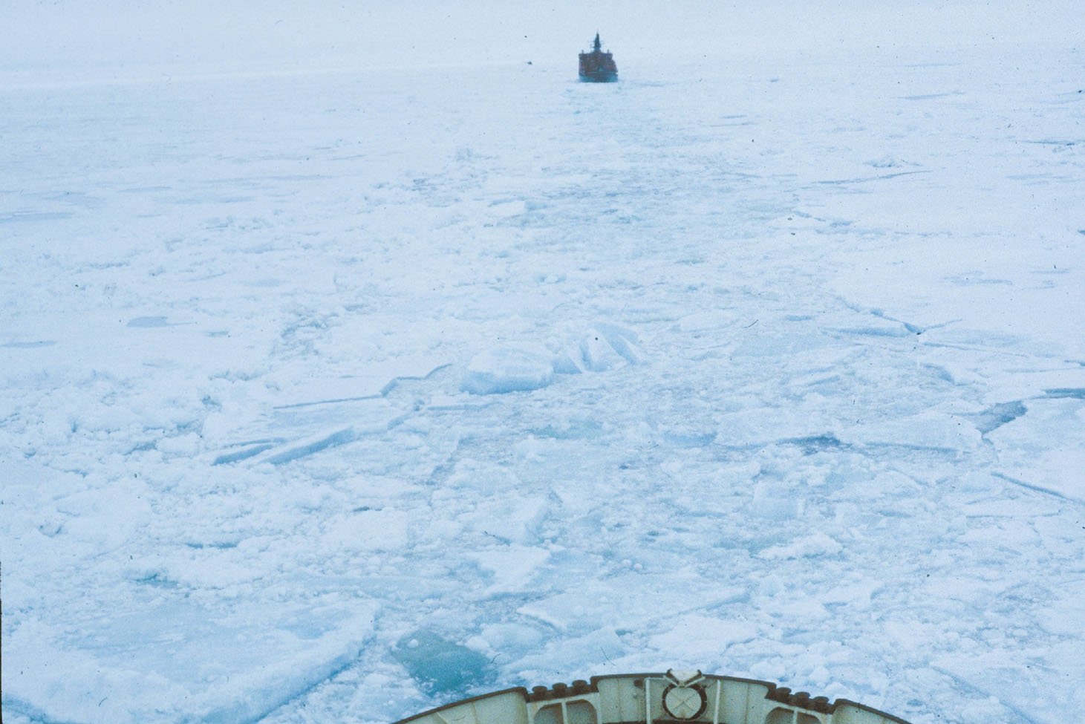
Notes:
Unique marine ecosystem beneath, upon, and within the ice
Barb’s hot spots start within the ice

Slide 18
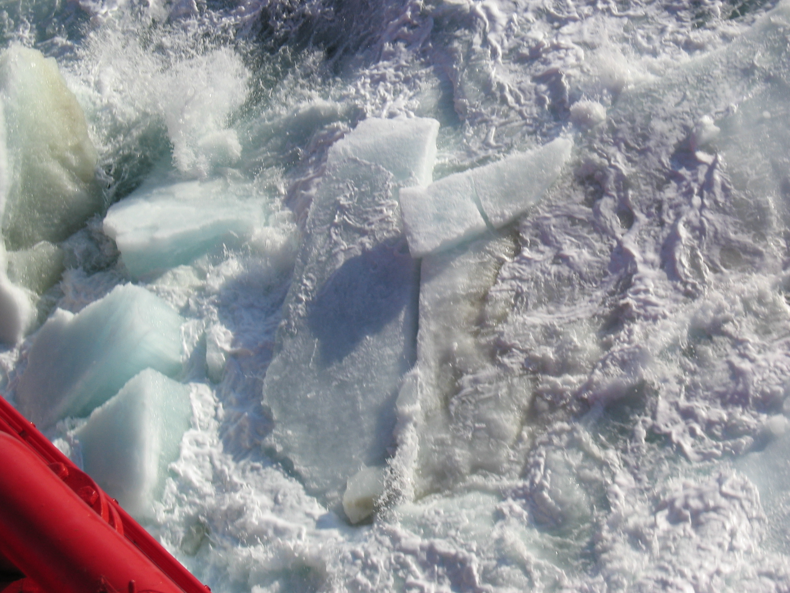

Slide 19
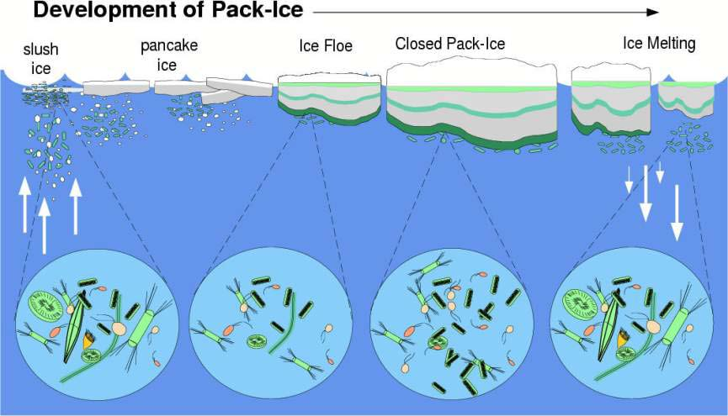
Adapted from Belem (2002)
Notes:
Figure 2.28 Schematic representation of the seasonal cycle of the Antarctic pack ice, with emphasis on important processes of incorporation of biological material and the physical evolution of sea ice until the melting season. Adapted from Belem (2002).

Slide 20
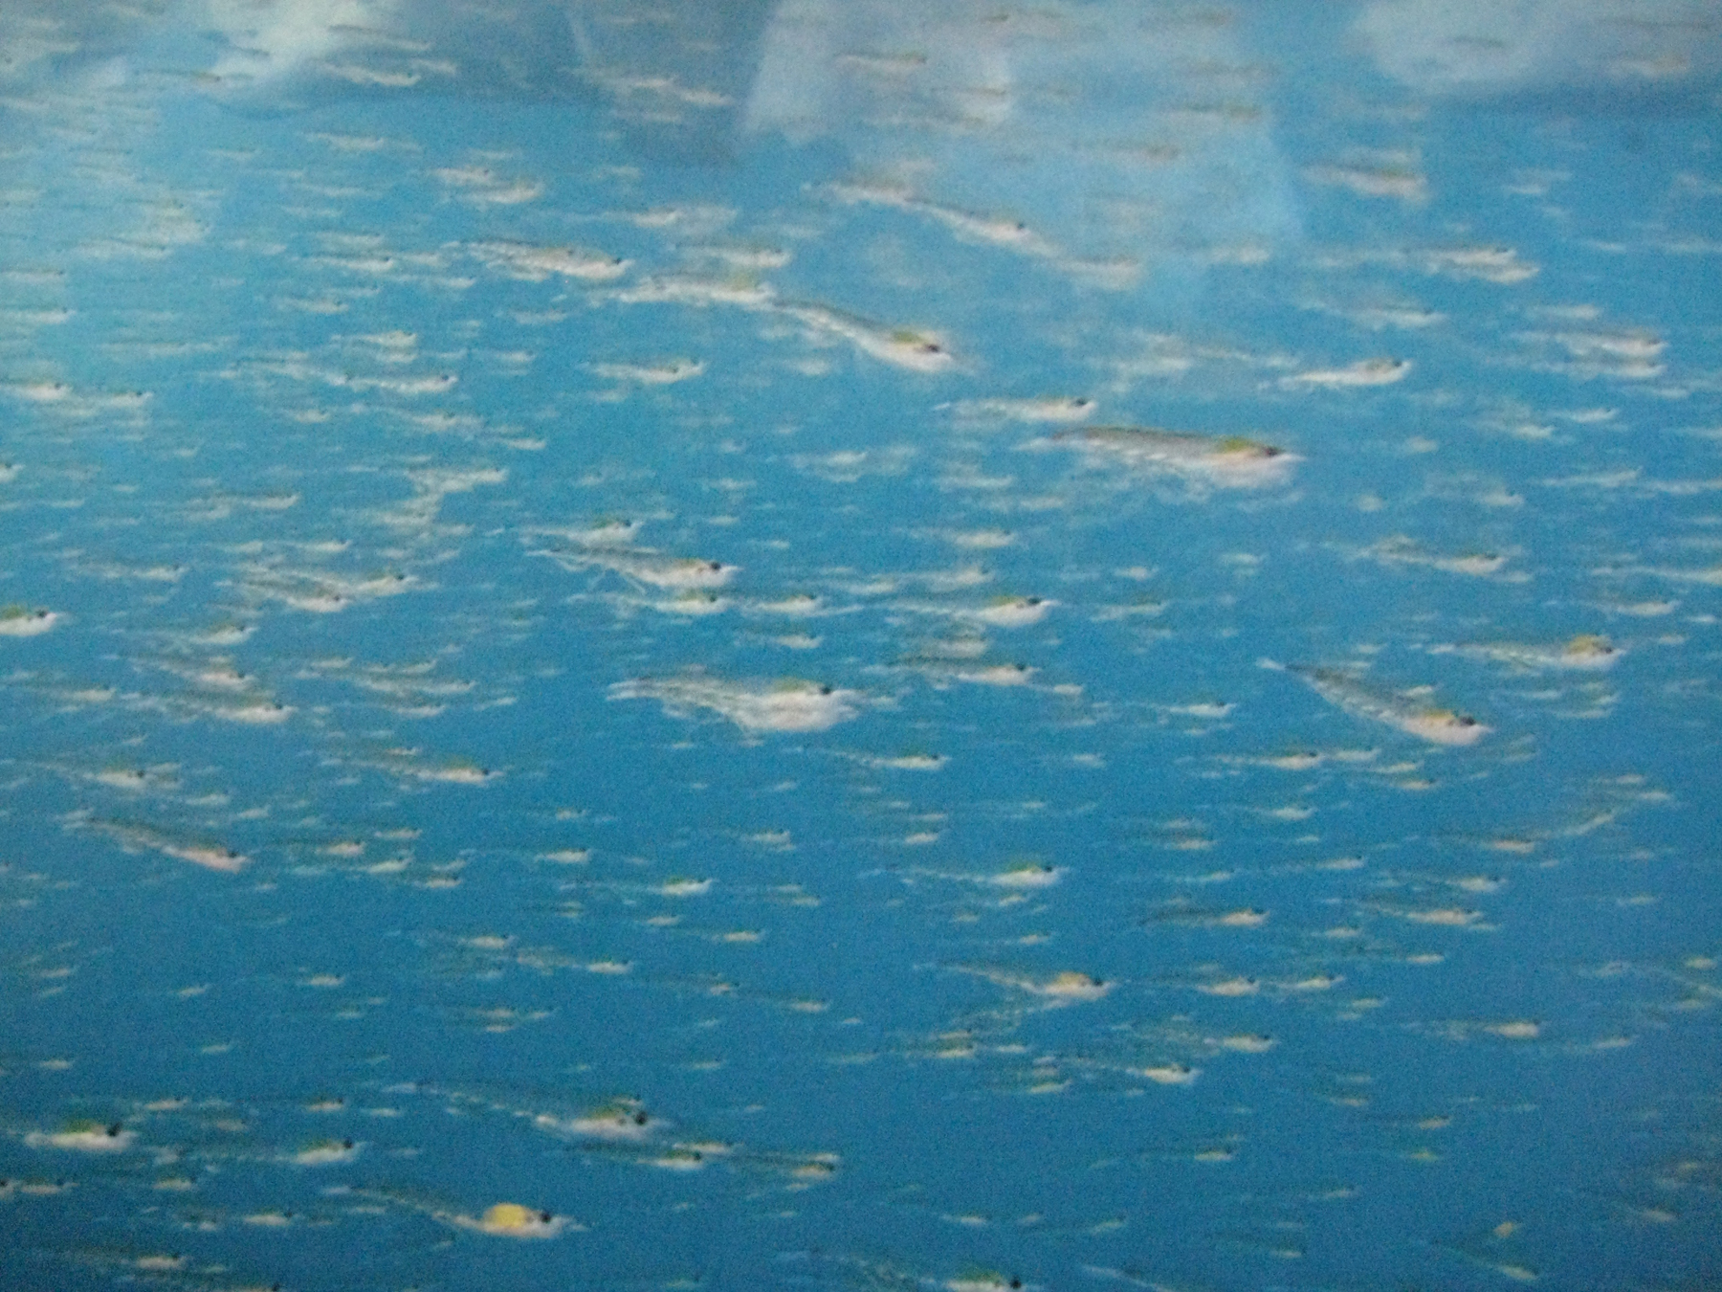
Paul Niklin Polar Obsession 2009
Notes:
Krill Swarm

Slide 21
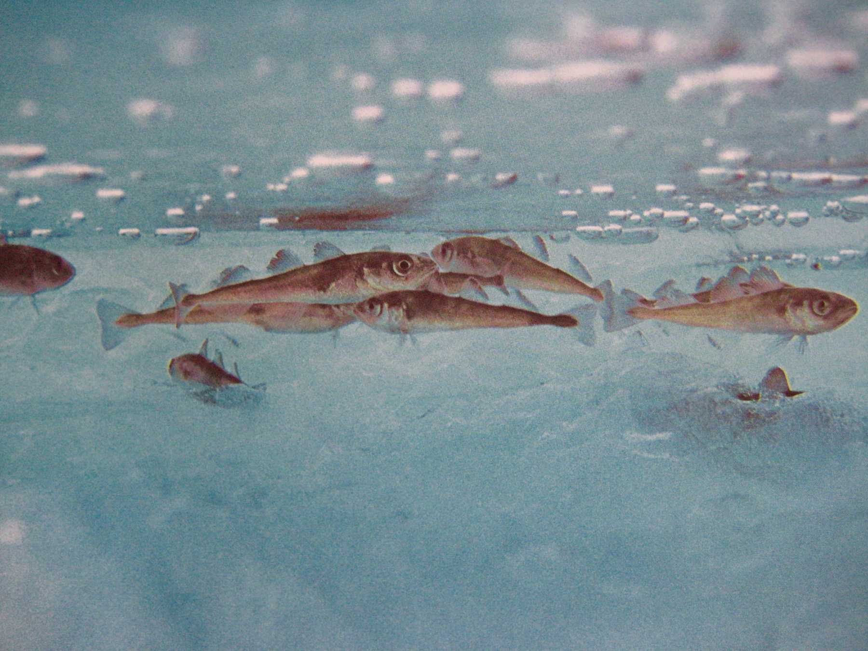
Boreogadus saida
Paul Niklin Polar Obsession 2009
Notes:
Arctic cod

Slide 22
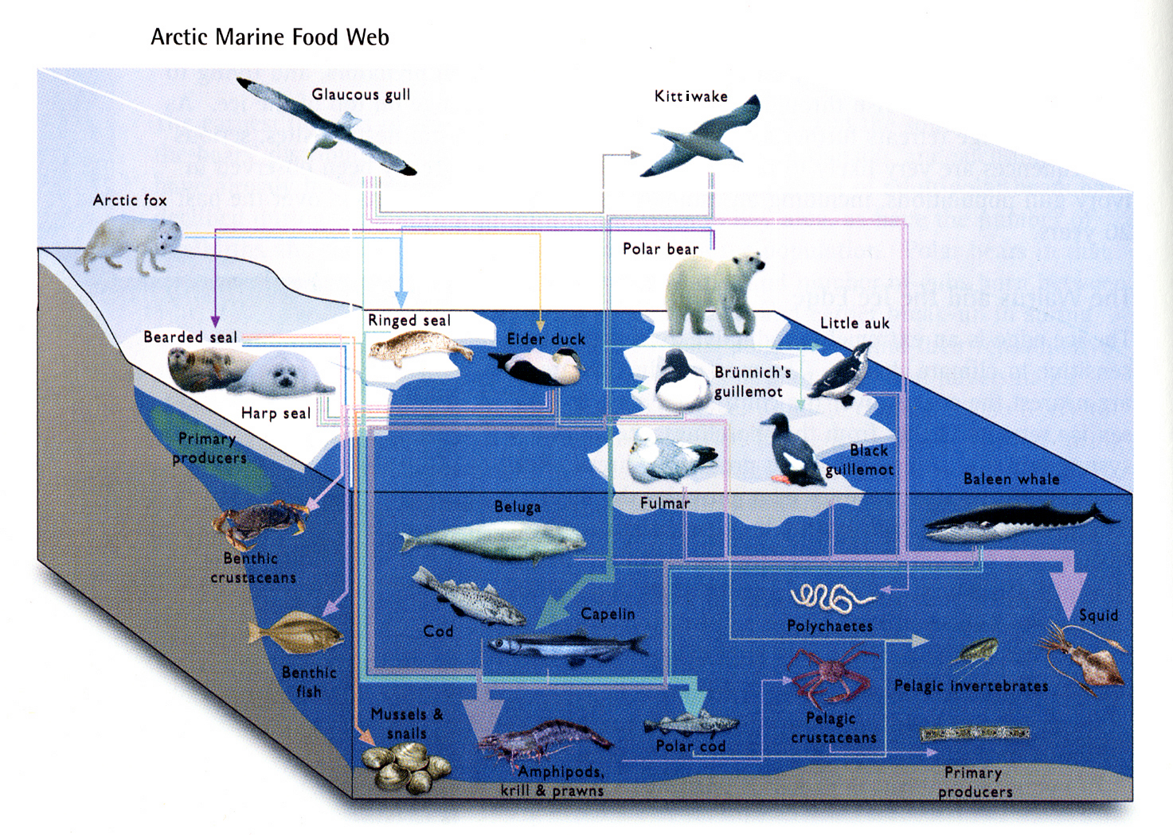
ACIA 2005

Slide 23
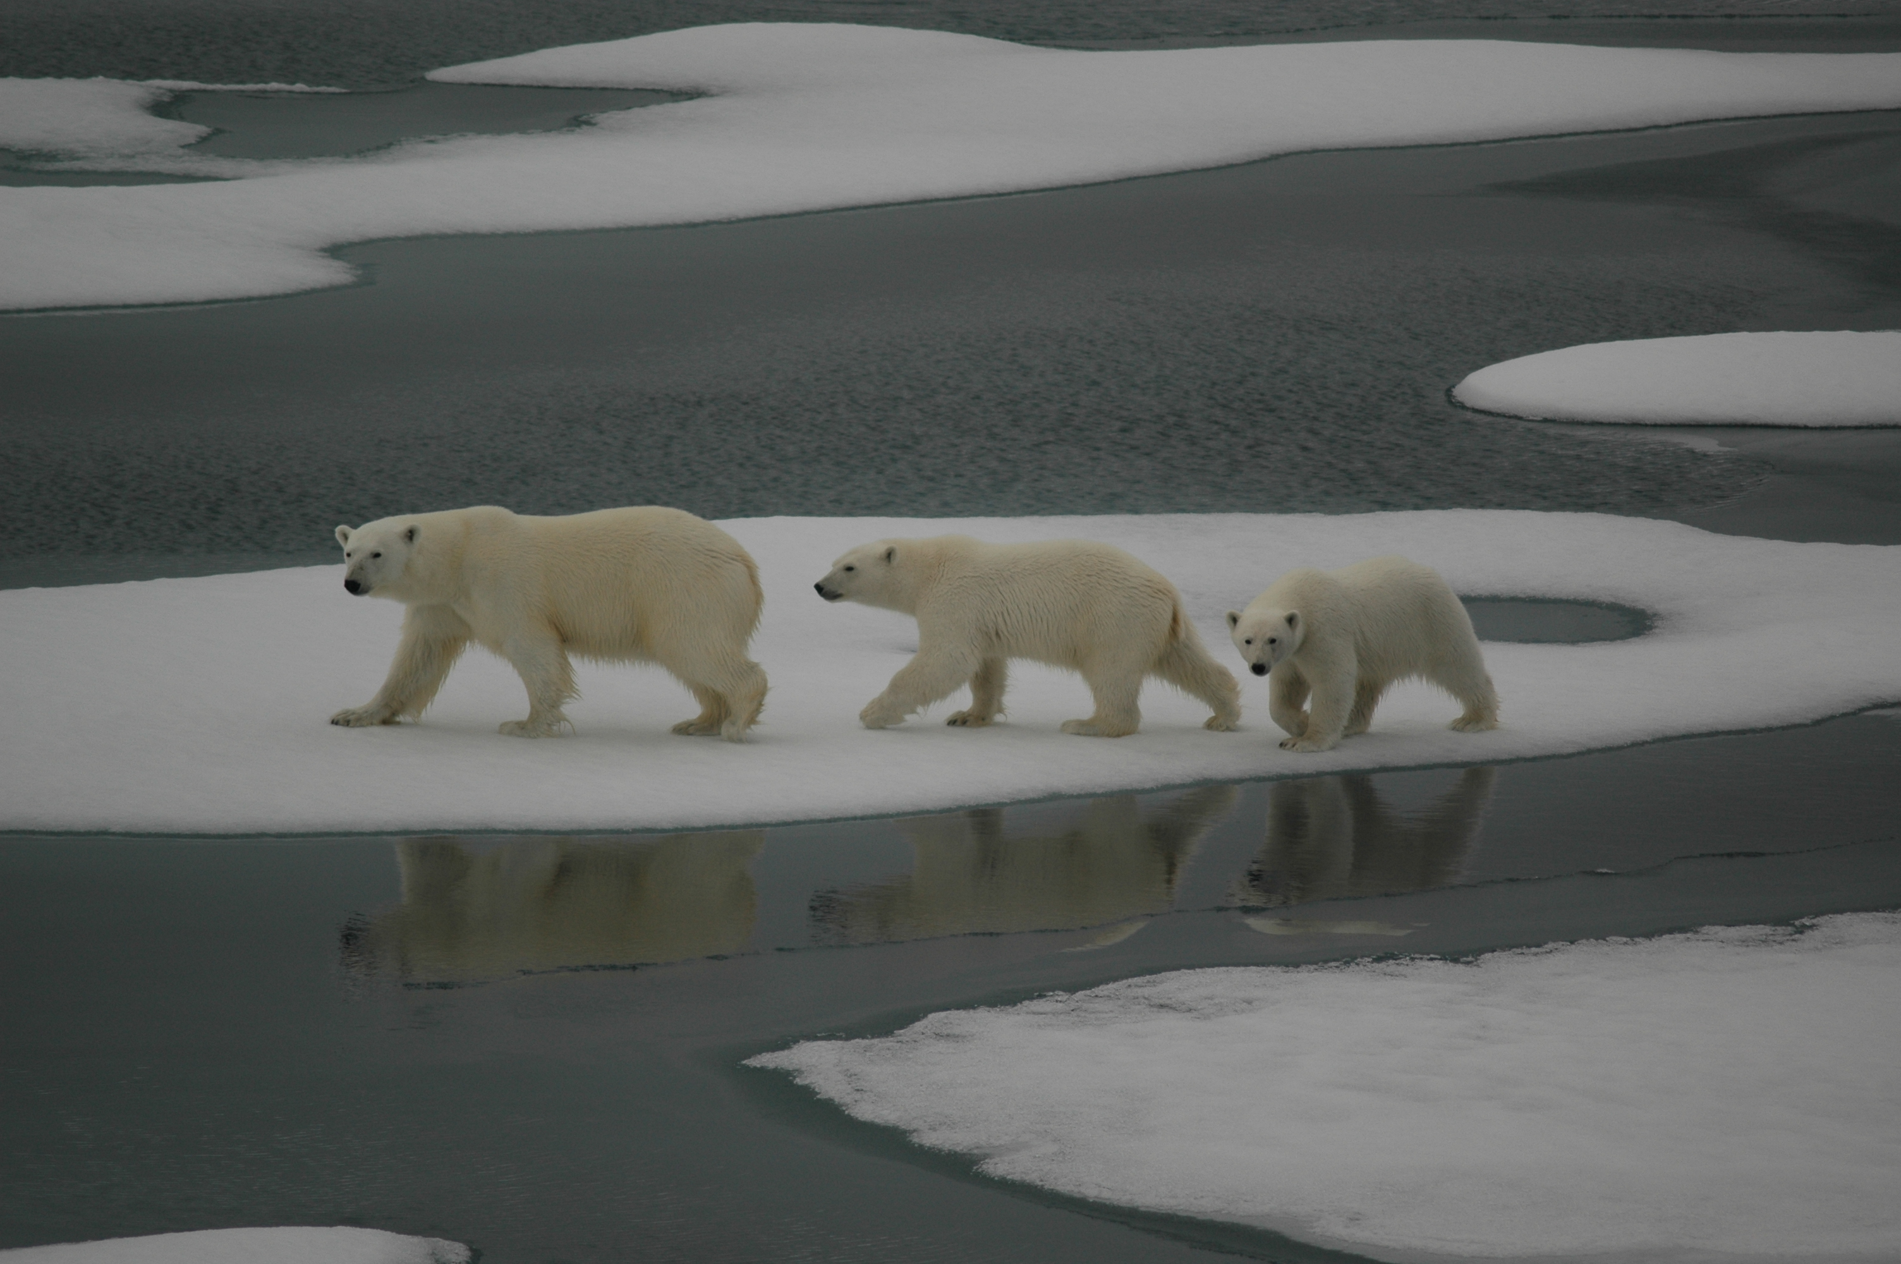
Notes:
The metaphor for Arctic climate change

Slide 24
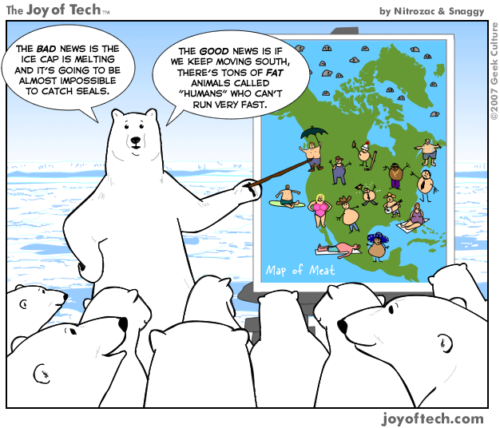

Slide 25
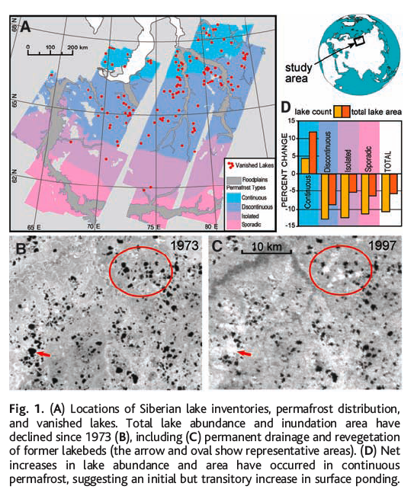
Smith et al. 2005

Slide 26
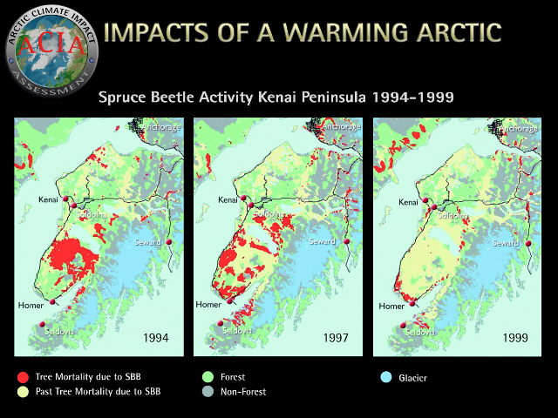

Slide 27
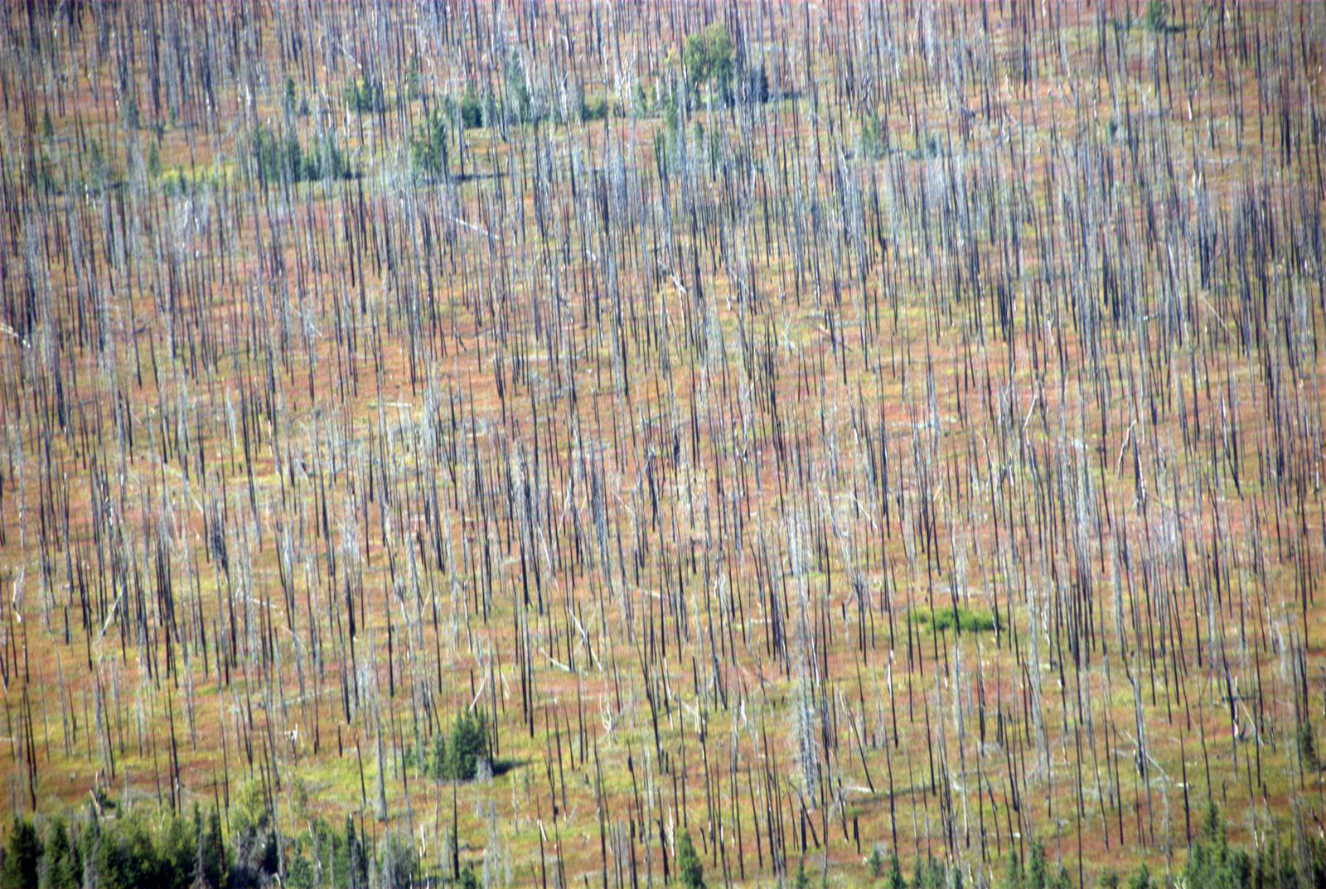
Kenai Peninsula Spruce “forest” 2007

Slide 28
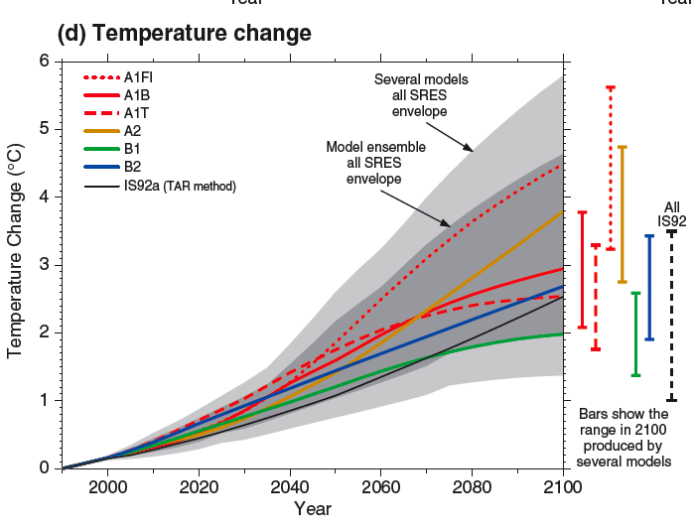
IPCC 2001
Notes:
Global warming vs. Climate change
Climate disruption
Climate shock

Slide 29
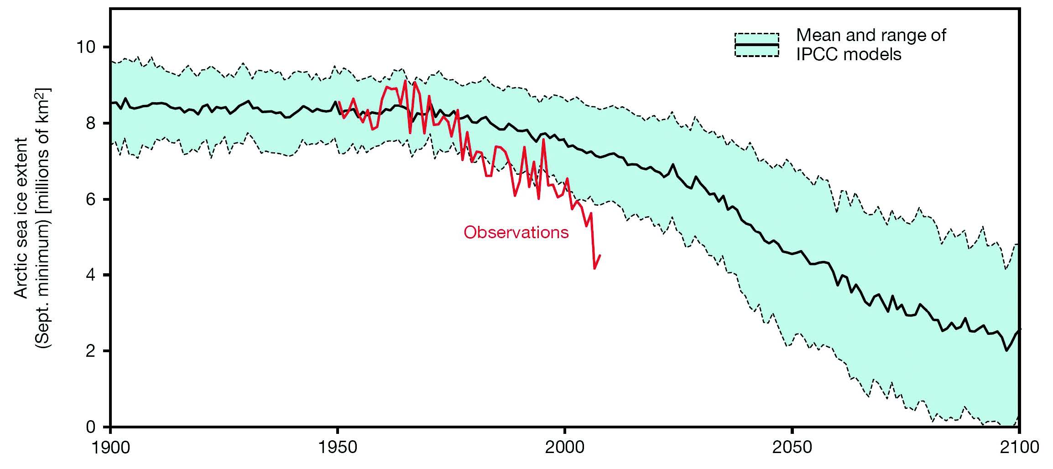
Observed (red line) and modeled September Arctic sea ice extent in millions
of square kilometers. The solid black line gives the ensemble mean of the 13
IPCC AR4 models while the dashed black lines represent their range. From
Stroeve et al. (2007) updated to include data for 2008.
Copenhagen Diagnosis 2009

Slide 30
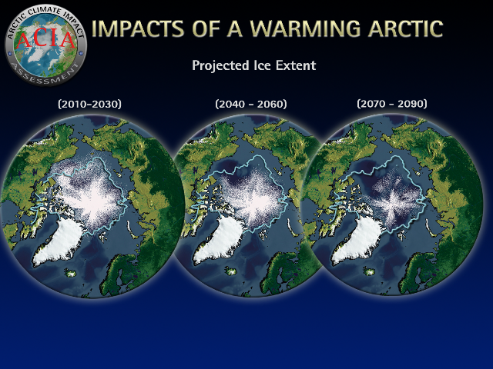
2004 Study
Five Models Project Sea Ice Extent for Mid-September
Notes:
Necessarily a bad thing?
Won’t there be winners (nations, businesses, etc) with some aspects of climate change?

Slide 31
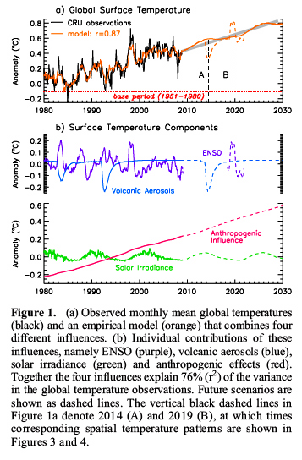
Lean and Rind 2009

Slide 32
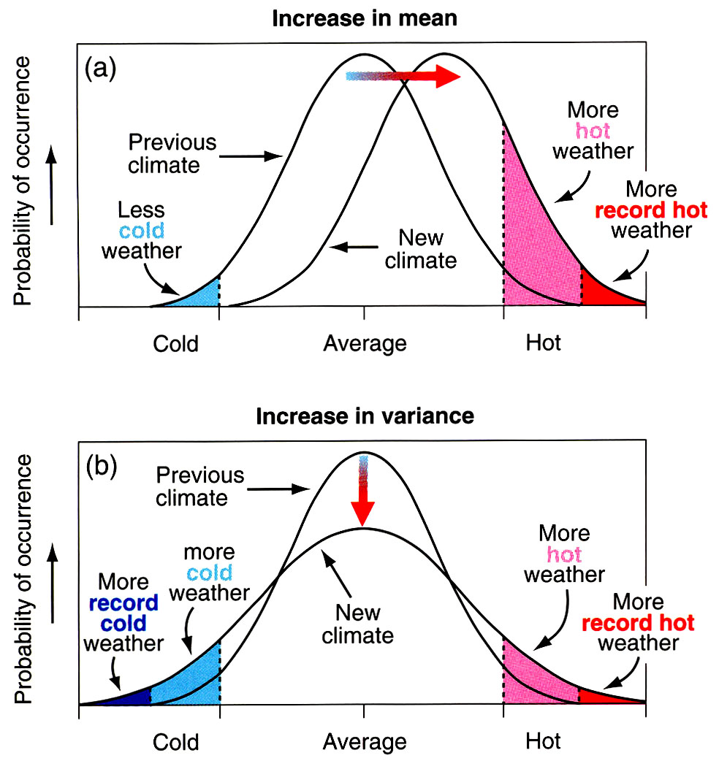
Changes in temperature extremes
IPCC

Slide 33
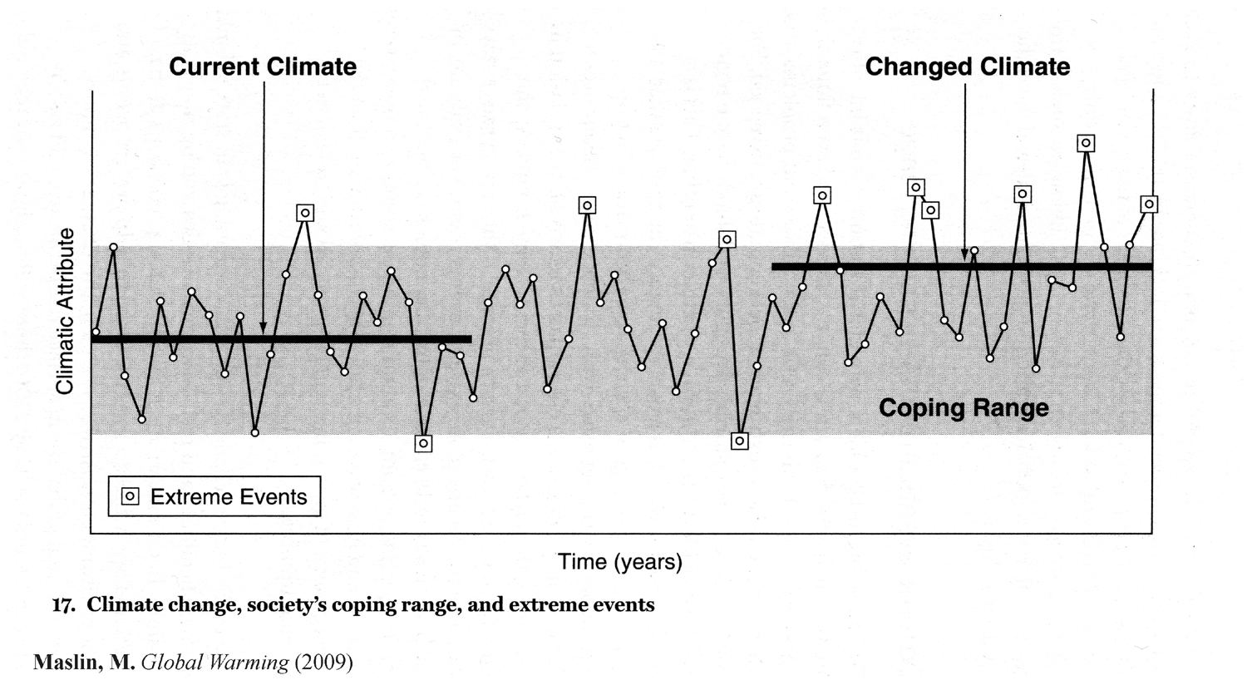
Notes:
Global warming, climate change, climate disruption, climate shock

Slide 34
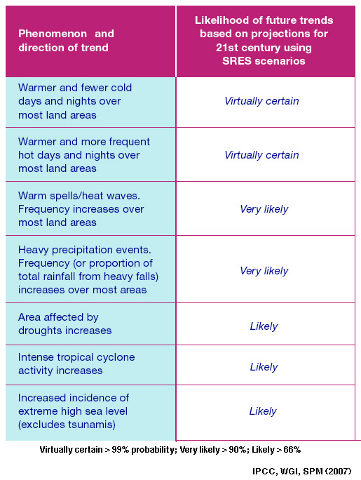

Slide 35
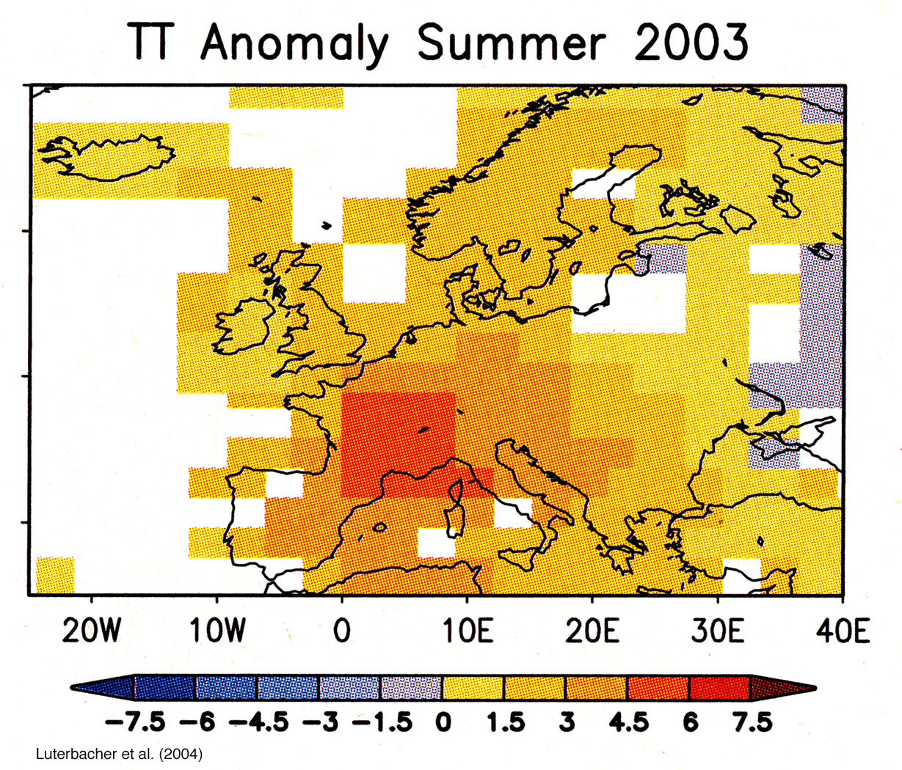
Notes:
Summer 2005 hundreds of US cities and towns set all time daily T records

Slide 36
Record-Breaking Heat - Europe 2003
Paris: highest nighttime T ever recorded on 11 and 12 August (25.5ºC)
The period between 4 and 12 August was unique in the meteorological history of Paris, with respect to the intensity, duration, and minimum and maximum daily temperatures.
Average daytime high was 37ºC.
15% of France’s cities recorded T above 40ºC

Slide 37
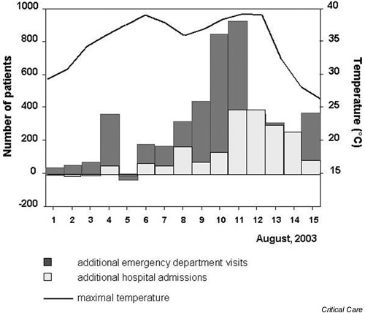
Maximal temperature in the Paris area, “excess” emergency department visits (grey bars) and hospital admissions (white bars) in the Assistance Publique-Hopitaux de Paris, 1-15 August 2003.
Notes:
Five European nations 21,000
France 15,000
Scaled to U.S. = 75,000 in two week period
most of the deceased were not likely to have died soon from other causes. Temperatures in Portugal reached 117 deg F, and widespread wildfires and crop failures accompanied the human tragedy

Slide 38
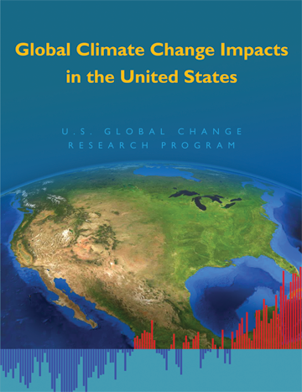

Slide 39
*
*
IPCC 2001

Slide 40
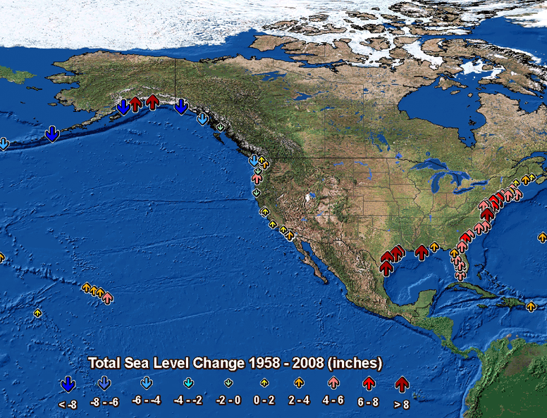
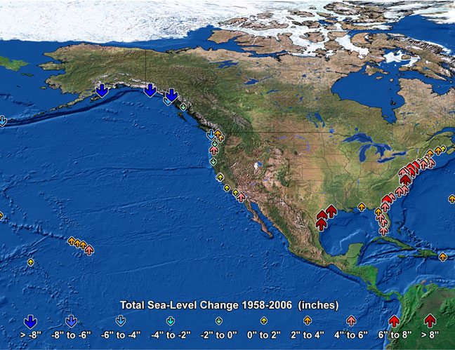

Observed U.S. Sea-Level Changes
Climate changes are underway in the U.S. and are projected to grow
Temperature rise
Sea-level rise
Increase in heavy downpours
Rapidly retreating glaciers
Thawing permafrost
Longer growing
season
Longer ice-free season
in the ocean and on lakes
and rivers
Earlier snowmelt
Changes in river flows
globalchange.gov/usimpacts

Slide 41
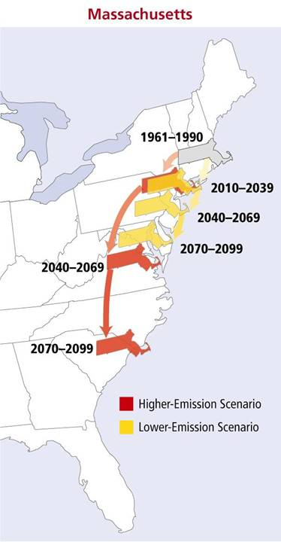
Heat index
How summers
could “feel”
NECIA, 2007 (see: www.climatechoices.org/ne/)
Notes:
Migrating State Climates
Changes in average summer heat index—a measure of how hot it actually feels, given temperature and humidity—could strongly affect quality of life in the future for residents of Massachusetts. Red arrows track what summers could feel like in Massachusetts over the course of the century under the higher-emissions scenario. Yellow arrows track what summers in these regions could feel like under the lower-emissions scenario.
End of century, higher emissions, Mass could feel like South Carolina

Slide 42

Source: NECIA, 2007 (see: www.climatechoices.org/ne/)
Source: NECIA, 2007 (see: www.climatechoices.org/ne/)
Notes:
2010
>90 deg JJA 18 days
>100 deg JJA 1 day

Slide 43
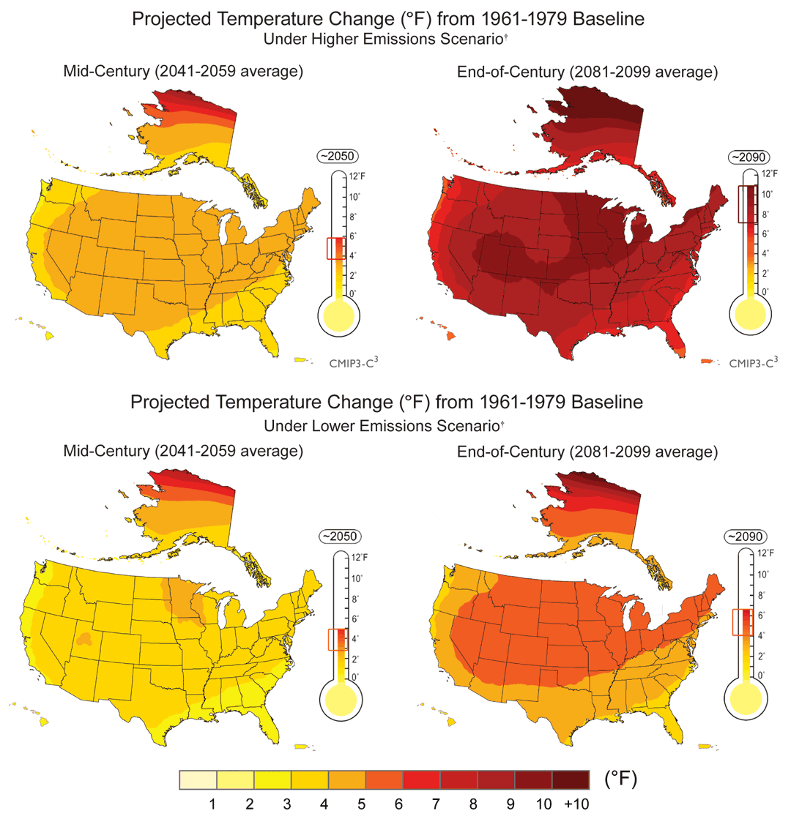
Projected Temperature Change (°F) from 1961-1979 Baseline
Climate changes are underway in the
U.S. and are projected to grow
Mid-Century (2041-2059 av.)
End of Century (2081-2099 av.)
Higher Emissions
Scenario
Lower Emissions
Scenario
globalchange.gov/usimpacts
Notes:
The maps on the right are based on projections of future temperature by 16 of the Coupled Model Intercomparison Project Three (CMIP3) climate models using two emissions scenarios from the Intergovernmental Panel on Climate Change (IPCC), Special Report on Emission Scenarios (SRES).⁶ The “lower” scenario here is IPCC SRES B1, while the “higher” is A2†. The brackets on the thermometers represent the likely range of model projections, though lower or higher outcomes are possible. Additional information on these scenarios is on pages 24 and 25 in the previous section, Global Climate Change. These maps, and others in this report, show projections at national, regional, and even local scales, using well-established techniques.⁷

Slide 44
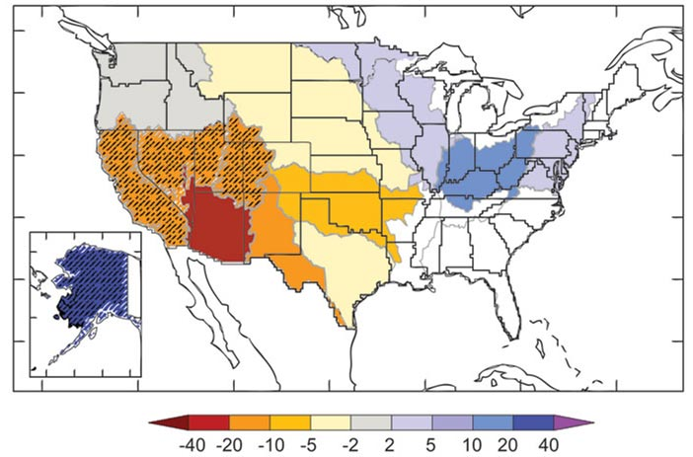
Projected Changes in Annual Runoff
Climate change will affect water
resources
globalchange.gov/usimpacts
Notes:
Projected changes in median runoff for 2041 to 2060, relative to a 1901 to 1970 baseline, are mapped by water-resource region. Colors indicate percentage changes in runoff. Hatched areas indicate greater confidence due to strong agreement among model projections. U.S. white areas indicate divergence among model projections. Results are based on emissions in between the lower and higher emissions scenarios

Slide 45
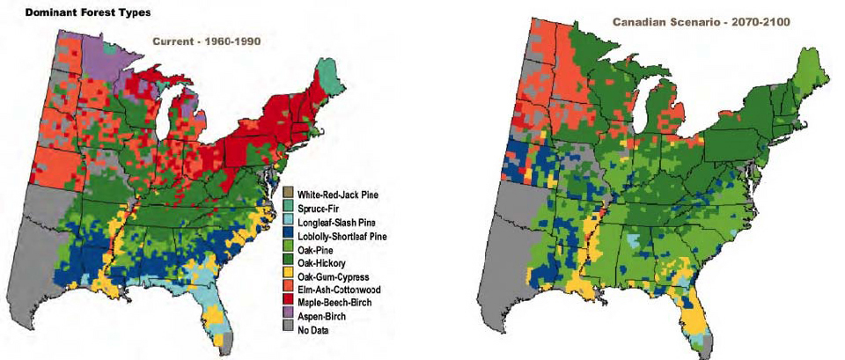
Projected shifts in forest ecosystem composition
FIGURE 2.7 Potential changes in the geographic ranges of the dominant forest
types in the eastern United States under projections of future climate change.
Many forest types shift their ranges northward or shrink in areas, while some
expand their areas.
NAS 2010

Slide 46
Changes in Cod
abundance
Fig. 4. Present and projected habitats for Atlantic
Cod. The Mid-Atlantic Bight is currently too warm
for reproductive success, hence young cod are
restricted to Georges Bank and the Gulf of Maine.
With projected warmer conditions late in this
century, young cod will only be viable further
north in the Gulf of Maine, and the adult cod
habitat on Georges Bank will be marginal.
(Frumhoff et al. 2007)
globalchange.gov/usimpacts

Slide 47
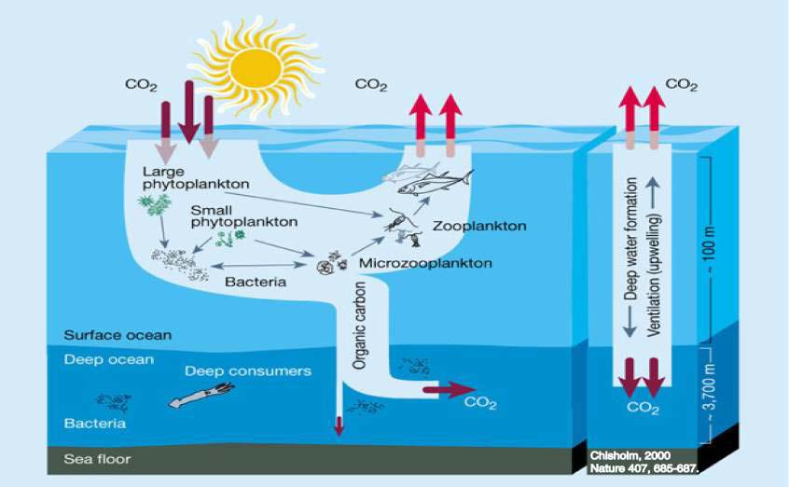
The Biological Pump
Notes:
Figure 1.12 A simple schematic representation of the biological pump (left) and physical pump (right) (Chisholm, 2000). Reprinted by permission from Macmillan Publishers Ltd: Nature doi: 10.1038/35037696, copyright 2000.

Slide 48
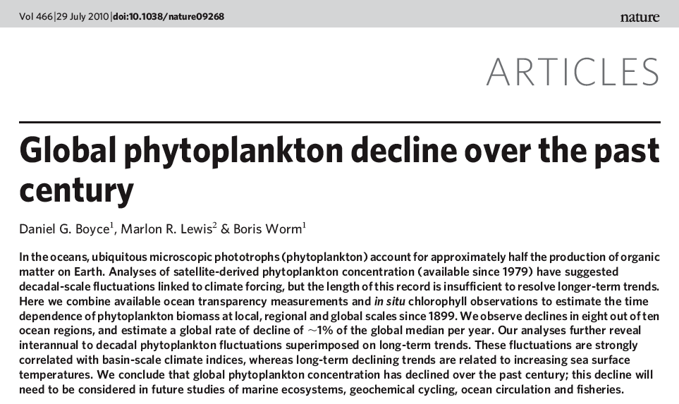

Slide 49
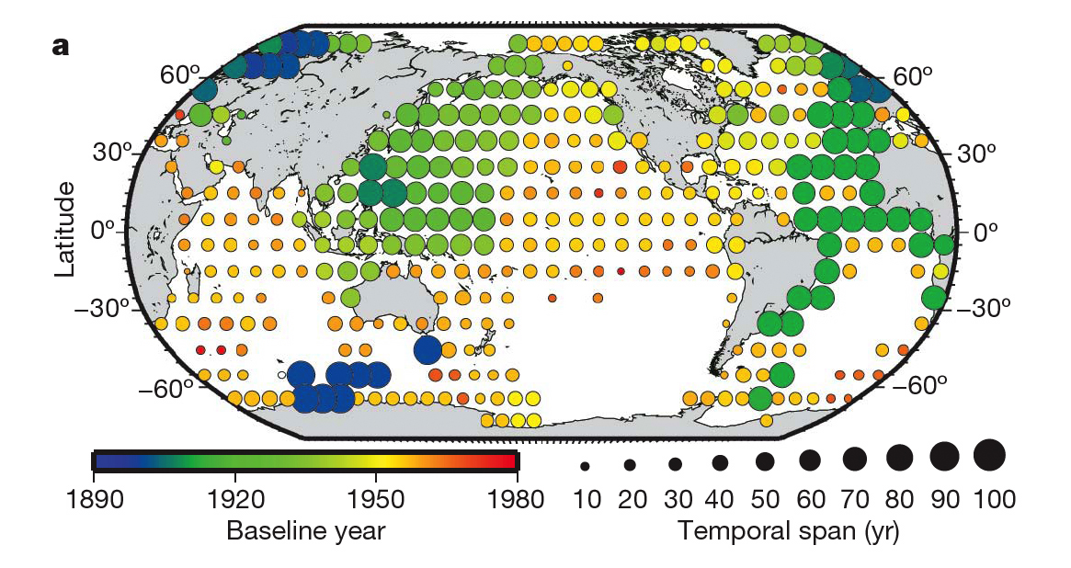
Boyce et al. 2010

Slide 50
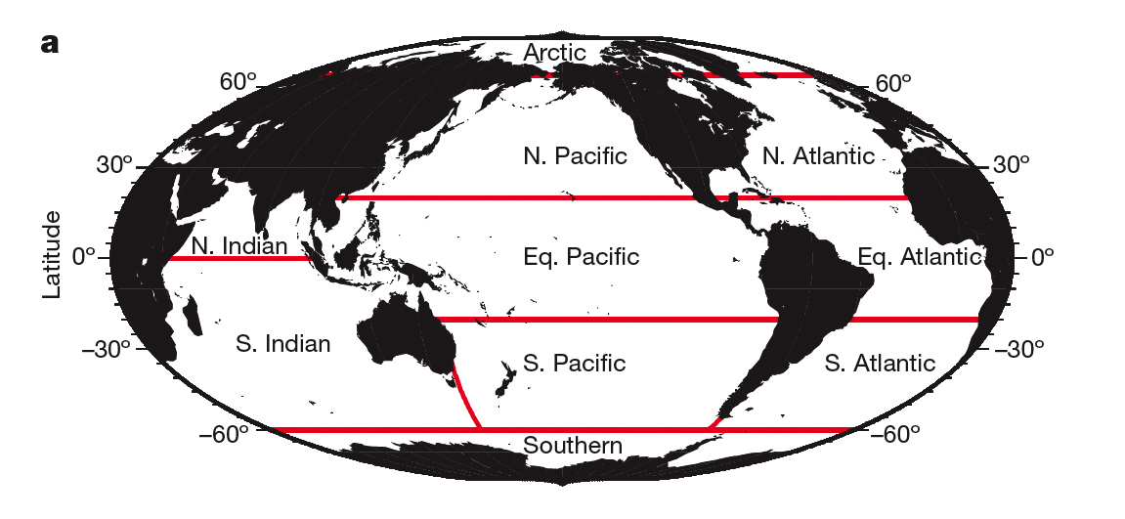
Boyce et al. 2010

Slide 51
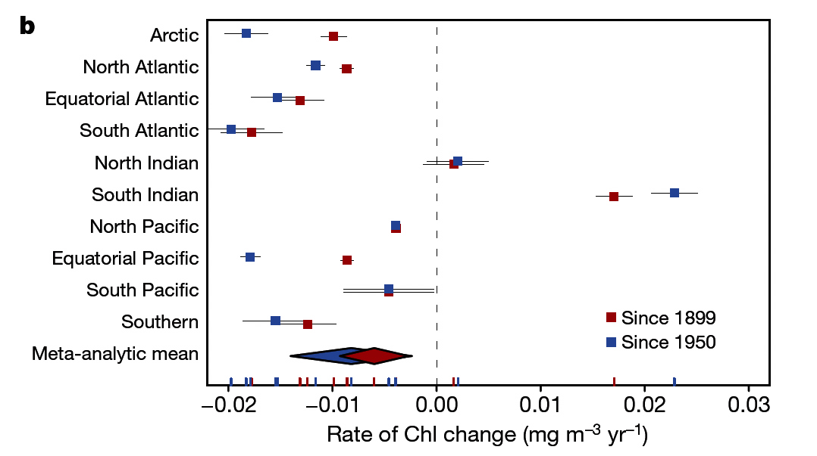
Boyce et al. 2010

Slide 52
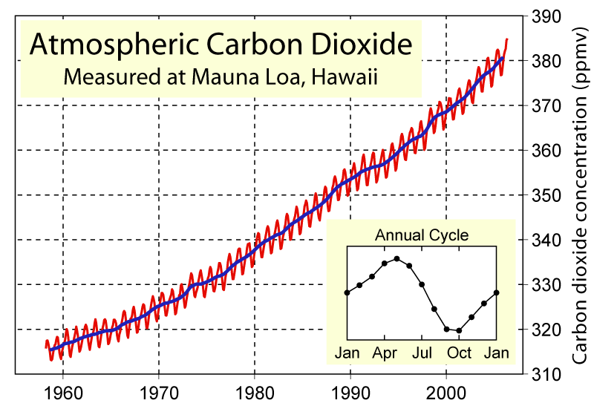

Slide 53
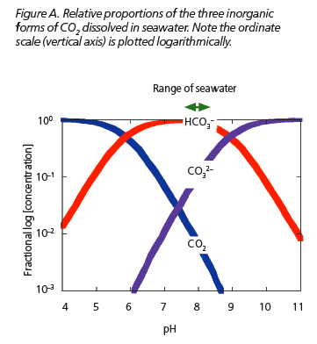
Royal Society 2006

Slide 54
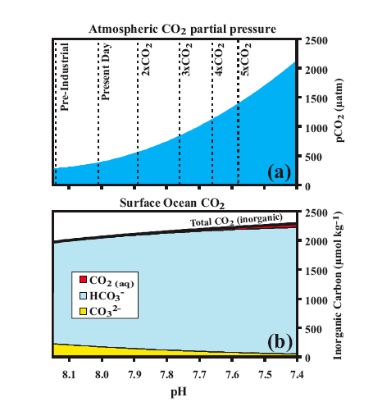
Kleypas et al. 2006

Slide 55
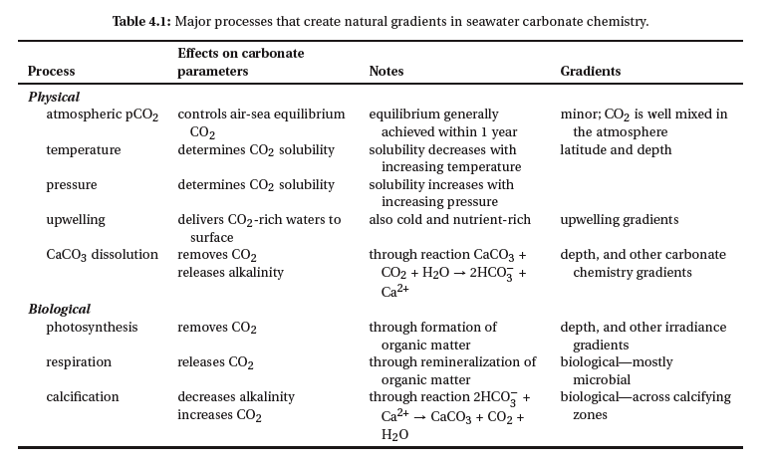
Kleypas et al. 2006

Slide 56


Slide 57

Kleypas et al. 2006

Slide 58

Corn Yields Through 2008
Crop and livestock production will be
increasingly challenged
Heat
Pests
Disease
Water availability
Weather extremes
Extreme weather reduces crop yields
globalchange.gov/usimpacts
Notes:
While technological improvements have resulted in a general increase in corn yields, extreme weather events have caused dramatic reductions in yields in particular years. Increased variation in yield is likely to occur as temperatures increase and rainfall becomes more variable during the growing season. Without dramatic technological breakthroughs, yields are unlikely to continue their historical upward trend as temperatures rise above the optimum level for vegetative and reproductive growth.

Slide 59
Copenhagen Diagnosis 2009

Slide 60


meters
Projected globally-averaged sea level rise by the end of the 21st century
Projected globally-averaged sea level rise by the end of the 21st century
Note!
meters
Source: IPCC Summary for Policy Makers, February 2007

Slide 61

Rates of glacial motion
and locations of outlet
glaciers with terrestrial
and marine termini
Pfeffer et al. 2008
Notes:
Fig. 1. Map showing Greenland and outlet glacier gates; marine-based gates are shown as dark green and nonmarine as black. Regions below sea level are colored blue. Ice velocities at 2000 m elevation from (21) shown by red dots.
Science 5 September 2008: Vol. 321. no. 5894, pp. 1340 – 1343
REPORTS Kinematic Constraints on Glacier Contributions to 21st-Century Sea-Level Rise W. T. Pfeffer,^{1*} J. T. Harper,² S. O'Neel³

Slide 62


Slide 63
“On the basis of calculations presented
here, we suggest that an improved
estimate of the range of sea level rise to
2100 including increased ice dynamics
lies between 0.8 and 2.0 meters
[31 – 78 inches].”
Pfeffer et al. 2008

Slide 64
Observed and Anticipated
Climate Change Impacts
James J. McCarthy
Harvard University
23 August 2010

