Slide 1


ACS GCI
Pharmaceutical Roundtable’s
Convergent PMI* Calculator
*Process Mass Intensity
ACS GCI Pharmaceutical Roundtable
Mission:
To catalyze the implementation of
green chemistry and engineering in the pharmaceutical industry globally.

Slide 2


















ACS GCI Pharmaceutical Roundtable
Membership as of Jan 1, 2014
No endorsement or approval by the ACS GCI Pharmaceutical Roundtable has been received or is in any way implied.

Slide 3
Strategic Priorities
Publications
Green Chem Articles of Interest
Key Research Areas
Key Engineering Challenges
Research
$1.3 M in GCIPR Research Grants
$1.2 M in grants leveraging government funding
Informing & Influencing the Research Agenda
Collaborating Globally
Educating Leaders
Tools/Resources
Solvent Selection Guide
PMI Tool
GC in Electronic Lab Notebooks
Organometallics in greener solvents
Global Collaboration
Global membership
Meetings in EU and US
Lecture tours in US, EU, India
Developing Tools for Innovation

Slide 4
The Challenge
Decreasing the amount of material used to make a drug is one of the major green chemistry challenges for the pharmaceutical industry.
ACS GCI Pharmaceutical Roundtable members have developed a common process mass intensity metric that allows data from each company to be compared on a transparent and equitable basis.

Slide 5
Process Mass Intensity Metric
Process Mass Intensity = quantity of raw materials input (kg)
quantity of bulk API out (kg)
Where:
Process is all steps of a synthetic path from commonly available materials to the final bulk active pharmaceutical ingredient (API)
Raw Materials are all materials including water that are used directly in the process of synthesizing, isolating, and purifying the API final form
Bulk API out is the final form of the active ingredient that was produced in the synthesis, dried to the expected specification

Slide 6
Why measure PMI?
Drive change towards more sustainable/green manufacturing processes
- Track environmental manufacturing footprint
- Measurement of process efficiency
Quantify improvements throughout process development life cycle
To be more transparent; basis for objective comparison
- Increasing expectations from internal and external audiences to describe
progress, demonstrate improvement
Benchmark
- Allows a simple comparison to the on-going green efforts throughout the
industry in the pursuit of mass efficient pharmaceutical processes.
Insight in sustainability of overall manufacturing process, from bulk
chemicals to API, is required.

Slide 7
Composition of PMI—Pharma Benchmarking
2008 Data
Water
28%
Solvents
58%
Other
6%
Reactants
8%
Consistent with 2010 benchmarking data

Slide 8
PMI by Development Phase
Median Values - 2008

Slide 9
The Next Logical Step…
Involve Suppliers
Measure PMI for all steps from commodity raw materials
Use one tool for consistency across the industry
In 2011, the ACS GCI Pharmaceutical Roundtable released a free, publicly available linear PMI calculator.
In 2014, the ACS GCI Pharmaceutical Roundtable is releasing this free, publicly available convergent PMI calculator.

Slide 10
New Convergent PMI Calculator
Goals
Enhance previous linear PMI calculator to accommodate convergent synthesis
Maintain current design and methodology (calculations)
  Thanks to Bill Pyrz and Merck
Maximize simplicity
Include instructions

Slide 11
Linear vs. Convergent

Slide 12
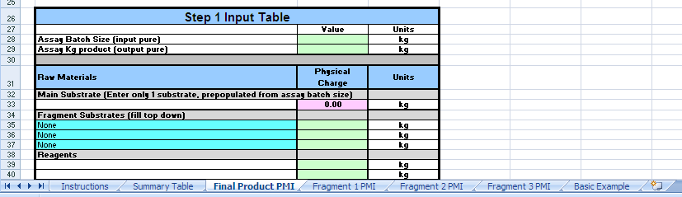
Convergent PMI Calculator—Layout
Workbook consists of 7 worksheets
  Instructions
  Summary Table
  Final Product PMI
  Fragment 1 PMI
  Fragment 2 PMI
  Fragment 3 PMI
  Basic Example

Slide 13
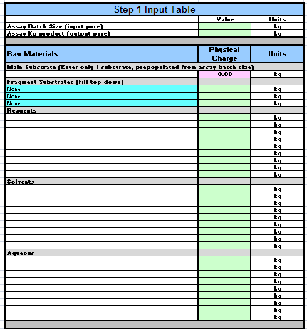
Convergent PMI Calculator—Final Product
Simplified input table
Single cell for main substrate
Dropdown for fragment substrates
  - Enables convergences
Color coded cells
  Only green require values
Solutions of substrates and products
  - Now manual (instructions included)

Slide 14
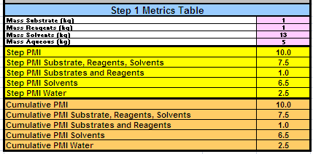
Convergent PMI Calculator—Step Metrics Table
Color coded cells
Calculations unchanged from linear calculator
  Except to allow for convergence

Slide 15
Convergent PMI Calculator—Capabilities
Up to 11 step linear sequence
Up to 3 branches for convergent synthesis
  11 steps per branch
Multiple branch points possible in a single step
Branches can be further branched
Up to 44 step linear sequence if treating additional steps as branches
  - Explained in instructions

Slide 16
Convergent PMI Calculator—Example
View spreadsheet for calculated example →
Disclaimer: The ACS GCI Pharmaceutical Roundtable or American Chemical Society does not guarantee the accuracy of the calculations and accepts no responsibility for any consequences of use.

Slide 17
Convergent PMI Calculator
Use of Solutions of Products and Substrates
Disclaimer: The ACS GCI Pharmaceutical Roundtable or American Chemical Society does not guarantee the accuracy of the calculations and accepts no responsibility for any consequences of use.

Slide 18
Going Forward
Encouraging suppliers to calculate and provide PMI data
- For all APIs and API intermediates
- At all stages of development
- Include breakdown of solvent, reagents, and water PMI
Find the Convergent PMI Calculator Tool at www.acs.org/gcipharmaroundtable
Questions or comments, email: gcipr@acs.org

Slide 19
Any comments, suggestions, or questions are great appreciated.
Thank you!
gcipr@acs.org
www.acs.org/gcipharmaroundtable
Disclaimer: The ACS GCI Pharmaceutical Roundtable or American Chemical Society does not guarantee the accuracy of the calculations and accepts no responsibility for any consequences of use.

